Slide 1


Modeling the transport and dispersion of atmospheric tracers
Mark Cohen¹ and Alice Crawford^{1,2},
and the rest of the NOAA Air Resources Laboratory HYSPLIT GROUP:
Christopher Loughner^{1,2}, Tianfeng Chai^{1,2}, Fantine Ngan^{1,2}, Hyun Cheol Kim^{1,2}, Barbara Stunder¹, Glenn Rolph¹, Ariel Stein¹, Roland Draxler, Albion Taylor, Jerome Heffter
A HYSPLIT Workshop presented at Howard University, Washington D.C., March 20, 2018
in conjunction with the 9th Biennial Education and Science Forum, of the
NOAA Educational Partnership Program with Minority Serving Institutions.
Hosted by Howard University and the NOAA Cooperative Science
Center in Atmospheric Sciences and Meteorology (NCAS-M)
¹NOAA Air Resources Laboratory, College Park, MD
²CICS-MD, College Park, MD
Notes:
NOTE: In the actual workshop where this PowerPoint was presented, a “Live Demonstration” of the HYSPLIT Tutorial and HYSPLIT Graphical User Interface (GUI) was simultaneously carried out, and shown on a 2nd screen.
However, in almost all cases, key screenshots and explanations corresponding to the Live Demonstration have been included in this PowerPoint presentation.
Therefore, this PowerPoint includes most of the important content of the Live Demonstration.

Slide 2
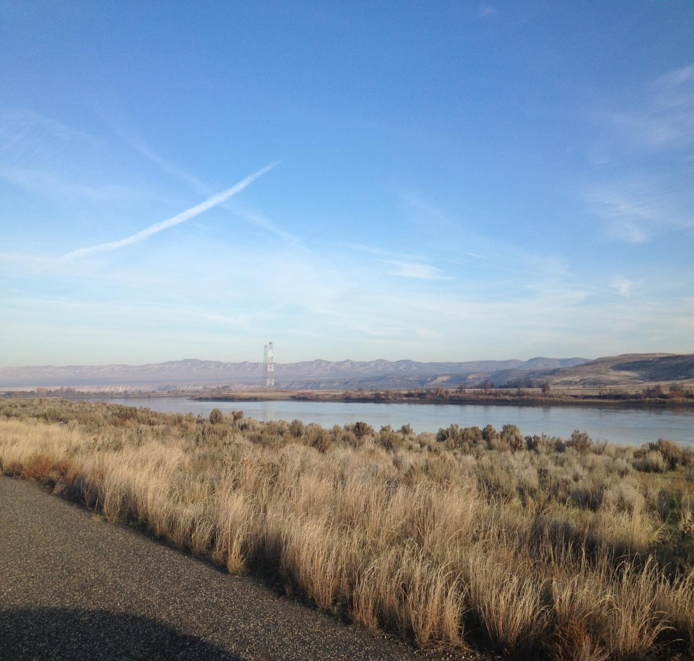
OUTLINE
Introduction
Trajectories
  Graphical User Interface (GUI)
  Meteorological data
  Running/Summarizing Many Trajectories
Dispersion / Air Concentrations
Scripting with HYSPLIT

Slide 3
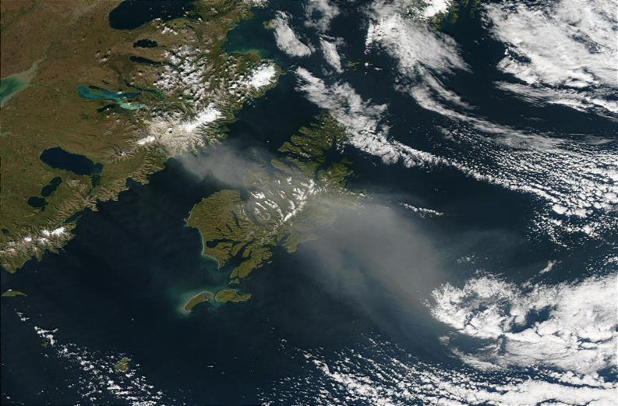
What does HYSPLIT do?
HYSPLIT is an Atmospheric transport and dispersion model
  Model transport of atmospheric tracers
    Smoke, dust, volcanic ash, chemical releases,
    Anything that is approximately a passive tracer in the atmosphere!
  Answers the questions
    Where is stuff going?
    Where did stuff come from?
  Two types of calculations
    trajectories
    dispersion
Katmai 21 Sept 2003
NASA image courtesy Jeff Schmaltz, LANCE/EOSDIS MODIS
Rapid Response Team at NASA GSFC.

Slide 4
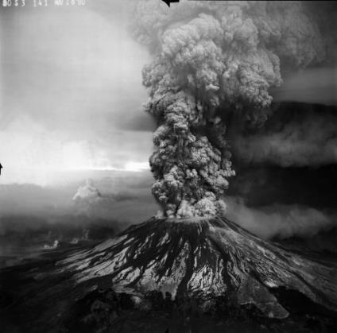
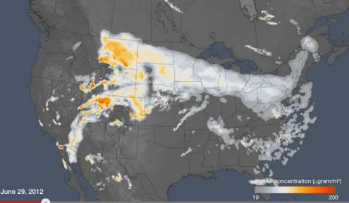
HYSPLIT
Modeling Research & Applications
Emergency Response
  Radiological releases
  Chemical releases
  Volcanic eruptions
Air Quality
  Wildfire smoke & wind-blown dust forecasting
  Global pollutant transport (mercury)
  Source-receptor analysis
Model Evaluation
  Data Archive of Tracer Experiments and Meteorology
  Meteorological data assimilation (WRF)
Decision Support
  Dispersion model training
  Real-time Environmental Applications and Display sYstem (READY)
Photo courtesy of USGS
Notes:
Overview of Dispersion Modeling and Research
RMSC – Regional Specialized Meteorological Centers with the specialization to provide atmospheric transport model products for environmental emergency response.
Volcanic Ash advisory center (VAAC)
Chemical releases?
READY is a web-based system developed by ARL to access and display meteorological data and to run trajectory and dispersion simulations. The System is unique in that it brings together the HYSPLIT model, graphical displays, and textual forecasts into a form that is readily available and easy to use by anyone. READY is particularly useful for weather and air quality forecasters, but it is also used by weather- sensitive industries and hobbyists (e.g.,balloonists, hang gliders) and the general public

Slide 5
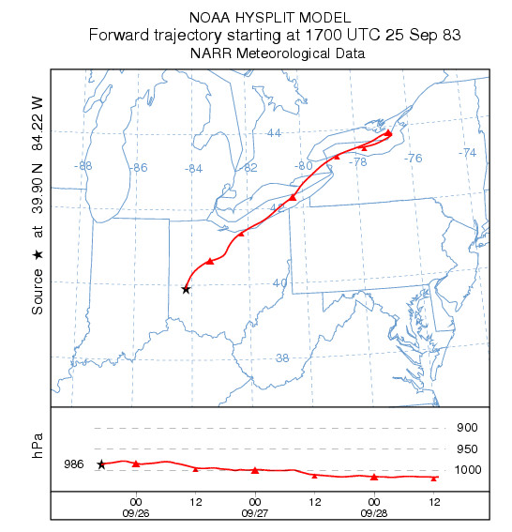
Trajectory shows path of air parcel following the wind field provided by a Numerical Weather Prediction (NWP) model.

Slide 6
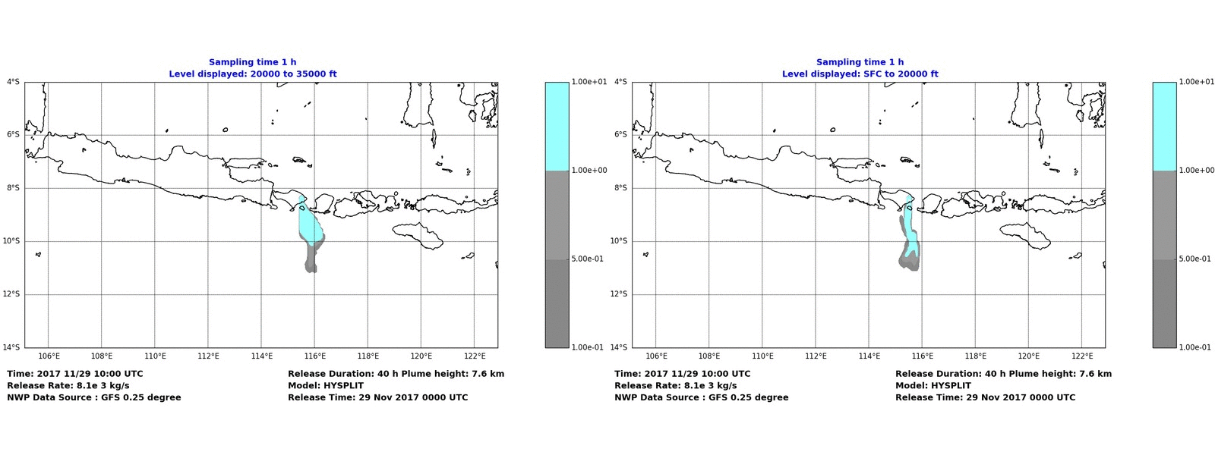
Dispersion calculation provides air concentrations.
Eruption of Agung volcano in Bali November 2017
High
Medium
Low
20,000 to 35,000 ft
SFC to 20,000 ft
HYSPLIT forecasts to support Volcanic Ash Advisory Centers
Notes:
20000 ft about 6 km.
35000 ft about 10 km

Slide 7
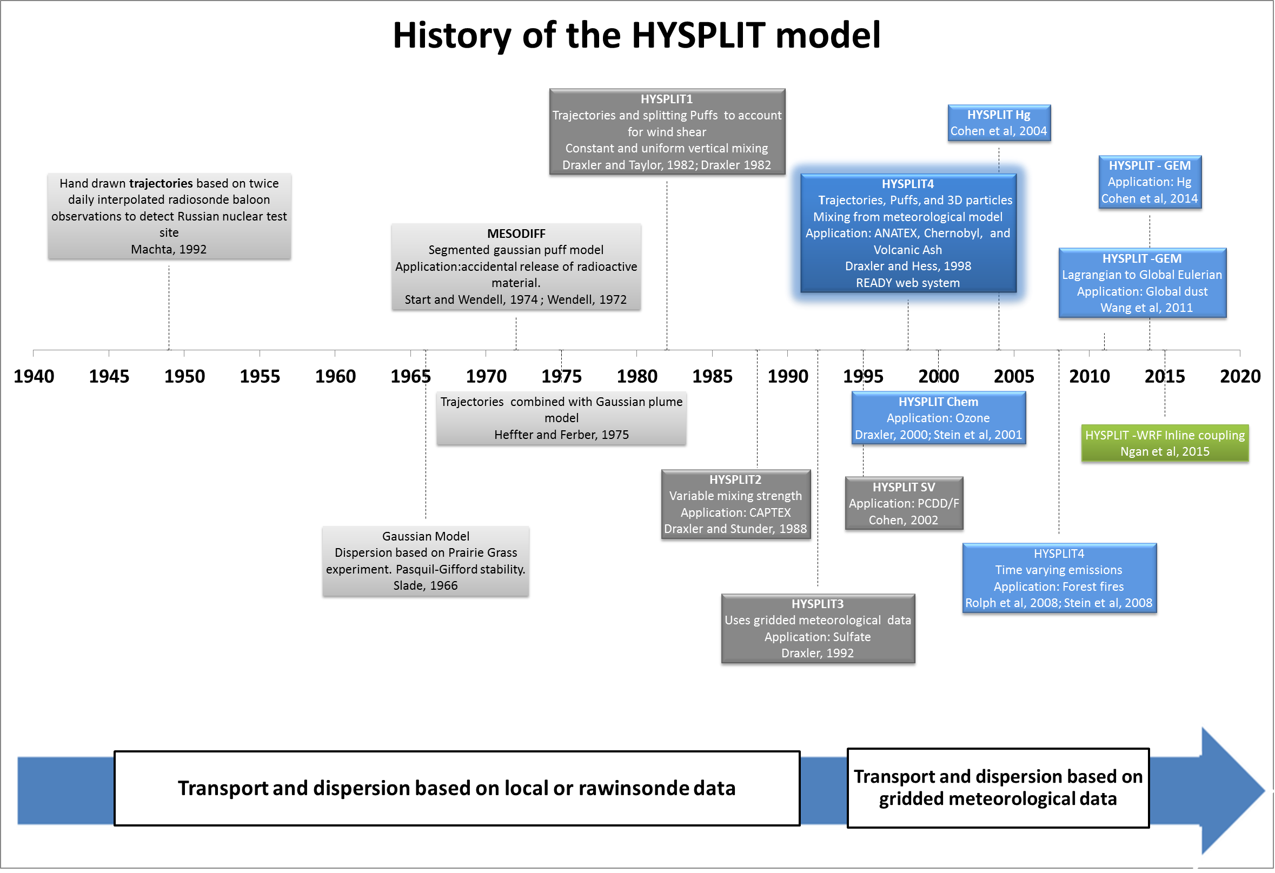
Global Eulerian Model
HYSPLIT-WRF INLINE
NOAA RESEARCH • AIR RESOURCES LABORATORY
Notes:
- The scientific foundation and inspiration for HYSPLIT’s trajectory capabilities can be traced back to 1949, when the Special Project Section (SPS) (ARL’s predecessor) of the U.S. Weather Bureau (now NOAA’s National Weather Service (NWS)) was charged with trying to find the source of radioactive debris originating from the first Soviet atomic test and detected by a reconnaissance aircraft near the Kamchatka Peninsula. For that purpose, back trajectories were calculated by hand based on wind data derived from twice-daily radiosonde balloon measurements. These trajectories followed 500 mb heights assuming geostrophic wind flow. Although these back trajectories were calculated more than 60 years ago, the percentage error between the calculated and actual source location relative to the distance covered by the trajectories was remarkably low (about 5%; Machta, 1992). Since then, trajectory calculations have been one of the backbones of ARL’s research activities.
- The HYSPLIT model evolved from MESODIFF, a segmented gaussian puff model that was used in Idaho for consequence assessment after the accidental release of radioactive material.
- Early versions of HYSPLIT based the dispersion calculations on interpolated meteorological observations, until HYSPLIT version 3 started using gridded meteorological data.

Slide 8
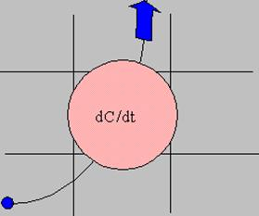
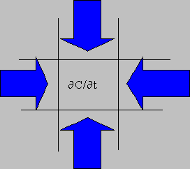

Eulerian versus Lagrangian
Lagrangian Modeling Approach
  Concentrations computed by summing the mass of each particle that is advected through the grid cell
  May require thousands of particles to adequately model pollutant dispersion
Eulerian Modeling Approach
  Concentrations are computed at every grid cell interface due to diffusion and advection.
  Each grid cell must be calculated even if pollutants are not advected into the cell.
Different Approaches - Same Answers
8

Slide 9
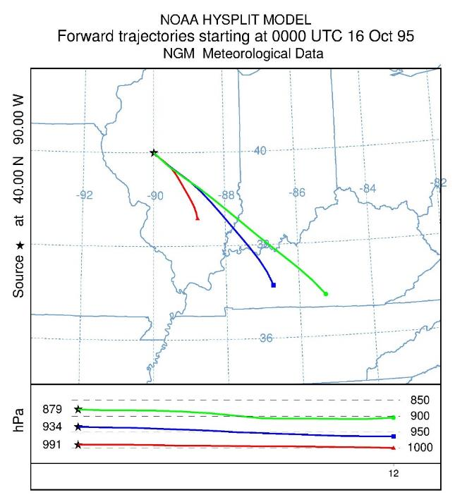
Trajectories
Just the centerline of air-parcel transport, i.e., no dispersion
A three-dimensional path, from a given starting location and time
The model requires meteorological data, including wind speed and direction, so it can estimate the path
Can be forward or backward
  forward: where will the material go that is emitted at a given time/place?
  backward (more common): where did the air come from that arrived at a given time and place, e.g., corresponding with a particular air pollution measurement?

Slide 10
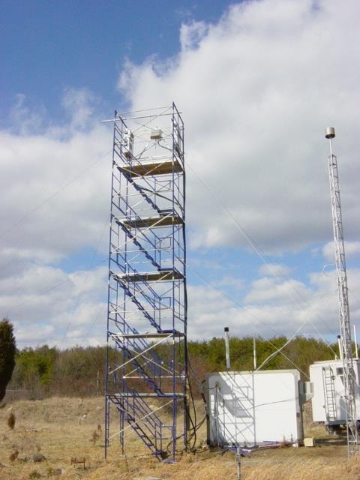

Back Trajectory Analysis – Episodes
Beltsville, Maryland
mercury site
Reactive Gaseous Mercury episode
Notes:
This is just an example to show how useful back-trajectories can be.
Sometimes we see high peaks of Reactive Gaseous Mercury and/or other mercury compounds.
Can we explain what is happening during these episodes? Why was the concentration so high?
Ultimately we want and need to be able to explain the continuous record of measurements at the site, but sometimes it is useful to focus on episodes.

Slide 11
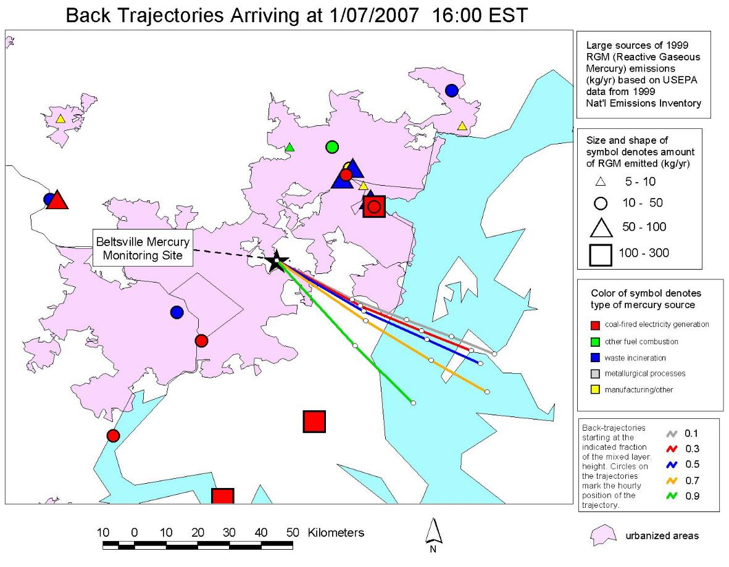
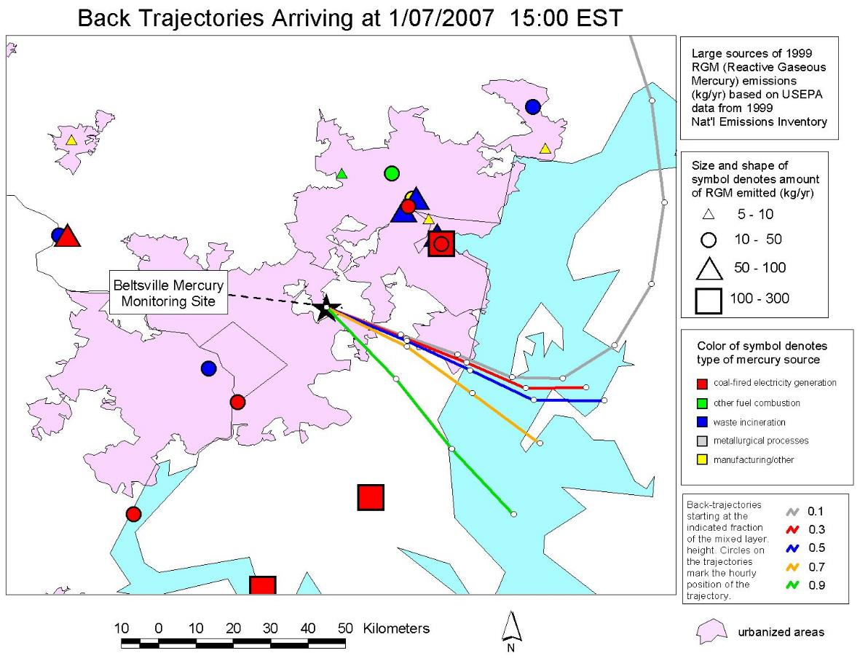
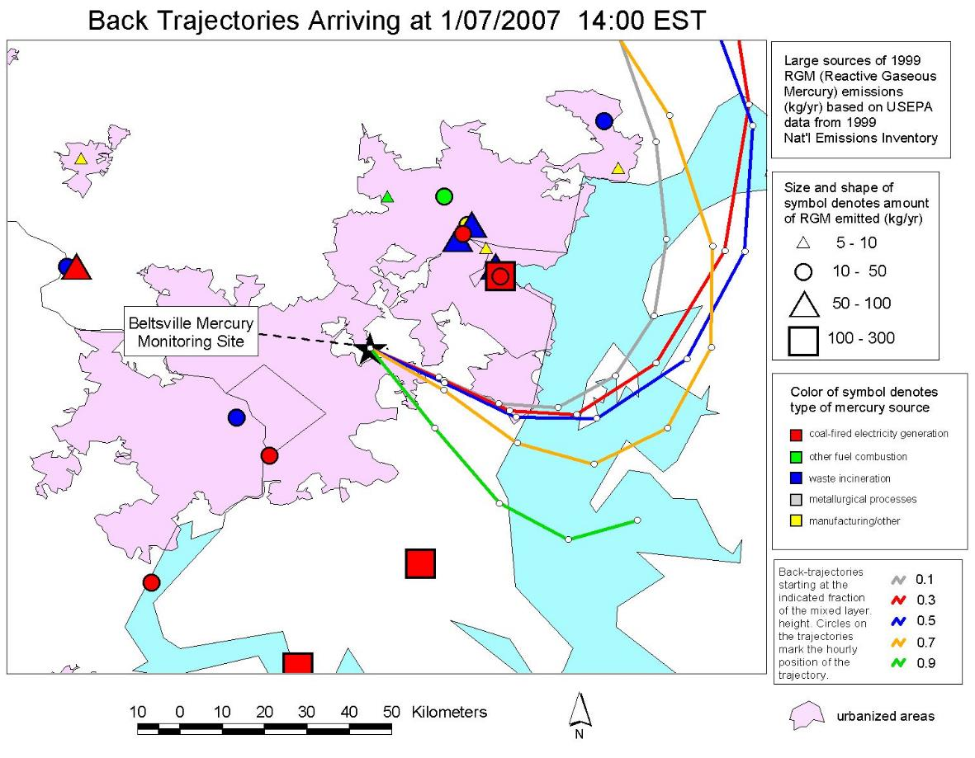
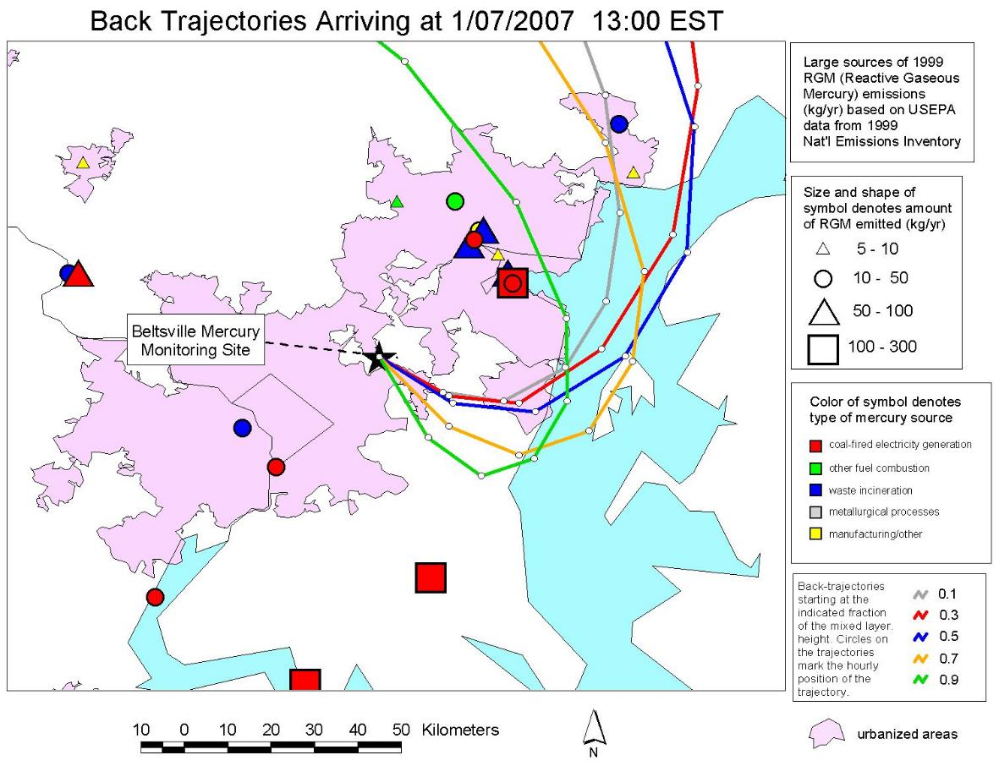
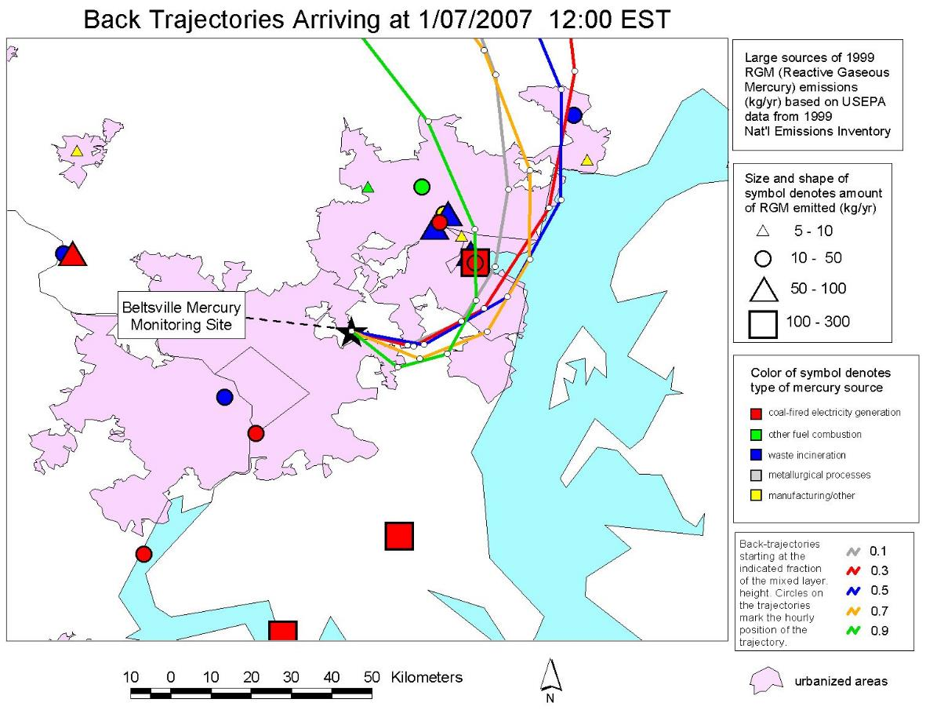
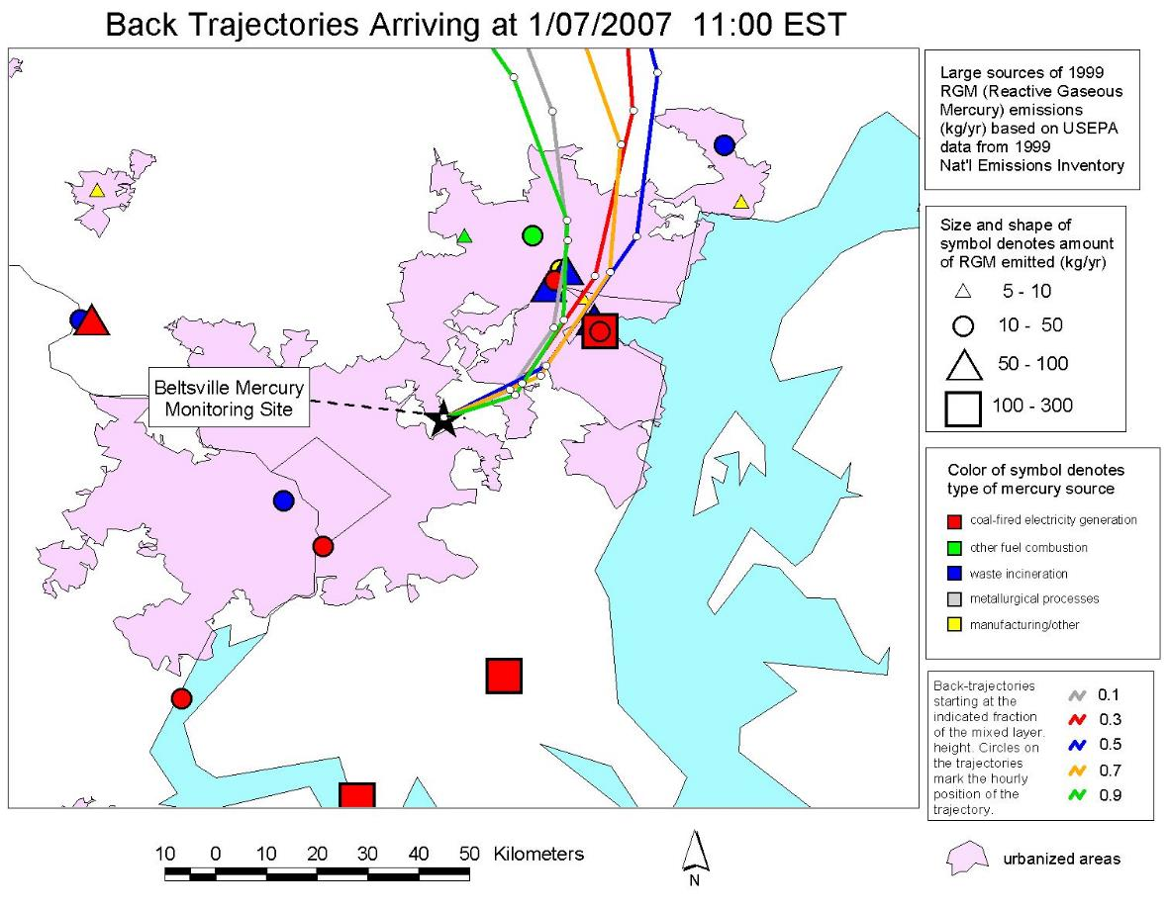
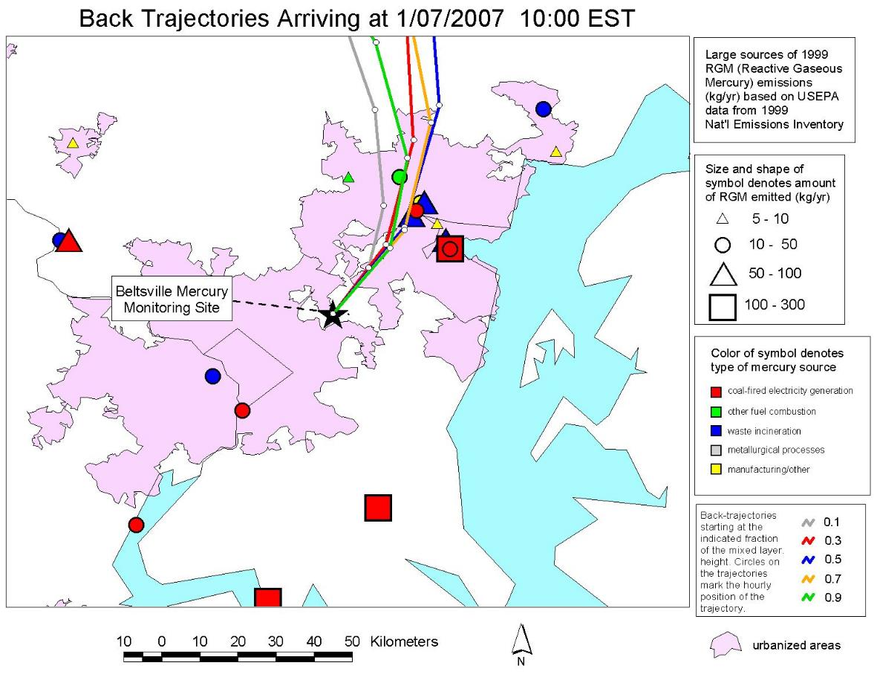
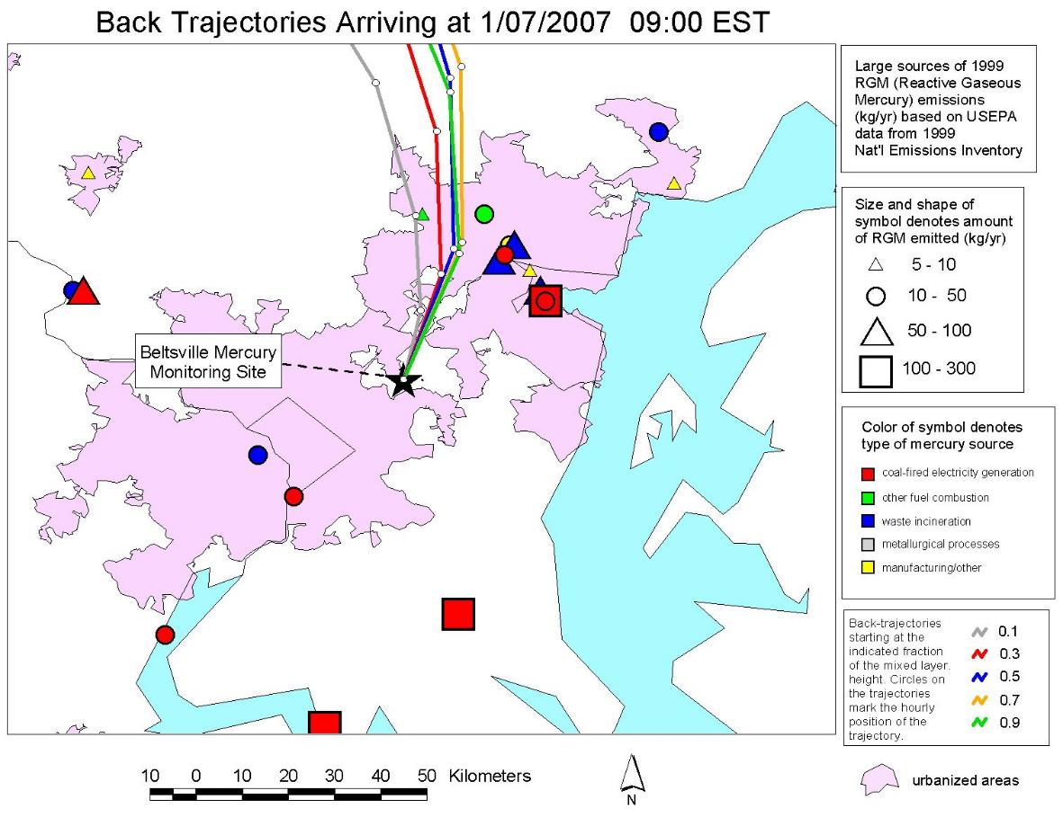
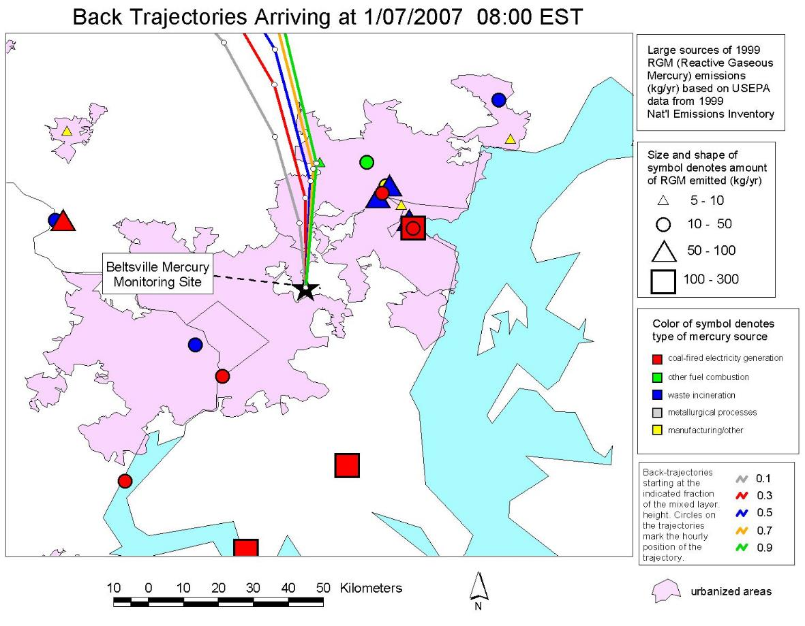
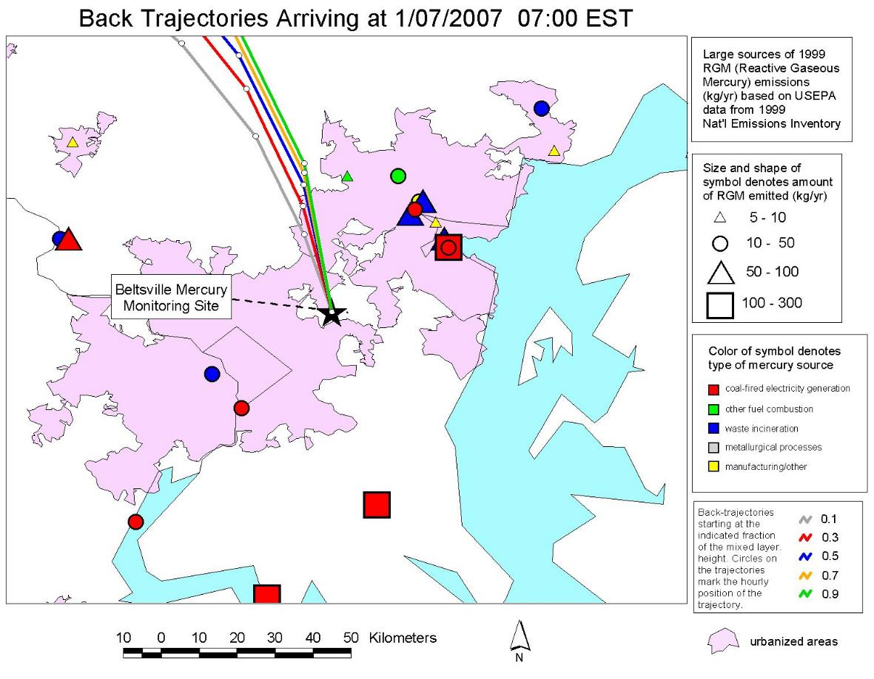
Baltimore
Chesapeake Bay
Washington D.C.
Notes:
When the concentration was high, the air masses appeared to be from a group of significant sources in the Baltimore region northeast of the site.
We have MANY examples of this kind of analysis.
This kind of analysis does not prove that the sources impacted the site and caused the episode, but it is suggestive.
Coupled with other information, this can contribute to a weight-of-evidence approach.

Slide 12
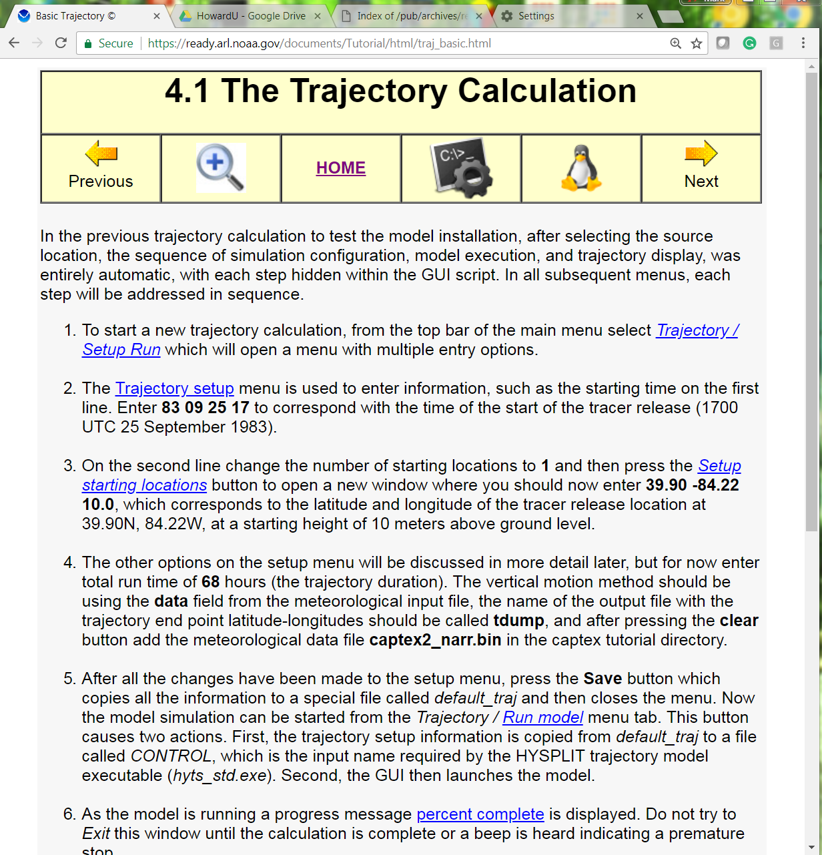
We are going to use parts of the Tutorial today, so you can see how it works
Shows you a DOS Batch Script for actions on this page
Shows you a Unix/Linux shell script for actions on this page
Takes you to the Table of Contents
Takes you to the previous page of the Tutorial
Takes you to the next page of the Tutorial
Links show you pictures of procedures, inputs, and outputs
Shows you the basic inputs needed for this page, in an abbreviated way

Slide 13
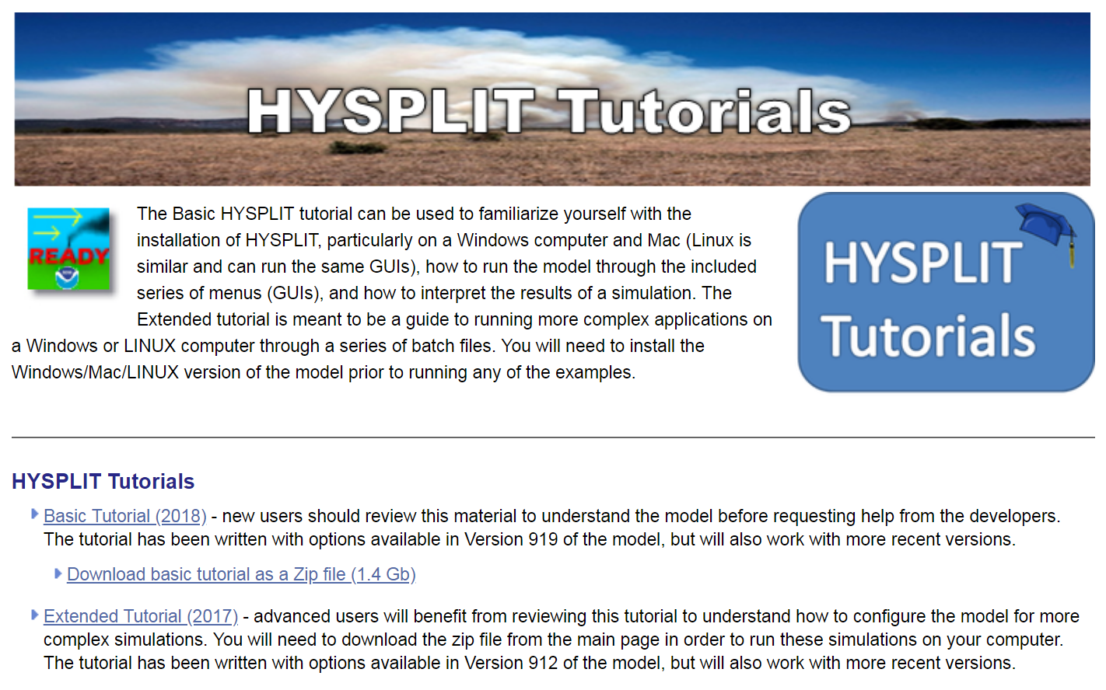
https://www.ready.noaa.gov/HYSPLIT_Tutorials.php
If you download the entire Tutorial, it gives you all of the meteorological files necessary to run the examples.
If you don’t download the entire Tutorial, you will still have to download the met data to do the examples.
(The Tutorial will tell you how to do this)
Either way, though, you will want to install the HYSPLIT program on your local computer to use the Graphical User Interface (GUI) to follow along with the Tutorial and run the examples provided
(The Tutorial also helps you with installation)
Online
Download all files your local computer

Slide 14
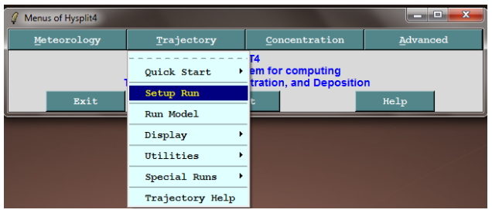
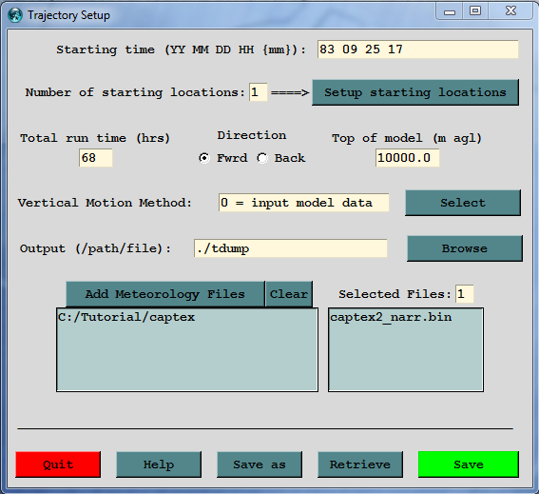
The Tutorial primarily teaches you how to use the Graphical User Interface (GUI)
The GUI is a great way to learn HYSPLIT.
Even if you are going to eventually run HYSPLIT using the command-line and scripting, you often start in the GUI to learn how and what you want to try to do.
Eventually, after learning things in the GUI, you might decide you want to automate a certain set of simulations in a script.

Slide 15
We will briefly go through the following parts of Section 4 of the Tutorial:
4.1 The Trajectory Calculation
4.2 The Trajectory Equation
4.3 Estimating Mixed Layer Depths
4.4 Mixed Layer Trajectories
4.5 Computational Trajectory Error
4.6 Meteorology Trajectory Error
NOTE: In the actual workshop where this PowerPoint was presented, a “Live Demonstration” of the HYSPLIT Tutorial and HYSPLIT Graphical User Interface (GUI) was simultaneously carried out, and shown on a 2nd screen.
However, in almost all cases, key screenshots and explanations corresponding to the Live Demonstration have been included in this PowerPoint presentation.
Therefore, this PowerPoint includes most of the important content of the Live Demonstration.

Slide 16

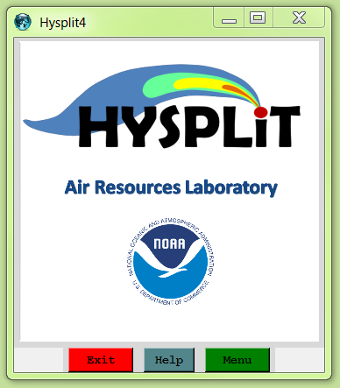
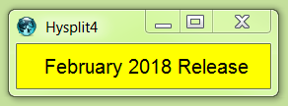
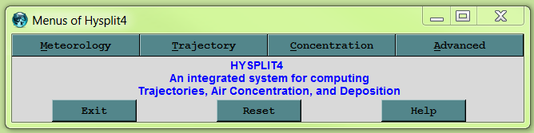
STEP 1: Open GUI
Can also open GUI from a terminal (e.g., Linux) (Either way, Tcl-Tk required!)
~/hysplit4/working> ../guicode/hysplit4.tcl
~/hysplit4/working> wish ../guicode/hysplit4.tcl

Slide 17
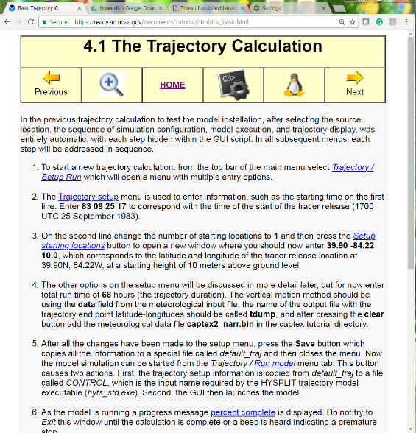
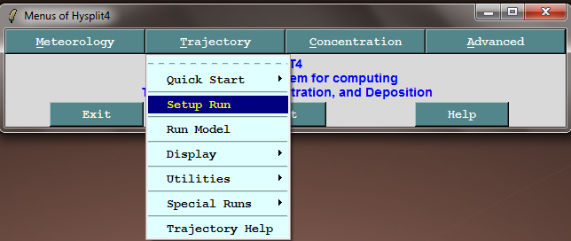
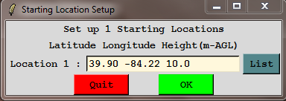
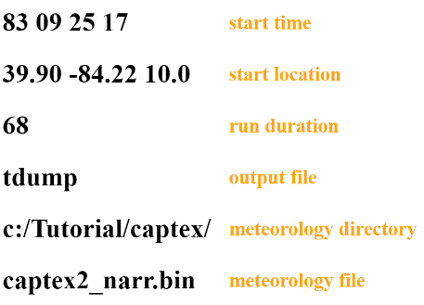

STEP 2: Setup Run

Slide 18
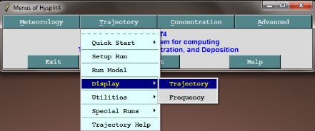
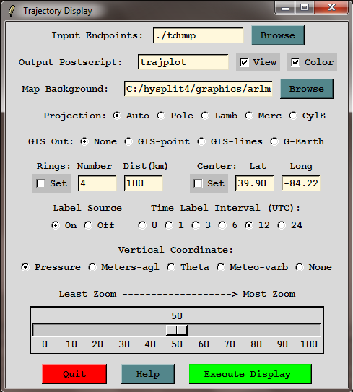
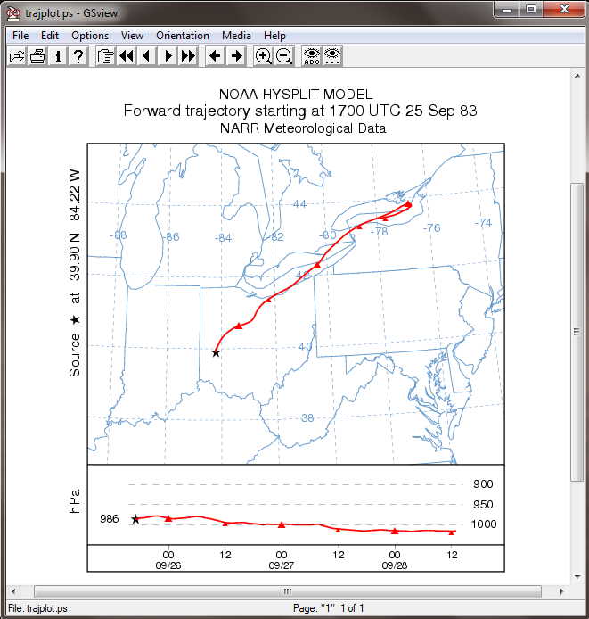
STEP 3: Display

Slide 19
We will briefly go through the following parts of Section 4 of the Tutorial:
4.1 The Trajectory Calculation
4.2 The Trajectory Equation
4.3 Estimating Mixed Layer Depths
4.4 Mixed Layer Trajectories
4.5 Computational Trajectory Error
4.6 Meteorology Trajectory Error
Sure, the model works in practice, but does it work in theory?

Slide 20
The advection of a particle or puff is computed from the average of the three-dimensional velocity vectors at the initial-position P(t) and the first-guess position P'(t+Δt).
The velocity vectors are linearly interpolated in both space and time.
The first guess position is: P'_{(t+Δt)} = P_{(t)} + V_{(P,t)} Δt
The second guess position is: P_{(t)} + V_{(P’,t+Δt)} Δt
The final position is: P_{(t+Δt)} = P_{(t)} + 0.5 [ V_{(P,t)} + V_{(P',t+Δt)} ] Δt
V_{(P’,t+ Δt)}
1st Guess
P’_{(t+Δt)} =
P_{(t)} + V_{(P,t)} * Δt
V_{(P,t)}
Final Position = average of 1st & 2nd guess
V_{(P,t)}
Initial Position
V_{(final)}
V_{(P’,t+ Δt)}
P_{(t)}
2nd Guess
P_{(t)} +
V_{(P’,t+ Δt)} * Δt

Slide 21
We will briefly go through the following parts of Section 4 of the Tutorial:
4.1 The Trajectory Calculation
4.2 The Trajectory Equation
4.3 Estimating Mixed Layer Depths
4.4 Mixed Layer Trajectories
4.5 Computational Trajectory Error
4.6 Meteorology Trajectory Error
Key Thing to Learn:
Introduction to the use of Meteorological Utilities in the GUI (in this case, the text profile utility)
When you work in the GUI, all input and output files are in the Working Directory

Slide 22
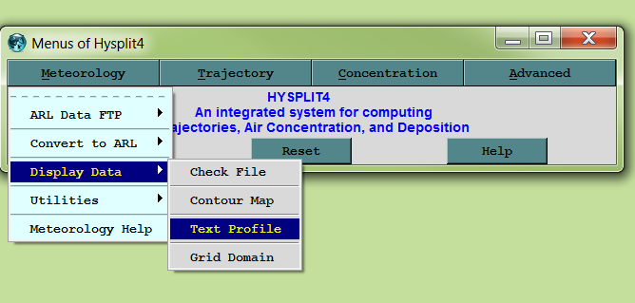
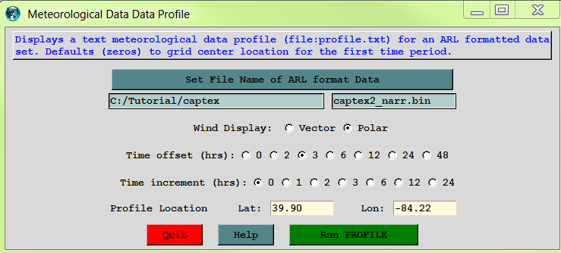

Slide 23
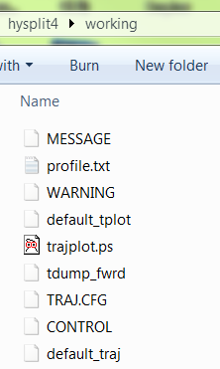
When you work in the Graphical User Interface (GUI), all of the input and output files that you create will generally be in the Working Directory
The GUI will typically show you the output files automatically when you carry out a procedure, but if you want to examine them later, the files will be in the Working Directory
But the names are typically “generic” (e.g., profile.txt), and will be overwritten the next time you carry out a similar procedure.
So, if you want to save a file and be sure you can refer to it later, you will want to rename the file to something other than the “generic” file name

Slide 24
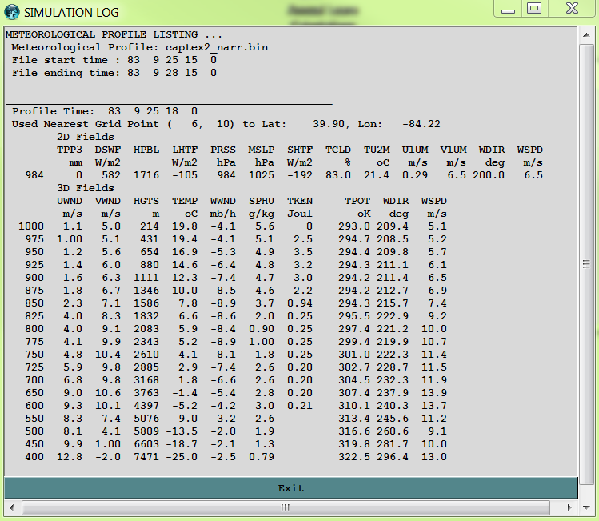
Info about the met file
Also written to profile.txt in working directory
Time and location for the data
Surface and other 2-dimensional variables (e.g., HPBL = height of the planetary boundary layer)
within the Planetary Boundary Layer (PBL)
3-dimensional variables, e.g., WDIR = wind direction (degrees)
above the Planetary Boundary Layer (PBL)
Notes:
The potential temperature is the temperature an unsaturated parcel would have if lowered (or raised) to a level of 1000 mb (100 kPa).
The potential temperature is conserved, or remains the same, for a parcel of air that is unsaturated and remains unsaturated as it rises and sinks.
If the Potential Temperature increases with height, the atmosphere is stable.
If the Potential Temperature decreases with height, the atmosphere is unstable
Above the PBL, TPOT starts to increase… evidence of stable atmos above the PBL
Above the PBL, the TKEN decreases… less turbulence
Above the PBL, the SPHU decreases… dryer air
Above the PBL, the wind speed increases

Slide 25
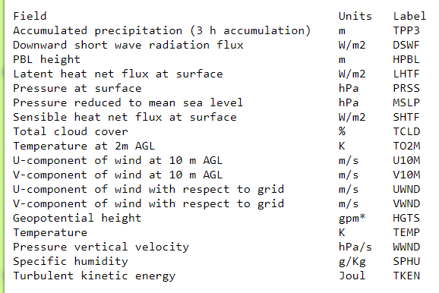
What do the variable names mean?
Information about met data files, and the files themselves are available:
https://ready.arl.noaa.gov/archives.php
https://ready.arl.noaa.gov/data/archives/narr/README.TXT

Slide 26
We will briefly go through the following parts of Section 4 of the Tutorial:
4.1 The Trajectory Calculation
4.2 The Trajectory Equation
4.3 Estimating Mixed Layer Depths
4.4 Mixed Layer Trajectories
4.5 Computational Trajectory Error
4.6 Meteorology Trajectory Error
Key Things to Learn:
Introduction to use of the Advanced Menu in the GUI
What height should you start a back-trajectory?

Slide 27
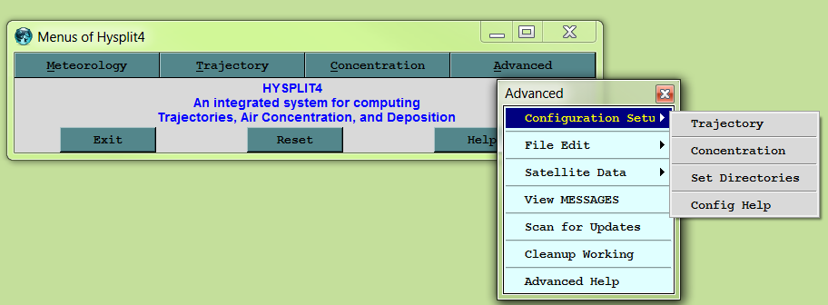
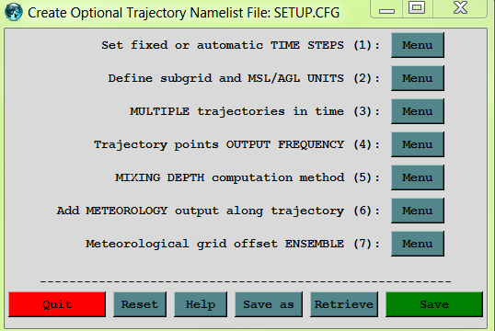
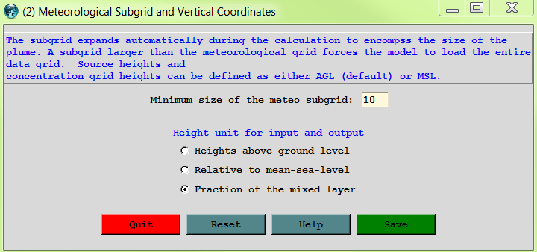
1
2
3
5
6
4
8
7

Slide 28
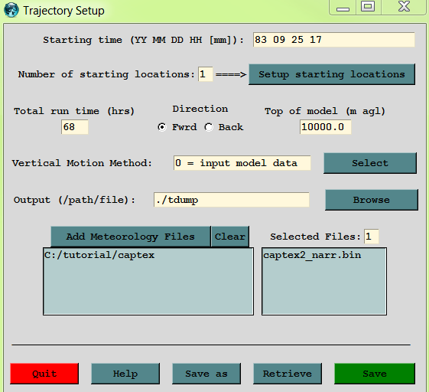
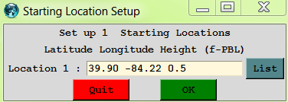
Now that we’ve told the model to interpret INPUT HEIGHTS as a fraction of the PBL (Planetary Boundary Layer, aka the mixed layer), the starting height will generally be between 0 and 1.

Slide 29
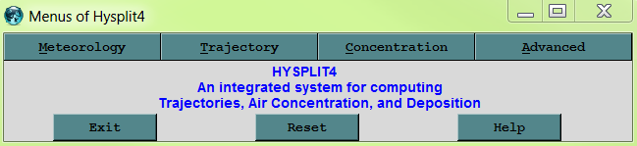
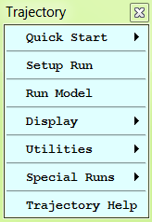
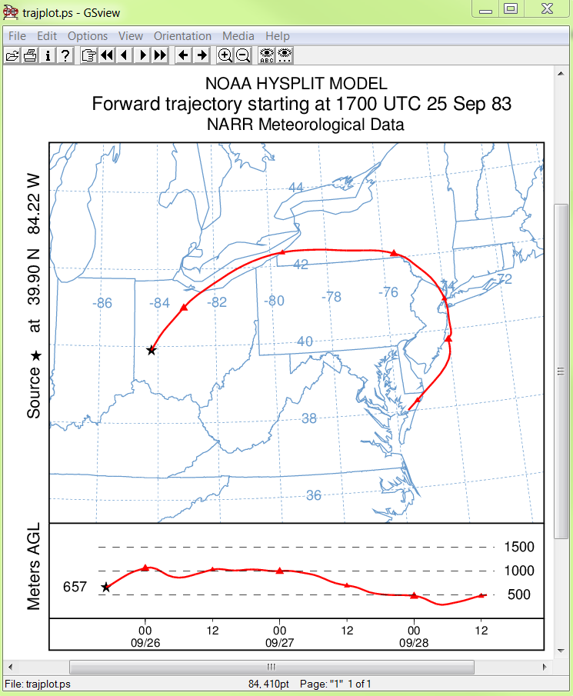
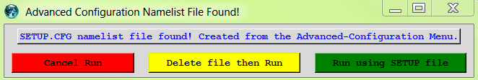
The model has noticed that there is now a SETUP.CFG file, which means that one or more of the advanced settings has been selected.
It just wants to make sure that you are aware of this, and not thinking that you are going to do a “default” simulation

Slide 30
What height should you start a back-trajectory at?
CASE 1:
  relatively simple terrain
  at least ~20 km or more away from any major sources
CASE 2:
  at the top of a relatively isolated mountain

Slide 31

CASE 1:
  relatively simple terrain
  at least ~20 km or more away from any major sources
Measurement of ambient air concentrations
~20 km or more

Slide 32

Greater than ~20km from the source,
if the forward trajectory from the source is within the PBL,
then the source can impact the measurement site,
even if the trajectory endpoint near the site is not at the height of the sampler…
This is because the PBL is relatively well-mixed during the day.
Height of Planetary Boundary Layer (PBL) During the Day
a forward trajectory is the “center line” of a plume
horizontal & vertical dispersion around this center line
Measurement of ambient air concentrations

Slide 33
At night, the Planetary Boundary Layer (PBL) is generally much shallower
Emissions from an elevated stack may be emitted above the PBL
In this case, there may be little impact on a ground-based measurement site until the next daytime period, when the boundary layer grows.
Height of Planetary Boundary Layer (PBL) At Night
Measurement of ambient air concentrations

Slide 34
At night, the Planetary Boundary Layer (PBL) is generally much shallower
Emissions from a relatively low stack may be emitted within the PBL
Note, if the pollutant dry deposits relatively rapidly, by the time the plume reaches the receptor, there may be little pollutant left… Back-trajectories do not include deposition!
Height of Planetary Boundary Layer (PBL) At Night
dry deposition can deplete near-ground plume
Measurement of ambient air concentrations

Slide 35
What are the implications of these ideas for back-trajectories?
What HEIGHT should one start a back-trajectory?
If you start very low to the ground, e.g., at the sampler height, the trajectories often hit the ground… This may not give a representative back-trajectory
“best” starting height for back-trajectories may be from the middle of the Planetary Boundary Layer
It can be useful to start trajectories at different heights to see what influence the starting height has on the results
PBL Height
H = 0.5 * PBL
Measurement of ambient air concentrations

Slide 36
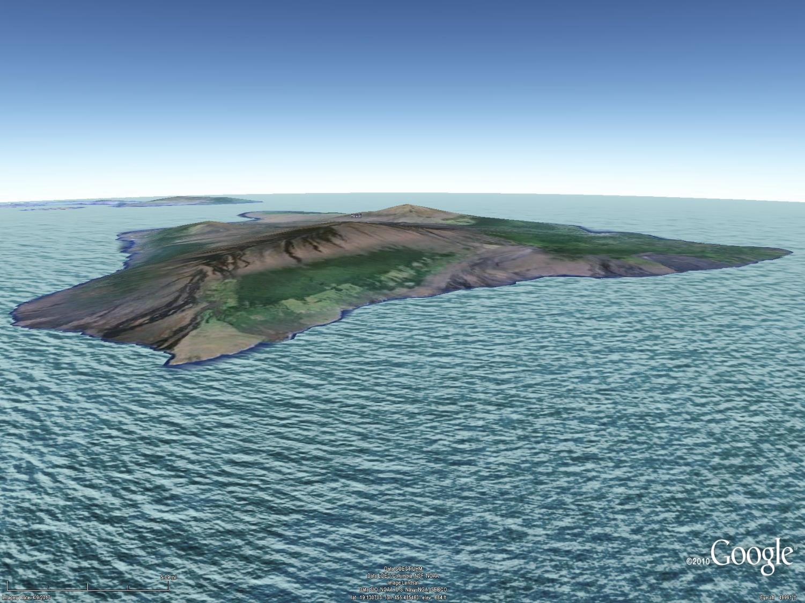
CASE 2: at or near the top of a relatively isolated mountain
Mauna Kea
13796 ft
Mauna Loa
13679 ft
Maui
Hilo
Hawaii
(Big Island)
N

Slide 37


Mercury measurement instruments on roof and
inside historic Keeling
Building, near the
summit of Mauna Loa

Slide 38

Mercury
measurement instruments on roof and inside historic Keeling Building,
near the summit
of Mauna Loa

Slide 39

In this case, especially if sampling free-tropospheric air masses, would likely want to start the back-trajectory simply at the height of the summit above mean sea level.
Exact terrain height may not be that accurately characterized in the met data, so selecting a height Above Ground Level can be problematical
Use Advanced Menu to select “Relative to mean-sea-level”, and could then simply use the height of the summit

Slide 40
We will briefly go through the following parts of Section 4 of the Tutorial:
4.1 The Trajectory Calculation
4.2 The Trajectory Equation
4.3 Estimating Mixed Layer Depths
4.4 Mixed Layer Trajectories
4.5 Computational Trajectory Error
4.6 Meteorology Trajectory Error
Key Things to Learn:
More info about input and output files in the Working Directory when you work in the GUI
Examination of the TDUMP Trajectory Endpoint Output File
Plotting more than one trajectory on a map

Slide 41



Trajectory -> Setup Run -> Save
Trajectory -> Run Model -> Exit
Trajectory -> Display -> Trajectory -> Execute Display

Slide 42



the most important output – the “tdump file” (next page)
MESSAGE file can also can be helpful
SETUP.CFG (renamed TRAJ.CFG by GUI) is what the “advanced” trajectory configuration setup creates (…optional…)
CONTROL
What the Setup Run GUI Menu Creates
A CONTROL file is required for any trajectory run

Slide 43




a TDUMP file (trajectory dump) is the basic output of a HySPLIT trajectory simulation
trajectory number
height above ground (meters)
met grid number
year
month
day
hour
minute
forecast hours
number of hours
Pressure (hPa)
latitude
longitude
Some abbreviated information about the trajectory at the top
we will use final trajectory “endpoint” to start a new trajectory going back the same way that it came.
We will use this final trajectory “endpoint” to start a new trajectory going back the same way that it came.

Slide 44



Trajectory -> Setup Run -> Save
Trajectory -> Run Model -> Exit
Trajectory -> Display -> Trajectory -> Execute Display

Slide 45


tdump_back+tdump_frwd
can also use a text file that lists any number (< 5000) of tdump file names, prefaced by a “+”, e.g. :
+list_of_tdump_files.txt

Slide 46
We will briefly go through the following parts of Section 4 of the Tutorial:
4.1 The Trajectory Calculation
4.2 The Trajectory Equation
4.3 Estimating Mixed Layer Depths
4.4 Mixed Layer Trajectories
4.5 Computational Trajectory Error
4.6 Meteorology Trajectory Error
Key Things to Learn:
What is the impact of using different meteorological data?
What met are available?
What factors influence your choice of met data to use?

Slide 47


2
1
3
5
4

Slide 48

You will typically get different results with different met data
In this case, we expect the earlier NARR-based result to probably be more accurate, as the horizontal resolution is ~8x the global reanalysis data, and the time resolution is 2x
original trajectory we did, with 32 km NARR data
new trajectory with global reanalysis met data (2.5 degree resolution, every 6 hours)
And in this special case, because this was in conjunction with the CAPTEX tracer experiment, we know that the NARR-based result was indeed more accurate

Slide 49
HYSPLIT requires met data to be in a special format (“HYSPLIT-format”)
Gridded output data from a variety of meteorological models are converted to HYSPLIT format and are archived at NOAA Air Resources Laboratory
These files are freely available to anyone
Most of the data sets are based on NOAA meteorological models
The HYSPLIT format files are “binary” and “packed”, so you can’t just look at the data in a text editor or a spreadsheet.
The HYSPLIT modeling suite has a number of met data utility programs that let you read and analyze the met data in various ways
We used one of the programs before (profile), when we created a text profile of met data at a certain location and time, but there are many others

Slide 50

TO GET MET DATA:
https://ready.arl.noaa.gov/READYamet.php

Slide 51


https://ready.arl.noaa.gov/archives.php

Slide 52
Dataset | Horizontal Resolution (km- approx.) | Full-grid dimensions | Temporal resolution (hrs) | Vertical Levels | Period of each file | Size of each file (GB) | Total size for one month of data (GB) | Availability
HRRR-3km | 3 | 1799 x 1059 | 1 | 37 | ¼ day | 3.2 | 390 | June 2015 ->
NAM-12km | 12 | 614 x 428 | 3 | 27 | 1 day | 0.395 | 12 | May 2007 ->
WRF-ARW-27km | 27 | 216 x 174 | 1 | 35 | 1 day | 0.210 | 6.4 | 1980-2016
NARR-32km | 32 | 309 x 237 | 3 | 24 | 1 month | 2.8 | 2.8 | 1979 ->
EDAS-40km | 40 | 185 x 129 | 3 | 27 | ½ month | 0.6 | 1.2 | 2004 ->
GFS - 0.25º | 27 | 1440 x 721 | 3 | 56 | 1 day | 2.7 | 82 | June 2016 ->
GDAS - 0.5º | 55 | 720 x 361 | 3 | 56 | 1 day | 0.468 | 14 | Sept 2007 ->
GDAS - 1º | 111 | 360 x 181 | 3 | 24 | 1 week | 0.571 | 2.5 | Dec 2004 ->
Global Reanalysis - 2.5º | 278 | 144 x 73 | 6 | 18 | 1 month | 0.11 | 0.11 | 1948 ->
North American
Global

Slide 54
What Met Data set should you use?
When and where is your simulation?
  North America vs. global
  Recent years, many options
  Going further back into the past, fewer options
Higher resolution generally better, but comes with a cost
  disk space
  simulations go slower
  many files necessary for a given simulation
Complex terrain (mountains) and coastal areas (sea/lake breeze)
  higher resolution data may be required
  but available data may not be highly resolved enough
Higher resolution data most important for “near-field” impacts
  further and further away from the starting location, resolution starts to matter less
  can create subgrid extracts of datasets for more practical use of high-resolution data
  can use both fine and coarse met data for a given simulation,
  the simulation continues on the coarse grid once it gets to the edge of the finer domain!
Can be useful to use different data, and examine the differences in your results
  If there are dramatic differences – or not -- this is useful to know
  Compare met data with measurements at your site(s), to see how “good” it is

Slide 55

HYSPLIT Inputs and Outputs
GUI creates:
CONTROL file:
Required to run HYSPLIT
Initial position(s)
Start time, duration
What met data to use
SETUP.CFG file:
optional – if not present, the defaults will be used
created through the Advanced Menu
allows the user to specify a number of different “non-default” choices
HYSPLIT-format
Meteorological
data files
Initialization
HYSPLIT
Output
For Trajectories,
primary outputs are tdump and MESSAGE

Slide 56


HYSPLIT FILES
Files are read from and written to the working directory.
Input files
CONTROL
SETUP.CFG
Output files
tdump
MESSAGE
WARNING
Notes:
Can show this slide while working with GUI on demonstration.

Slide 57
Using the GUI to Run and Summarize “a lot” of Trajectories
  Run Daily menu (Tutorial 6.1)
  Frequency Analysis (Tutorial 6.1)
  Clustering Analysis (Tutorial 6.2)

Slide 58

Using the GUI to Run and Summarize “a lot” of Trajectories
  Run Daily menu (Tutorial 6.1)
  Frequency Analysis (Tutorial 6.1)
  Clustering Analysis (Tutorial 6.2)

Slide 59

start with traj_frwd_control.txt
change starting time to beginning of month
change run time to 48 hrs
change met data to RP198309.gbl
this file is an extract of the 2.5 degree global reanalysis, covering the entire region, for Sept 1983
change output to “fdump”
If we ran the model “now”, we would just get one trajectory

Slide 60



1
2
3
4
5

Slide 61


112 runs have been done!
28 days * 4 runs per day (every 6 hours) = 112 trajectory simulations
We have 112 new output tdump-type files in our working directory:
  fdump83090100
  fdump83090106
  fdump83090112
  fdump83092818

Slide 62

Using the GUI to Run and Summarize “a lot” of Trajectories
  Run Daily menu (Tutorial 6.1)
  Frequency Analysis (Tutorial 6.1)
  Clustering Analysis (Tutorial 6.2)

Slide 63




1
2
3
4
5
6
8
7
make sure there are no “extraneous” fdump files in the INFILE
the GUI script just takes all files that begin with the Base Name specified and creates a list of the files

Slide 64


Creates a grid, default is 1º x 1º
For each grid square, counts the number of the 112 trajectories that passes through it
A trajectory is deemed to pass through a grid square if there is at least one endpoint that falls within the grid square
# of trajectories passing
through a given grid square
Freq = ----------------------------------------
total # of trajectories
What percent of the trajectories pass through any given grid square?

Slide 65


Slide 66


Slide 67

DEFAULT:
Residence Time option = 0
# of trajectories passing through a grid square divided by the total number of trajectories
Max value = 100

Slide 68

ALTERNATIVE:
Residence Time option 1:
# of endpoints per grid square divided by total number of trajectories
Values can be greater than 100

Slide 69

ALTERNATIVE:
Residence Time option 2:
# of endpoints per grid square divided by total number of endpoints
Values are relatively small

Slide 70

ALTERNATIVE:
Residence Time option 3:
# of endpoints per grid square divided by number of endpoints in the most “popular” grid square

Slide 71




Res Time = 0:
# of trajectories passing through a grid square divided by the total number of trajectories
Res Time = 1:
# of endpoints in a grid square divided by the total number of trajectories
Res Time = 2:
# of endpoints in a grid square divided by the total number of endpoints
Res Time = 3:
# of endpoints in a grid square divided by number of endpoints in most popular grid square

Slide 72



Res Time Option #3:
# of endpoints per grid square divided by # of endpoints in most popular grid square
global reanalysis met data
2.5 deg (~250 km)
6 hr time resolution
NARR met data
32 km
3 hr time resolution

Slide 73
Trajectory frequency analysis can be very useful
Example, hourly air pollutant measurements at a given site
Where did the air come from when the concentrations were relatively high? when low?
You can run back-trajectories for every hour – very easy with a script!
Put the TDUMP filenames for all trajectories corresponding to high concentrations in one INFILE, and those for the low concentrations in a separate INFILE
Run frequency analysis on both sets of trajectories – are the regions where the air came from different?

Slide 74

Difference between the normalized percent of trajectory endpoints between the top 10% and bottom 10% of Gaseous Elemental Mercury (GEM) concentrations measurements at Beltsville MD during 2007-2015, along with USEPA TRI and Environment Canada NPRI point-source total-mercury emissions data for 2011.
Positive numbers (yellow-red-brown) indicate that 1ºx1º grid squares were more likely to be encountered during high GEM concentration events. (Equivalent to Figure 10a in Ren et al., 2016)
Notes:
Note – this took the analysis a few more steps:
Took difference between RT=3 frequencies between two sets of trajectories, high vs. low GEM
Modified trajfreq so that endpoint only counted in a grid square if the height was below the PBL at the time the endpoint was in the grid square
Difference between the normalized percent of trajectory endpoints between the top 10% and bottom 10% of GEM concentrations, along with USEPA TRI and Environment
Canada NPRI point-source total-mercury emissions data for 2007-2015 (with 2011 emissions). Positive numbers (yellow-red) indicate that grid squares (1º x 1º) were more likely to be encountered during high GEM concentration events. Trajectory endpoints are only counted for a given grid point if the height of the endpoint is less than the HYSPLIT-estimated mixed-layer depth at that location and time.
Equivalent to Figure 10a in: 2016 Ren, X., W.T. Luke, P. Kelley, M.D. Cohen, R. Artz, M.L. Olson, D. Schmeltz, M. Puchalski, D.L. Goldberg, A. Ring, G.M. Mazzuca, K.A. Cummings, L. Wojdan, S. Preaux , and J.W. Stehr, Atmospheric mercury measurements at a suburban site in the Mid-Atlantic United States: Inter-annual, seasonal and diurnal variations and source-receptor relationships, Atmospheric Environment 146, 141-152, DOI:10.1016/j.atmosenv.2016.08.028. Open Access: https://dx.doi.org/10.1016/j.atmosenv.2016.08.028

Slide 75

Using the GUI to Run and Summarize “a lot” of Trajectories
  Run Daily menu (Tutorial 6.1)
  Frequency Analysis (Tutorial 6.1)
  Clustering Analysis (Tutorial 6.2)

Slide 76




INFILE in c:\hysplit4\cluster\working

Slide 77



Slide 78


if try to group all 112 trajectories in 1 or 2 clusters, a very large TSV = “total spatial variance”
if group into 3 different clusters, get a big decrease in TSV
the “sweet spot” may be 5 clusters, as have relatively low TSV, and doesn’t get much lower if you keep adding more clusters…

Slide 79




Slide 80






Slide 81

Dispersion

Slide 82
We will briefly go through the following sections:
Dispersion / Air concentration equations (tutorial section 7.2)
CONTROL file
SETUP.CFG file
Outputs
Additional input files
Interpreting results
Key Thing to Learn:
How does HYSPLIT model the dispersion of passive tracers and air concentrations?
Passive tracer- material which is transported in the atmosphere without affecting the flow.
smoke, dust, volcanic ash, gasses, chemicals……..

Slide 83

Lagrangian particle model
Velocity of fluid particles
$$U=\left\langle U\right\rangle +u$$
Langevin equation – originally used as stochastic model for molecules undergoing Brownian motion.
Fluctuating velocity is modeled
Mean velocity from NWP model
u(t+Δt) = R(Δt) u(t) +σ λ( 1-R(Δt)² )^{0.5}
Correlation
R(Δt) = exp(-Δt/T_{L})
Random number.
Velocity standard
deviation

Slide 84

Example: Fluctuating velocity for 10 particles.
u(t+Δt) = R(Δt) u(t) +σ λ( 1-R(Δt)² )^{0.5}
Fluctuating Velocity (m/s)
Time (minutes)
DNS and experiments show velocity PDF of
fluid particles in a turbulent flow is very close to Gaussian
Velocity autocorrelation is represented well. Velocity is correlated over the Lagrangian time scale. (Time scale of largest scales).

Slide 85


2-D Dispersion example
No Dispersion (trajectory)
Mean wind 2 m/s in u direction
Instantaneous release of 100
particles from (0,0)
v
u
Dispersion large sigma
Dispersion small sigma
Dispersion large sigma

Slide 86
To accurately represent the dispersion of the fluid
particles, velocity variance needs to be estimated.
Velocity variance is estimated using information from the NWP model
HYSPLIT has different methods to compute σ.
The default is a good place to start.
Which method you use depends in part on what data is available from the NWP model you are using.
Temperature and wind profiles available from all data sets.
Some datasets have friction velocity, momentum fluxes, heat fluxes, PBL height.
A few have TKE (turbulent kinetic energy).
More information:
Tutorial section 9.3
Supplemental information in the BAMS article.

Slide 87
We will briefly go through the following sections:
Dispersion / Air concentration equations (tutorial section 7.2)
CONTROL file
SETUP.CFG file
Outputs
Additional input files
Interpreting results
Key Things to Learn:
The CONTROL file for modeling concentrations is similar to the one for trajectories but contains some extra information.
We will set up a CONTROL file using the GUI.

Slide 88






Pollutant, Deposition and Grids setup
If you want to tabulate deposition, one of the levels in the concentration grid must be “0”
Must hit “SAVE” (or “OK”) when done with each menu and submenu in order to write the CONTROL file

Slide 89

CONTROL
FILE
example
start date
Lat, Lon, Altitude
Met data directory
Pollutant Group
Not in
Trajectory
CONTROL
file
Concentration Grid
Deposition

Slide 90
CONTROL FILE example

Slide 93

Setting concentration grid
Example
One emission source
Six measurement stations
measure 12 or 24 hour average concentrations
1 month of emissions and measurements.
AUX04
FRX27
GBX86
NZX46
AUX04
Tip: You can set multiple concentration grids.
Maurer et. al. (2017) International challenge to model the long-range transport of radioxenon released from medical isotope production to six Comprehensive Nuclear Test-Ban Treaty monitoring stations. Submitted to Journal of Environmental Radioactivity.

Slide 94

Number of concentration grids
7
-37.73 145.1
1.0 1.0
3.00 3.00
./
cdump.AUX04.001
1
1000
13 05 11 07 00
00 00 00 00 00
00 12 00
-37.07 -12.31
1.0 1.0
3.00 3.00
./
cdump.FRX27.001
1
1000
13 05 11 14 00
00 00 00 00 00
00 24 00
Grid for AUX04 station
Each grid has it’s own
output cdump file.
Grid for FRX27
station

Slide 95
Tips on setting the concentration grid
Multiple concentration grids may be specified.
Resolution will depend on application. Fine resolution may require more particles.
Vertical resolution is defined by the top height.
Here the concentration is calculated from ground to 100 m.
If a 0 level is defined, deposition will be output to that level.
Usually an average concentration over some time is used.

Slide 96
We will briefly go through the following sections:
Dispersion / Air concentration equations (tutorial section 7.2)
CONTROL file
SETUP.CFG file
Outputs
Additional input files
Interpreting results
Key Things to Learn:
The SETUP.CFG file has many options.
Know where to look up information about the options.
Complete list of NAMELIST file SETUP.CFG options in help at:
https://www.ready.noaa.gov/hysplitusersguide/S410.htm

Slide 97



In the GUI options for
The SETUP.CFG file are found
In Advanced- Configuration SETUP – Concentration
Menu.

Slide 98
Number of Computational Particles?
SETUP.CFG
&SETUP initd = 0,
numpar = 2500,
ninit = 1,
ndump = 0,
ncycl = 0,
pinpf ='PARINIT',
poutf = 'PARDUMP',
maxpar = 10000, /
Complete list of NAMELIST file SETUP.CFG options in help at:
https://www.ready.noaa.gov/hysplitusersguide/S410.htm

Slide 99



Number of Particles?
Release 1 kg gram
Consider :
Concentration grid size
Averaging time
Length of time
Minimum detection
10 particles Each particle 100g
v
u
100 particles Each particle 10g
1000 particles Each particle 1g

Slide 100
SETUP.CFG
Just a few of the other things you can do:
  Specify whether optional input files are used.
  Run with puffs rather than particles.
  Choose methods to compute dispersion.

Slide 101
We will briefly go through the following sections:
Dispersion / Air concentration equations (tutorial section 7.2)
CONTROL file
SETUP.CFG file
Outputs
Additional input files
Interpreting results
Key Things to Learn:
The cdump file is the main output.
Additional output/ input file is the pardump / parinit file.
MESSAGE and WARNING file may be useful for trouble shooting.

Slide 102
CDUMP file – what is in it?
con2asc utility will convert a binary cdump file to ascii format.
File format described at:
https://ready.arl.noaa.gov/hysplitusersguide/S363.htm
Concentration in each grid box for each level for each pollutant
for each time period.
Eruption of Agung volcano in Bali November 2017
High
Medium
Low
20,000 to 35,000 ft
SFC to 20,000 ft

Slide 103


Plotting a cdump file with concplot
More options available from
the command line.
Tutorial section 8.2

Slide 104

2008 Eruption of Kasatochi in the Aleutian Islands
Mass Loading plot for volcanic ash
was constructed by adding concentrations
For 6 different particle sizes and several
different levels.
Crawford, et al., (2016) Initializing HYSPLIT with satellite observations of volcanic ash: A case study of the 2008 Kasatochi eruption J. of Geophysical Research: Atmospheres, 121, p 10,786, doi:10.1002/2016D024779

Slide 105

Plotting a pardump file with parxplot

Slide 106


Animations from a PARINIT (PARDUMP) file.
Eruption of Kasatochi Volcano
in August 2008
Transport of Xe-133 from a radiopharmaceutical facility in Australia)
Colors represent different altitude ranges
Notes:
HYSPLIT is a Lagrangian Transport and Dispersion Model.
Computational particles or puffs which represent the pollutant are released.
Advection determined by 3d winds from met model.
In a puff mode – the size of the puffs
Puff - In a puff model, the source is simulated by releasing pollutant puffs at regular intervals over the duration of the release. Each puff contains the appropriate fraction of the pollutant mass. The puff is advected according to the trajectory of its center position while the size of the puff (both horizontally and vertically) expands in time to account for the dispersive nature of a turbulent atmosphere.
Particle - In a Lagrangian particle model, the source can be simulated by releasing many particles over the duration of the release. In addition to the advective motion of each particle, a random component to the motion is added at each step according to the atmospheric turbulence at that time. In this way a cluster of particles released at the same point will expand in space and time simulating the dispersive nature of the atmosphere. In a homogeneous environment the size of the puff (in terms of its standard deviation) at any particular time should correspond to the second moment of the particle positions
The basis of any Lagrangian model is that the dispersion is computed following the particle or puff. That is, the advection of a particle is computed independently. Hence once the basic (U,V,W) meteorological data have been processed and interpolated to the internal model grid, trajectories (the integrated advection term of a particle) can be computed to test the advection components of the model. The advection of a particle or puff is computed from the average of the three-dimensional velocity vectors for the initial-position P(t) and the first-guess position P'(t+Δt). The velocity vectors are linearly interpolated in both space and time. The first guess position is P'(t+Δt) = P(t) + V(P,t) Δt (18) and the final position is P(t+Δt) = P(t) + 0.5 [ V(P,t) + V(P',t+Δt) ] Δt,

Slide 107
We will briefly go through the following sections:
Dispersion / Air concentration equations (tutorial section 7.2)
CONTROL file
SETUP.CFG file
Outputs
Additional input files
Interpreting results
Key Things to Learn:
An EMITTIMES file can be created and input into HYSPLIT if more complex emissions are needed.
The particle position (PARDUMP) file can also be used as input into HYSPLIT.

Slide 108
Additional
Inputs and
outputs
CONTROL File
SETUP.CFG
EMITTIMES (text file)
PARINIT (binary file)
ARL formatted file
Meteorological data
&SETUP initd = 0,
numpar = 2500,
ninit = 1,
ndump = 12,
ncycl = 12,
pinpf ='PARINIT',
poutf = 'PARDUMP',
maxpar = 10000,
efile= EMITTIMES.txt, /
HYSPLIT
cdump (binary file)
PARDUMP (binary file)
MESSAGE (text file)
WARNING (text file if failed)

Slide 109

EMITTIMES.txt
Allows user to specify more
complex source terms which
vary in space and time.
https://ready.arl.noaa.gov/hysplitusersguide/S417.htm

Slide 110
We will briefly go through the following sections:
Dispersion / Air concentration equations (tutorial section 7.2)
CONTROL file
SETUP.CFG file
Outputs
Air Concentration display options (tutorial section 8.2)
Additional input files
Interpreting results
Key Things to Learn:
Where does uncertainty in model results come from?
How to evaluate your results?

Slide 111
Where does uncertainty come from?
Output from NPW Model
(WRF, NARR, GDAS, ECMWF….)
Emissions Data
Conversion utility
ARL formatted file
Initialization
For verification we look for data-sets with good
Emissions data and good measurement data.
For many applications, HYSPLIT model output is more
more sensitive to uncertainties in the initialization
And the NWP model inputs than to uncertainties in
the dispersion calculation.
HYSPLIT
Output
Data
Evaluate

Slide 112

Compare modeled concentrations with
station measurements.
Blue – HYSPLIT forecasts
Red – PM10 measurements at a station
Utilities c2datem and statmain (Tutorial section 8.4)
https://www.arl.noaa.gov/research/dispersion/datem/

Slide 113



See how sensitive results are to changes in the model configuration
AUX09
RP – 2.5 degree
GDAS – 1 degree
AUX04
-● measurements
-- mdc
Maurer et. al. (2017) International challenge to model the long-range transport of radioxenon released from medical isotope production to six Comprehensive Nuclear Test-Ban Treaty monitoring stations. Submitted to Journal of Environmental Radioactivity.
ALSO SEE:
Inline Coupling of WRF-HYSPLIT: Model Development and Evaluation Using Tracer Experiments. Fong Ngan, Ariel Stein, and Roland Draxler, 2015. J. Appl. Meteor. Climatol., 54, 1162-1176. doi: http://dx.doi.org/10.1175/JAMC-D-14-0247.1
Notes:
RP – is NCEP-NCAR 2.5 degree global model.

Slide 114




Compare forecast and observed mass loading.
MODIS Satellite product
2008 Eruption of Kasatochi in the Aleutian Islands
Crawford, et al., (2016) Initializing HYSPLIT with satellite observations of volcanic ash: A case study of the 2008 Kasatochi eruption J. of Geophysical Research: Atmospheres, 121, p 10,786, doi:10.1002/2016D024779
²Pavolonis, Hiedinger, Sieglaff, "Automated Retrievals of Volcanic Ash and Dust Cloud Properties From Upwelling Infrared Measurements.", J. of Geophysical Research: Atmospheres, VOL. 118, 1436-1458, doi:10.1002/jgrd.50173, 2013.

Slide 115

Scripting with HYSPLIT
call SET_TRAJ_DOS_001 83 09 01 00 00 39.900 -84.220 750.0 0 48 FORWARD n0001_83_09_01_00_00 ..\metdata\global_reanalysis\ RP198309.gbl RP198310.gbl 60 1 FRWD_48hr_gbl2p5
call SET_TRAJ_DOS_001 83 09 01 06 00 39.900 -84.220 750.0 0 48 FORWARD n0002_83_09_01_06_00 ..\metdata\global_reanalysis\ RP198309.gbl RP198310.gbl 60 1 FRWD_48hr_gbl2p5
call SET_TRAJ_DOS_001 83 09 01 12 00 39.900 -84.220 750.0 0 48 FORWARD n0003_83_09_01_12_00 ..\metdata\global_reanalysis\ RP198309.gbl RP198310.gbl 60 1 FRWD_48hr_gbl2p5
call SET_TRAJ_DOS_001 83 09 01 18 00 39.900 -84.220 750.0 0 48 FORWARD n0004_83_09_01_18_00 ..\metdata\global_reanalysis\ RP198309.gbl RP198310.gbl 60 1 FRWD_48hr_gbl2p5

Slide 116
Scripting with HYSPLIT
  Introduction: Running HYSPLIT from the Command Line
  Scripting Example: Running Trajectories
  Scripting Example: Frequency Analysis

Slide 117
Scripting with HYSPLIT
  Introduction: Running HYSPLIT from the Command Line
  Scripting Example: Running Trajectories
  Scripting Example: Frequency Analysis

Slide 118



To run HYSPLIT from the Command Line, you must first open up a “terminal window” on your computer – slightly different in Windows, Linux, and Mac
Windows
Linux & Mac
Start → Search for “Command Prompt”

Slide 119

Basic Navigation within Terminal Windows
Windows
Linux and Mac
Often starts in users directory
c: → changes to c: drive
cd\ → changes directory to c:\]
cd hysplit4 → change dir to hysplit4
cd working → change dir to working
dir → lists contents of directory (folder)
Starts in users Home directory
cd hysplit4 → change dir to hysplit4
cd working → change dir to working
ls → lists contents of directory (folder)
cd\ [enter]
cd hysplit4 [enter]
cd working [enter]
dir [enter]

Slide 120
Basic Navigation within Terminal Windows
Windows
Linux & Mac
c: → changes to c: drive
cd\ → changes directory to c:\]
cd hysplit4 → change dir to hysplit4
cd working → change dir to working
dir → lists contents of directory (folder)
dir/w → wide listing of directory
mkdir → make directory
del → delete a file
copy → copy a file
rename → rename a file
“up arrow” → previous command(s)
“down arrow” → following command(s)
cd ~ → changes to home directory
cd hysplit4 → change dir to hysplit4
cd working → change dir to working
ls → lists contents of directory (folder)
ls -ltr → detailed dir, with new items last
mkdir → make directory
rm → remove (delete) a file
cp → copy file
mv → move file (e.g., to a different name)
“up arrow” → previous command(s)
“down arrow” → following command(s)

Slide 121

For Windows
dir ..\exec\ /w [enter]
/w = list in a wide format
exec\ = and then once you are there, look for the exec directory
..\ = go back one directory to hysplit4

Slide 122
For Linux & Mac
ls ../exec/

Slide 123
For most “executables” in the c:\hysplit4\exec\ directory,
if you “run” the program by typing in its name and hitting enter,
with no other “arguments” on the command line,
it will give you a list of the arguments that it either needs or could use!

Slide 124


Slide 125
C:\hysplit4\working>..\exec\showgrid
Usage: showgrid [-filename options]
-D[input metdata directory name with ending /]
-F[input metdata file name]
-P[process ID number for output file]
-I[grid point plotting increment (0=none)]
-L[lat/lon label interval in degrees]
-A[location of arlmap or shapefiles.<(txt)|processid>]
-X[Read from standard input]
-Q[subgrid lower left latitude (xxx.xx)]
-R[subgrid lower left longitude (xxxx.xx)]
-S[subgrid upper right latitude (xxx.xx)]
-T[subgrid upper right longitude (xxxx.xx)]
-B[plot symbol at each lat/lon in file SYMBPLT.CFG]
NOTE: leave no space between option and value
C:\hysplit4\working>..\exec\showgrid -DC:\Tutorial\captex\ -FRP198309.gbl -I1 -L10.0
C:\hysplit4\working>dir showgrid.ps
Volume in drive C has no label.
Volume Serial Number is 1AEB-47F5
Directory of C:\hysplit4\working
03/18/2018 08:44 PM 980,386 showgrid.ps
1 File(s) 980,386 bytes
0 Dir(s) 436,537,696,256 bytes free
C:\hysplit4\working>showgrid.ps
C:\hysplit4\working>
In Linux / Mac, front slashes instead of backslashes.
>../exec/showgrid –D~/Tutorial/captex/ -FRP198309.gbl -I1 -L10.0
In Windows, since we have installed Ghostview with HYSPLIT, you just type the name of the postscript file, i.e., “showgrid.ps” and hit return, and it will be shown

Slide 126

global reanalysis a “global” dataset, but a subgrid extract was prepared for use in Tutorial.
subgrid extracted using a program called: xtrct_grid
xtrct_grid not available in the GUI, but can run from the command line or a script

Slide 127
Scripting with HYSPLIT
  Introduction: Running HYSPLIT from the Command Line
  Scripting Example: Running Trajectories
  Scripting Example: Frequency Analysis

Slide 128



The basic model operation from the Graphical User Interface (GUI) involves a few basic steps:
With the Setup Run menu, the simulation details are configured and saved to a file called default_traj.
If the Advanced menu is optionally used, a namelist file TRAJ.CFG is created
When Model Run is invoked, the default_traj file is copied to a file named CONTROL , and if present, the TRAJ.CFG file is copied to a file named SETUP.CFG
When the model runs, it reads these files, and creates two key output files: tdump and MESSAGE
The Display menu calls a program to read the model output file (tdump) and creates a Postscript graphics file.
Unless otherwise specified, all files are written to the Working Directory.

Slide 129

When HYSPLIT runs, the first thing it looks for is the “CONTROL” file. This must be present – and properly configured -- in the working directory for HYSPLIT to run successfully.
What is in this CONTROL file?
Open up the CONTROL file in the hysplit4\working directory, in a text editor
(Windows: e.g., Notepad or Notepad++; Mac: e.g., TextEdit)
We’re going to study this more in a few minutes, but first, a warning:

Slide 130

Warning:
When you are dealing with these input files for HYSPLIT, or when creating scripts, you always want to use a “plain text editor” that saves files with just “ascii text” characters.
And must be careful to save files as “plain text”, if you have a choice
More sophisticated word-processors (e.g., Microsoft Word) will generally save files with numerous “hidden” characters that govern formatting, etc.
If a file has these extra characters, it will not work as a HYSPLIT input or as a script.

Slide 131

Here’s an example with Microsoft Word.
The file looks like its “correct” if you open it in MS Word.
But if you save it as a regular MS Word file, it contains the information shown on the following page:

Slide 132


If your text editor can even read it, here’s what a plain text editor sees when looking at that MS Word file!

Slide 133

It is often possible with Word Processors to “save as” a plain text file.
This should usually work, e.g., it does seem to work with MS Word.
But, script will not work if you forget to save as plain text
So, it’s common practice for script writers to use a plain text editor, or an editor designed for script-writing.

Slide 134

End of Line Terminators are different in different operating systems
In Windows, the End of Line (EOL) terminator is:
Carriage Return (CR) Line Feed (LF)
\r\n
In MAC (and Linux), the End of Line (EOL) terminator is:
Line Feed (LF)
\n
If you have the wrong End of Line terminators for the system you are on, your script will probably not work!
Some editors will let you display the End of Line terminators, and this can be helpful to make sure you have them correct for your operating system!

Slide 135
Starting year, month, day, hour
Number of starting locations
Lat, Long, Height of each starting location
Number of hours to run the trajectory
Vertical motion option
Top of model domain (meters)
Number of meteorological data files to use
Directory and then
Name of each met file
Directory of output endpoints file (tdump)
Name of output endpoints file

Slide 136
When HYSPLIT runs, the 2nd thing it looks for is the “SETUP.CFG” file.
Unlike the CONTROL file, the SETUP.CFG file is optional.
If its present in the Working Directory, HYSPLIT will read it and use the information in the simulation.
If its not present, HYSPLIT will automatically use “default” values for the “advanced” parameters and settings that could be specified in this file.
So, what is in this SETUP.CFG file?
Open up the last SETUP.CFG file we saved earlier, in a text editor
(Windows: e.g., Notepad or Notepad++; Mac: e.g., TextEdit)
If you are familiar with Fortran, you will recognize the SETUP.CFG file as a “namelist” entry file

Slide 137
&SETUP
tratio = 0.75,
mgmin = 10,
khmax = 9999,
kmixd = 0,
kmsl = 0,
nstr = 0,
mhrs = 9999,
nver = 0,
tout = 60,
tm_tpot = 0,
tm_tamb = 0,
tm_rain = 0,
tm_mixd = 0,
tm_relh = 0,
tm_sphu = 0,
tm_mixr = 0,
tm_dswf = 0,
tm_terr = 0,
dxf = 1.0,
dyf = 1.0,
dzf = 0.01,
/
SETUP.CFG
When we changed the “height” option to interpret starting heights as a fraction of the local Planetary Boundary Layer (PBL), this changed the kmsl parameter to be “2”
But we changed it back to the default, which is kmsl=0, which means starting heights are in meters above ground level
We could have told the program to add information about precipitation along the trajectory.
It would have changed the “tm_rain” parameter to be “1”
What do all of these parameters mean, and what are the different acceptable values?

Slide 138

You can click “help” from just about anywhere in the GUI and it will usually take you to the relevant documentation

Slide 139


Slide 140


Slide 141

c:\hysplit4\document\user_guide.pdf

Slide 142


Slide 143
So, if we wanted to write automate the process ourselves, we could try to write a script that did the following:
Create CONTROL file
Create SETUP.CFG file
Run HYSPLIT
Create Map(s) (run “TRAJPLOT”)
Save all results

Slide 144
What is a SCRIPT ?
A scripts is a list of operating system commands that you could run from the command line
But, instead of typing them in one at a time at the command line, and hitting enter after each one, you can write them down in a “script” and then run the script
In Windows, historically, the basic scripting language has been “DOS BATCH”
  (…but there are others that can be used, e.g., Python, Tcl-Tk)
  (in fact, the HYSPLIT “GUI” is written in Tcl-Tk)
With Mac & Linux computers, basic Unix/Linux shell scripts can be used, e.g., Bourne, Bash, Korn, and C shells, as well as Python, Tcl-Tk, and others…
In the examples presented here:
  Windows scripts: DOS BATCH
  Mac & Linux scripts: Korn Shell
You could certainly consider using a different scripting language, e.g., Python

Slide 145
WINDOWS
@echo off
echo 13 12 24 15 05 > CONTROL
echo 1 >> CONTROL
echo -7.17 -29.96 0.5 >> CONTROL
echo -241 >> CONTROL
echo 0 >> CONTROL
echo 25000.0 >> CONTROL
echo 1 >> CONTROL
echo C:/D/METDATA/global_reanalysis/ >> CONTROL
echo RP201312.gbl >> CONTROL
echo ./ >> CONTROL
echo tdump >> CONTROL
echo ^&setup > SETUP.CFG
echo kmsl = 2, >> SETUP.CFG
echo / >> SETUP.CFG
..\exec\hyts_std
..\exec\trajplot –itdump –l1 –v1
trajplot.ps
Here is a very simple DOS BATCH script for Windows that:
writes the CONTROL and SETUP.CFG files,
runs HYSPLIT, and then creates a map.
-l[Label interval: -12, -6, 0, (6), 12, ... hrs]
-v[Vertical: 0-pressure (1)-agl 2-isentropic 3-meteorology 4-none]

Slide 146
Linux & MAC
#!/bin/ksh
echo ”13 12 24 15 05” > CONTROL
echo ”1” >> CONTROL
echo ”-7.17 -29.96 0.5” >> CONTROL
echo ”-241” >> CONTROL
echo ”0” >> CONTROL
echo ”25000.0” >> CONTROL
echo ”1” >> CONTROL
echo ”~/METDATA/global_reanalysis/” >> CONTROL
echo ”RP201312.gbl” >> CONTROL
echo ”./” >> CONTROL
echo ”tdump” >> CONTROL
echo “&SETUP” > SETUP.CFG
echo “kmsl = 2,” >> SETUP.CFG
echo “/” >> SETUP.CFG
../exec/hyts_std
../exec/trajplot –itdump –l1 –v1
Here is a very simple Korn Shell script for MAC that:
writes the CONTROL and SETUP.CFG files,
runs HYSPLIT, and then creates a map.
-l[Label interval: -12, -6, 0, (6), 12, ... hrs]
-v[Vertical: 0-pressure (1)-agl 2-isentropic 3-meteorology 4-none]

Slide 147

But you don’t want to have to write a separate script for each trajectory!
A more powerful and useful approach: Call one script by another
In the first script, the “RUN” script, we set the basic parameters for what we want a given run to be
In the second script, the “SET” script, we take these parameters and do all of the operations that we desire, e.g., write the CONTROL and SETUP.CFG files, run HYSPLIT, create graphics, etc.
If designed properly, you can use the same “SET” script for all of your runs.
The “SET” script is generic; the “RUN” script provides the specifics for each run
Each line in the “RUN” script calls this same “SET” script and does the run you want to do, with the particular parameters for that particular run
If you want to do a lot of runs, this is a way to do it

Slide 148
Here’s a set of parameters for which a “RUN” and “SET” script have been created around, as an example for this workshop
How to you decide “what” to make a parameter?
The parameters are anything that might change from run to run
Things that don’t change from run to run can be “hardwired” into the SET script.
parameter #1: start year
parameter #2: start month
parameter #3: start day
parameter #4: start hour
parameter #5: start minute
parameter #6: latitude
parameter #7: longitude
parameter #8: starting height
parameter #9: KMSL (0=AGL, 1=MSL, 2=fraction of PBL)
parameter #10: run duration (hrs)
parameter #11: direction (FORWARD or BACKWARD)
parameter #12: run name
parameter #13: met data directory
parameter #14: met data file #1
parameter #15: met data file #2
parameter #16: output delta (minutes)
parameter #17: Environment (1=NOAA, …)
parameter #18: Results Sub-Directory (subdirectory of ..\results\)

Slide 149
So what does this look like?
Here’s an example for a DOS BATCH “RUN” script, that calls a particular DOS BATCH “SET” script called SET_TRAJ_DOS_001.bat
call SET_TRAJ_DOS_001 83 09 01 00 00 39.900 -84.220 750.0 0 48 FORWARD n0001_83_09_01_00_00 ..\metdata\ RP198309.gbl RP198310.gbl 60 1 FRWD_48hr_gbl2p5
Windows DOS Batch
Here’s an example for a Korn Shell “RUN” script, that calls a particular Korn Shell “SET” script called SET_TRAJ_LINUX_001.ksh
./SET_TRAJ_LINUX_001.ksh 83 09 01 00 00 39.900 -84.220 750.0 0 48 FORWARD n0001_83_09_01_00_00 /home/markc/metdata/global_reanalysis/ RP198309.gbl RP198310.gbl 60 1 FRWD_48hr_gbl2p5
Linux / Mac Korn Shell
The 18 parameters are listed in order – and they must be in the correct order, i.e., the order that the “SET” script expects!
They are actually all on the same line, but the line is too long to display, so it “wraps”
On the next page, I’ve put each parameter on its own line just so you can see them more easily

Slide 150
call SET_TRAJ_DOS_001
83
09
01
00
00
39.900
-84.220
750.0
0
48
FORWARD
n0001_83_09_01_00_00
C:\D\METDATA\global_reanalysis\
RP198309.gbl
RP198310.gbl
60
1
FRWD_48hr_gbl2p5
#1: start year
#2: start month
#3: start day
#4: start hour
#5: start minute
#6: latitude
#7: longitude
#8: starting height
#9: KMSL (0=AGL, 1=MSL, 2=fraction of PBL)
#10: run duration (hrs)
#11: direction (FORWARD or BACKWARD)
#12: run name
#13: met data directory
#14: met data file #1
#15: met data file #2
#16: output delta (minutes)
#17: Environment (1=NOAA, …)
#18: Results Sub-Directory
These are the entries for Windows; entries for Linux / Mac are very similar

Slide 151
So what does the “SET” script look like?
Its over 600 lines long, and we will look at it in a text editor if there is time, but here is basically what it does:
brings in parameters and assigns them descriptive names
reads the Environment variable, and sets key directories
establishes results directory if it doesn’t already exist
writes the CONTROL file based on the parameters supplied
  some items are supplied by parameters
  some items are “hardwired” in, if they don’t change
writes the SETUP.CFG file based on parameters supplied
  some items are supplied by parameters
  some items are “hardwired” in, if they don’t change
runs HYSPLIT
makes trajectory maps
  Postcript, JPG, KML, ArcGIS (lines and points)
renames all files so that “run_name” is in file name, with descriptive file extension, e.g., CONTROL is renamed to “run_name”.ctl
Moves all of the files to the appropriate results folders

Slide 152
Note: this workshop was not a “hands-on” workshop. It was just a demonstration.
In this PowerPoint, we show some of the key elements of some example scripts, but don’t go through the scripts line by line, in any detail.
If the user is interested, we have posted a zip file containing these example scripts, as well as an abbreviated set of script results, at the following URL.
ftp://1397guest:2018arl@ftp.arl.noaa.gov/.Workshops/.Howard_2018/script_examples.zip
A brief description of what is in the scipt_examples.zip file is on the following page
If scripts are downloaded, it is likely they would have to be edited in order for them to work on your computer. The most likely things that might have to be edited would be the directories where met data are being kept, but other edits might also be required.
The scripts require that met data files being used in the scripts have been downloaded
For example, the DOS Batch script for running trajectories (RUN_TRAJ_DOS_001.bat)
  assumes global_reanalysis met data is in: ..\metdata\global_reanalysis\,
  these files are present in that directory: RP198309.gbl and RP198310.gbl
  Note: can obtain from: ftp://arlftp.arlhq.noaa.gov/pub/archives/reanalysis

Slide 153
script_examples.zip
Contains DOS Batch script examples, that can be edited to work on Windows computers. Can be placed in hysplit4 directory, i.e., alongside working directory.
Contains Korn Shell script examples, that could be edited to work on Mac & Linux computers. Can be put in hysplit4 directory, i.e., alongside working directory.
working_Howard
working_Howard_LINUX
results
  FRWD_48hr_gbl2p5_EXAMPLE_RESULTS
    cfg
    ctl
    freq
    jpg_2000km
    kml
    lns
    msg
    ps_2000km
    pts
    tdp
  FRWD_48hr_NARR_EXAMPLE_RESULTS
    same set of named subdirectories as above, for each type of result files
Contains two subdirectories below, with additional sub-sub-directories in each of those. The trajectory scripts, for example, produce the same 112 trajectories as produced in Section 6.1 of the Tutorial. But, results are just provided in these directories for the 1st and 112th trajectory. That is, instead of 112 files or sets of results in each subdirectory, there are only two.
Results using global reanalysis met data. Corresponds to the trajectories run in Tutorial section 6.1
SETUP.CFG files for each trajectory
CONTROL files for each trajectory
results from Frequency Scripts
jpg maps for each trajectory
Google Earth output for each trajectory
Line shapefiles for each trajectory
MESSAGE files for each trajectory
postscript maps for each trajectory
Shapefiles for each trajectory, for endpoints
TDUMP files for each trajectory
Results using NARR met data.

Slide 154
In the Scripts.zip file, within the working_Howard and working_Howard_LINUX directories, there is also an Excel spreadsheet:
Run_Generator_for_Howard_Univ_Workshop_scripting_example_v001.xlsx
  This gives you an example of how you might create a RUN script, that has one line for each trajectory you want to run, and that calls a specific SET script.
  And it also provides a list of TDUMP files that can be used in to make an INFILE (or several different INFILES) for frequency or clustering analysis
  This spreadsheet example file does not have this, but you could also include measurement data associated with your site, associated with each trajectory.
    Then, you can select different sets of TDUMP file names for INFILE(s) for frequency or clustering analysis, based on their relative corresponding concentrations.
    E.g., can select a set of TDUMP file names corresponding to high concentrations, and another corresponding to low concentration, copy to respective INFILE’s, and then run Frequency or Clustering analysis on both, to see if there is a difference in air mass paths between the two sets.

Slide 155

Each line in the spreadsheet specifies a certain time, etc., and information is assembled to create all the information needed for the “RUN” script line for each trajectory to run
This file does not have this, but you could also include measurement data associated with your site, associated with each trajectory. Then, you can select different sets of TDUMP file names for INFILE(s) for frequency or clustering analysis, based on their relative corresponding concentrations. E.g., can select a set of TDUMP file names corresponding to high concentrations, and another corresponding to low concentration, copy to respective INFILE’s, and then run Frequency or Clustering analysis on both, to see if there is a difference in air mass paths between the two sets.

Slide 156

At the “end” of the columns, you create the actual line in the RUN script. The text results in these columns can be copied to text files and form the basis for RUN scripts.

Slide 157
Here’s how you would try to run these example scripts
Windows
Linux & Mac
Open a COMMAND PROMPT window
Navigate to “working_Howard”
  cd\ [ENTER]
  cd hysplit4 [ENTER]
  cd working_Howard [ENTER]
  dir [ENTER] (to see all of what’s there)
  dir *.bat [ENTER] (see just the scripts)
  Open up a text editor (e.g., Notepad or Notepad++)
  From within the editor, open:
    RUN_TRAJ_DOS_001.bat
    SET_TRAJ_DOS_001.bat
    [Don’t just double click on these files,
    as they will then simply start to run!]
    Consider any changes needed, e.g.,
      Location of metfiles?
      Location of HYSPLIT executables?
      Save the files as plain text
      RUN_TRAJ_DOS_001 [ENTER] (try to run)
      (you don’t type the “.bat”)
      when script pauses, and says “type any key to continue”, hit CNTL-C and then “y” to stop script
Open a TERMINAL window
Navigate to “working_traj_001”
  cd Hysplit4 [ENTER]
  cd working_Howard [ENTER]
  ls [ENTER] (to see all of what’s there)
  ls *.ksh [ENTER] (to see just the scripts)
  Open up a text editor (e.g., TextEdit)
  From within the editor, open:
    RUN_TRAJ_LINUX_001.ksh
    SET_TRAJ_LINUX_001.ksh
    [Don’t just double click on these files,
    as they could start to run!]
    Consider any changes needed, e.g.,
      Location of metfiles?
      Location of HYSPLIT executables?
      Save the files as plain text
      chmod +x *.ksh [ENTER]
      (make scripts executable)
      10. ./RUN_TRAJ_DOS_001.ksh [ENTER] (try to run)
      11. when script pauses, and says “Press ENTER to continue…”, hit CNTL-C and then “y” to stop script

Slide 158
For Mac/Linux operating systems, Command Line and scripting work is generally case-sensitive.
  E.g., if you are trying to run the script: RUN_TRAJ_001.ksh
  then:
  ./RUN_TRAJ_001.ksh will work
  but
  ./run_traj_001.ksh will not work
For Windows operating systems, Command Line and scripting work is generally not case-sensitive, at least for DOS Batch scripting. But, it’s a good idea to “pretend” things are case-sensitive and just use the right case.

Slide 159
Here’s what it might look like in Windows
C:\hysplit4>cd working_Howard
C:\hysplit4\working_Howard>dir *.bat
Volume in drive C has no label.
Volume Serial Number is 1AEB-47F5
Directory of C:\hysplit4\working_Howard
03/17/2018 01:29 PM 19,402 RUN_TRAJ_DOS_001.bat
03/17/2018 01:44 PM 17,274 RUN_TRAJ_DOS_NARR_001.bat
03/17/2018 02:12 PM 27,327 SET_TRAJ_DOS_001.bat
03/17/2018 07:56 PM 6,327 TRAJFREQ_RUN_DOS_001.bat
03/17/2018 08:39 PM 15,660 TRAJFREQ_SET_DOS_001.bat
6 File(s) 86,472 bytes
0 Dir(s) 436,528,087,040 bytes free

Slide 160
C:\hysplit4\working_Howard>RUN_TRAJ_DOS_001
start year = 83
start month = 09
start day = 01
start hour = 00
start minute = 00
LAT = 39.900
LONG = -84.220
HEIGHT = 750.0
KMSL = 0
run duration (hrs) = 48
direction = FORWARD
run name = n0001_83_09_01_00_00
metfile_dir = C:\D\METDATA\global_reanalysis\
metfile_01 = RP198309.gbl
metfile_02 = RP198310.gbl
output_delta = 60
ENVR = 1
RESULTS_SUB_DIRECTORY = FRWD_48hr_gbl2p5
inside SET, ENVR = 1
ENVR has been set to 1
have established results directory if it didn't already exist
in FORWARD direction section
1 file(s) copied.
have written CONTROL file
1 file(s) copied.
have written SETUP.CFG
HYSPLIT4 - Initialization
Last Changed Rev: 927
Last Changed Date: 2018-01-25 16:56:26 -0500 (Thu, 25 Jan 2018)
NOTICE: using namelist file
SETUP.CFG
Calculation Started ... please be patient
Percent complete: 2.0
Percent complete: 4.1
Percent complete: 6.1
Percent complete: 8.2
Percent complete: 10.2
Percent complete: 12.2
Percent complete: 14.3
Percent complete: 16.3
Percent complete: 79.6
Percent complete: 81.6
Percent complete: 83.7
Percent complete: 85.7
Percent complete: 87.8
Percent complete: 89.8
Percent complete: 91.8
Percent complete: 93.9
Percent complete: 95.9
Percent complete: 98.0
Percent complete: 100.0
Complete Hysplit
have run hyts_std
Started Trajectory Drawing
Last Changed Rev: 927
Last Changed Date: 2018-01-25 16:56:26 -0500 (Thu, 25 Jan 2018)
Complete Trajplot
1 file(s) copied.

Slide 161
1 file(s) copied.
have run trajplot to get GIS points
Started Trajectory Drawing
Last Changed Rev: 927
Last Changed Date: 2018-01-25 16:56:26 -0500 (Thu, 25 Jan 2018)
Complete Trajplot
1 file(s) copied.
have run trajplot to get GIS lines
Started Trajectory Drawing
Last Changed Rev: 927
Last Changed Date: 2018-01-25 16:56:26 -0500 (Thu, 25 Jan 2018)
Complete Trajplot
have run trajplot to get Google Earth output
have converted ps to jpg
1 file(s) copied.
1 file(s) copied.
1 file(s) copied.
1 file(s) copied.
1 file(s) copied.
1 file(s) copied.
1 file(s) copied.
have copied output files to include run-name
have created separate folders for each file type, if they did not already exist
1 file(s) moved.
1 file(s) moved.
1 file(s) moved.
have moved files to appropriate results subdirectories
Press any key to continue . . .
Terminate batch job (Y/N)?
CNTL-C
y

Slide 162

Scripts usually don’t work perfectly the first time you try them…
It can take a little time to debug a script.
You can put in “echo” statements to report out what is happening, to help you debug.
And you can also “pause” the script at critical points, to examine more closely what is happening.
But once you get it to work “once”, you can then use for as many trajectories as it is applicable for…

Slide 163

Lets look at results
SETUP.CFG
CONTROL
(frequency – later)
Jpg map*
Google Earth
ARCMap – Lines
MESSAGE
Postscript map
ARCMap – Points
tdump
*jpgs won’t be present on Mac, if you didn’t install ImageMagick
(…and/or if you didn’t edit korn shell script to include “convert” command…)
And the frequency directory will not be there yet (we will do this later)

Slide 164
Scripting with HYSPLIT
  Introduction: Running HYSPLIT from the Command Line
  Scripting Example: Running Trajectories
  Scripting Example: Frequency Analysis

Slide 165
Parameters for RUN and SET scripts to carry out Frequency Analysis
parameter #1: name of run
parameter #2: directory for infile
parameter #3: name of infile
parameter #4: directory for tdumps
parameter #5: directory for trajfreq working
parameter #6: directory for trajfreq results
parameter #7: directory for exec
parameter #8: endpt_freq
parameter #9: traj_duration
parameter #10: num_traj
parameter #11: grid_size
parameter #12: trajfreq residence time option

Slide 166
The RUN and SET scripts for the frequency analysis do the following:
  Carries out frequency analysis for the results with
    global reanalysis met data
    NARR met data
  Analysis for each Residence Time option (0, 1, 2, and 3)
  So, 8 different sets of results are prepared (2 met data x 4 Res Time options)
  Produces GIS output along with conventional output
  Makes trajectory frequency maps

Slide 167
Summary of General Points about HYSPLIT Scripting
Execute a given program from “exec” directory with no arguments to obtain a list of arguments for that program
Some arguments required (e.g., input file names), but some are optional
No spaces between option and value, e.g., if –f is the input file name, and you wanted to have tdump.txt be the input file name, then that part of the command line / script execution line would be –ftdump.txt
For trajectories and dispersion (concentration) runs, scripts generally do at least the following:
  Write CONTROL file, and optionally write SETUP.CFG
  Execute HYSPLIT (hyts_std, hycs_std)
  Postprocessing, e.g., make maps with TRAJPLOT or CONCPLOT
  Rename output files to identify later
  Move all input / output files you want to save to a “Results” directory

Slide 168
Summary of General Points about HYSPLIT Scripting
Can use “RUN” scripts with specific values of parameters for each specific simulation and pass the parameters to a generic “SET” script that takes the parameters and does everything you want
The “RUN” script is generally one line for each run. The “SET” script can be relatively lengthy
Make the things that change from run to run parameters that you pass from the “RUN” to the “SET” script
For things that stay the same, you can hardwire them into the “SET” script

Slide 169
Summary of General Points about HYSPLIT Scripting
You can use any scripting language that you want. Examples today provided for Windows DOS BATCH scripts and Linux/Mac Korn Shell scripts.
Python is that it can be used on both Windows and Linux/Mac platforms
Whatever scripting language you use, scripts generally have to be in “plain text”
Have to make scripts “executable” on Linux/Mac systems (e.g. chmod +x *.ksh),
DOS BATCH scripts are generally executable without any special designation
Helpful to use an editor that has “context-sensitive-highlighting”, e.g.,
  comment lines are a different color
  key words are a special color, etc.
For debugging scripts:
  write diagnostic things to the screen or to a file to examine
  “pauses” to stop the script so you can see how things worked up to that point
  use “error catching” code, e.g., if a parameter is obviously “wrong”

Slide 170
Summary of General Points about HYSPLIT Scripting
A good idea to delete any run-specific input and output files before a new run. This is because you don’t want them there if the next run “crashes”. If they are still there from the previous run, you will think that you got output, but actually the run crashed!
Comments, comments, comments!
Environment variables can be helpful, if using the script on different computers
Scripts give a record of what you did, and lets you do things again relatively easily if you want, e.g., with a small change
There are some features of HYSPLIT programs that are not available in the Graphical User Interface (GUI) and so if you want to use them, you have to use the command line or a script
There are even some entire HYSPLIT programs that are not available in the GUI, and so these must be accessed via the command line or a script

Slide 171
Summary of General Points about HYSPLIT Scripting
Even if you are doing scripting, the Graphical User Interface (GUI) can be very helpful to learn and try things out.
But to do something over and over, a good idea to automate the process with scripts
The GUI itself is just a big script, written in the Tcl-Tk scripting language
When you work in the GUI, input/output files are generally in the working directory
When you work on the command line or with scripts, you can work in any directory
It can be useful to have a separate working directory for each project
  Scripts for this workshop were run from c:\hysplit4\working_Howard
Whatever you do, can generally only have one run at a time in any given working directory, e.g., there can be only “one” CONTROL file at a time, etc.

Slide 172

READY
Real time Environmental Applications and Display and sYstem.
You can run HYSPLIT from our web page:
https://ready.arl.noaa.gov/index.php

Slide 173
HYSPLIT models the transport and dispersion of passive tracers in the atmosphere.
Summary:
Trajectories
Dispersion / Air concentrations
HYSPLIT is usually used to find out where substances in the atmosphere are going or where they came from.

Slide 174

QUESTIONS?
GDAS
ECMWF
Forecasts produced were similar to those
produced with the data insertion method.
How were the best results obtained?
Assuming observation of ash over 3 model layers.
Zero mass loading in ash-free regions not enforced.
Zero concentrations in areas above or below observed cloud tops not enforced.
Using observations at multiple times. Using observations at T1 and T2 to find emissions produced better forecasts at T3 than using T2 alone.
https://ready.arl.noaa.gov/HYSPLIT.php
Hysplit Forum

