Slide 1
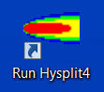
The HYSPLIT model
Mark Cohen, Roland Draxler, Ariel Stein,
Glenn Rolph, Barbara Stunder, Fantine Ngan,
Tianfeng Chai, and Alice Crawford
NOAA Air Resources Laboratory, College Park, MD
Webinar Presentation:
Exposure Science for the 21st Century
13 Aug 2015
Notes:
Major parts of this presentation were originally developed by Roland Draxler and Ariel Stein with contributions from the other researchers in the Transport Modeling Group at NOAA’s Air Resources Laboratory, College Park, Maryland.

Slide 2
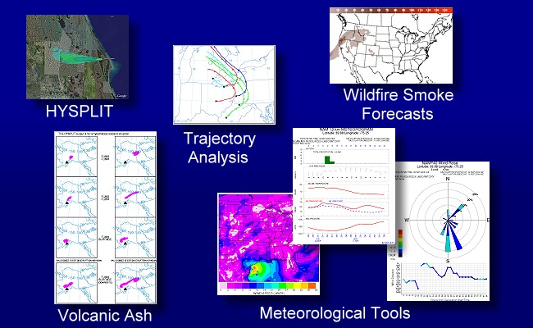
What is the HYSPLIT model?

Slide 3
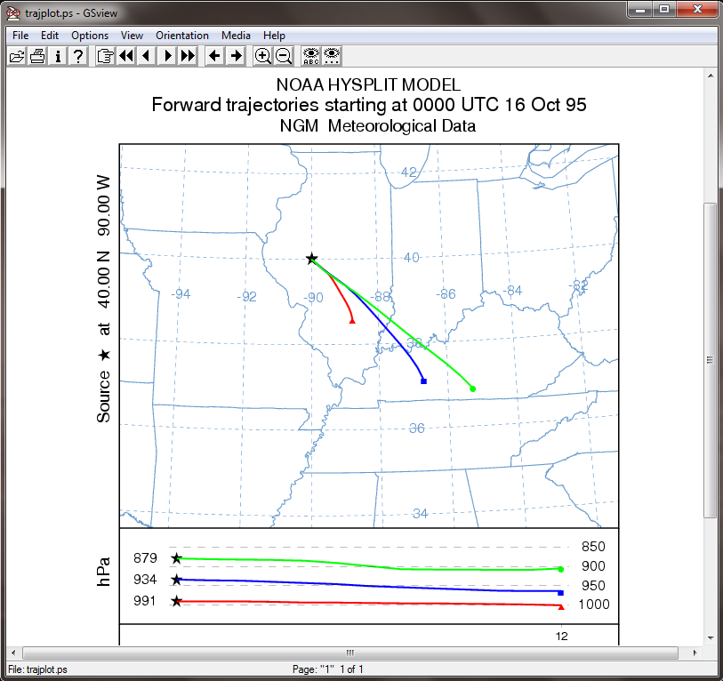
What is the HYSPLIT model?
Air Parcel Trajectory Model
Why do you want to run trajectories?
Back-trajectories can tell you "where" the wind came from that arrived at any given time at any given location – commonly used to help interpret measurement data
Forward trajectories can show you the center line of the plume from any atmospheric emissions source

Slide 4
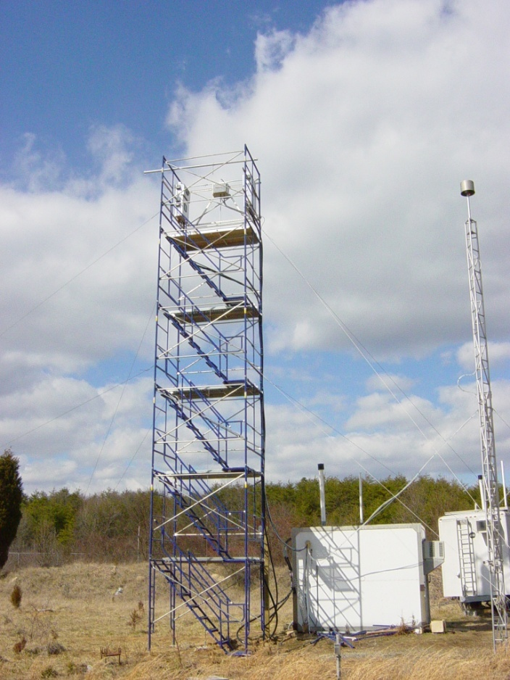
Back Trajectory Analysis – Episodes
Beltsville, Maryland
mercury site
Reactive Gaseous Mercury episode
Notes:
Sometimes we see high peaks of RGM and/or other mercury compounds.
Can we explain what is happening during these episodes? Why was the concentration so high?
Ultimately we want and need to be able to explain the continuous record of measurements at the site, but sometimes it is useful to focus on episodes.

Slide 5
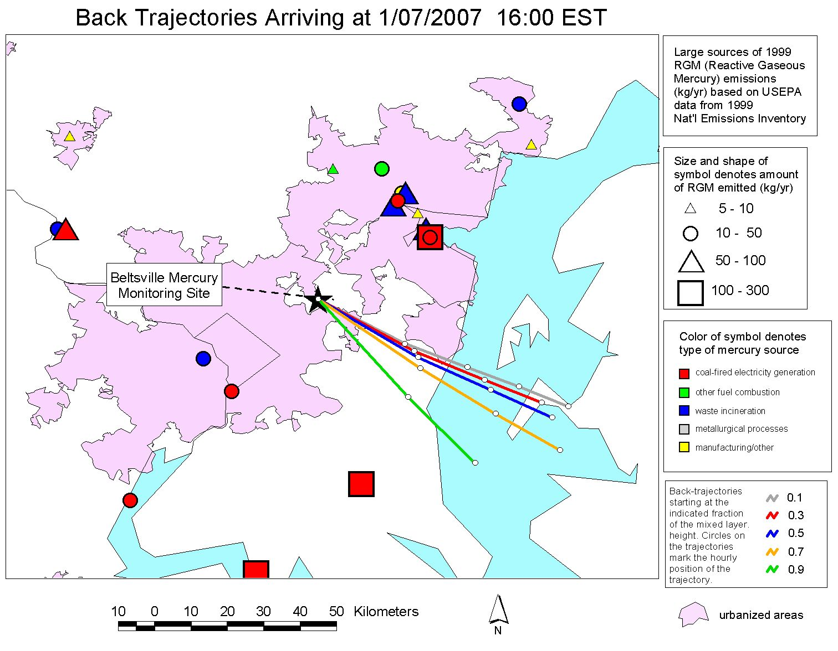
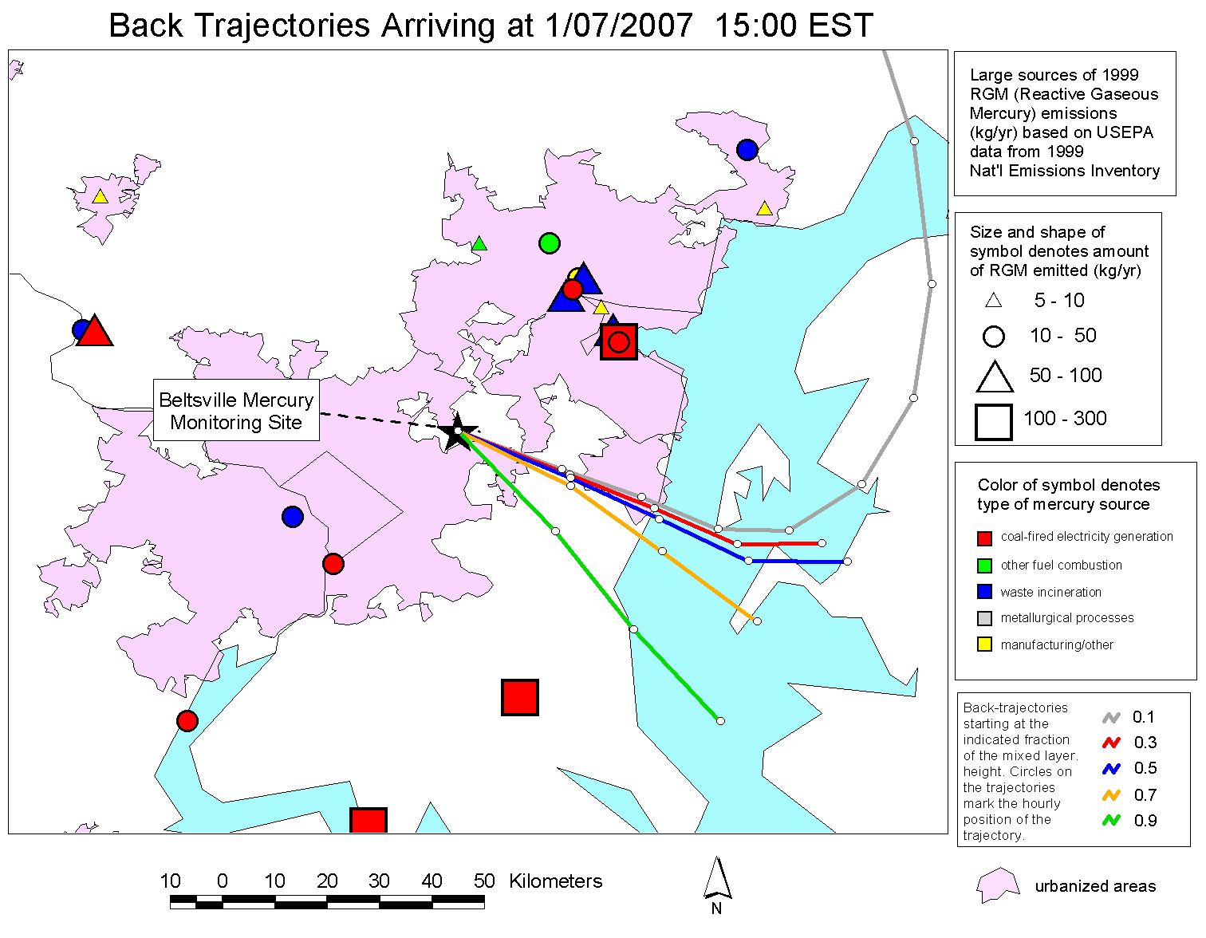
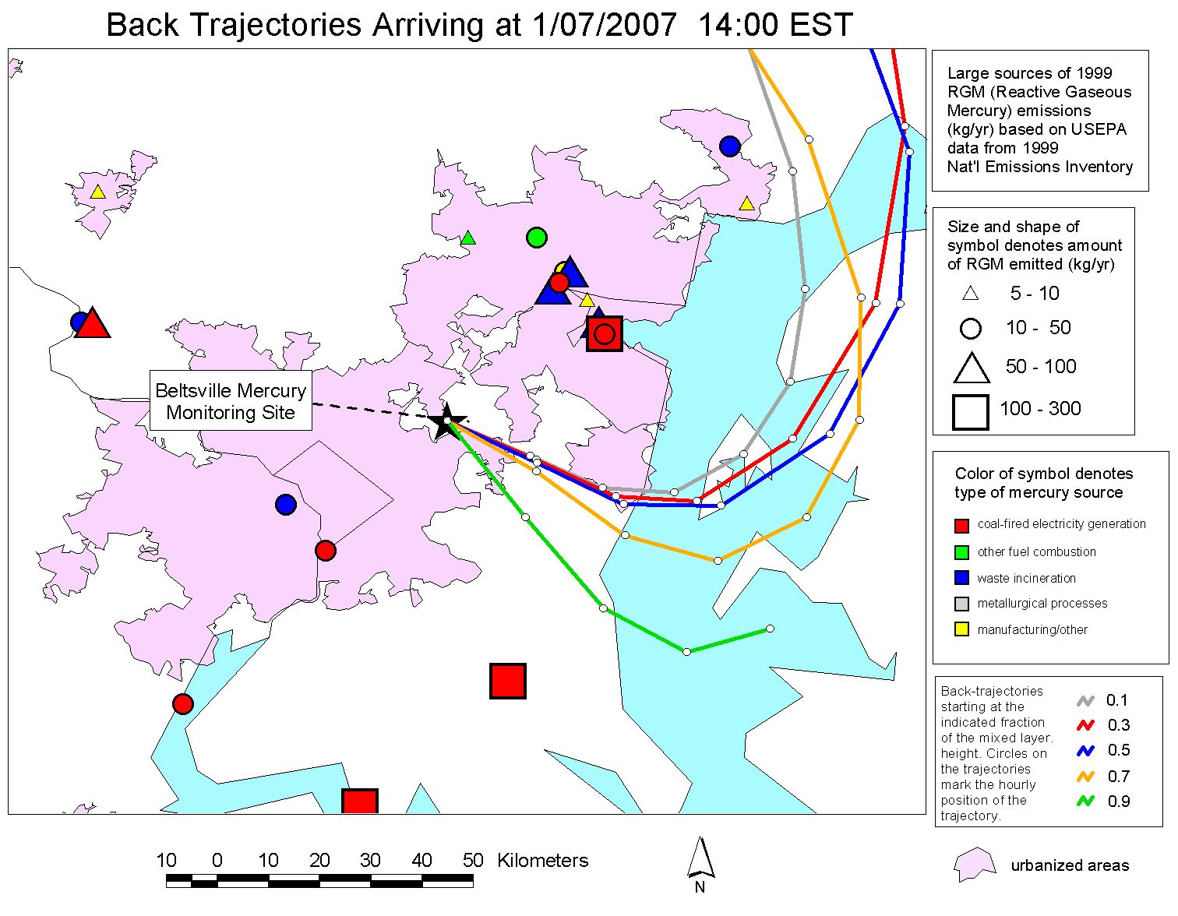
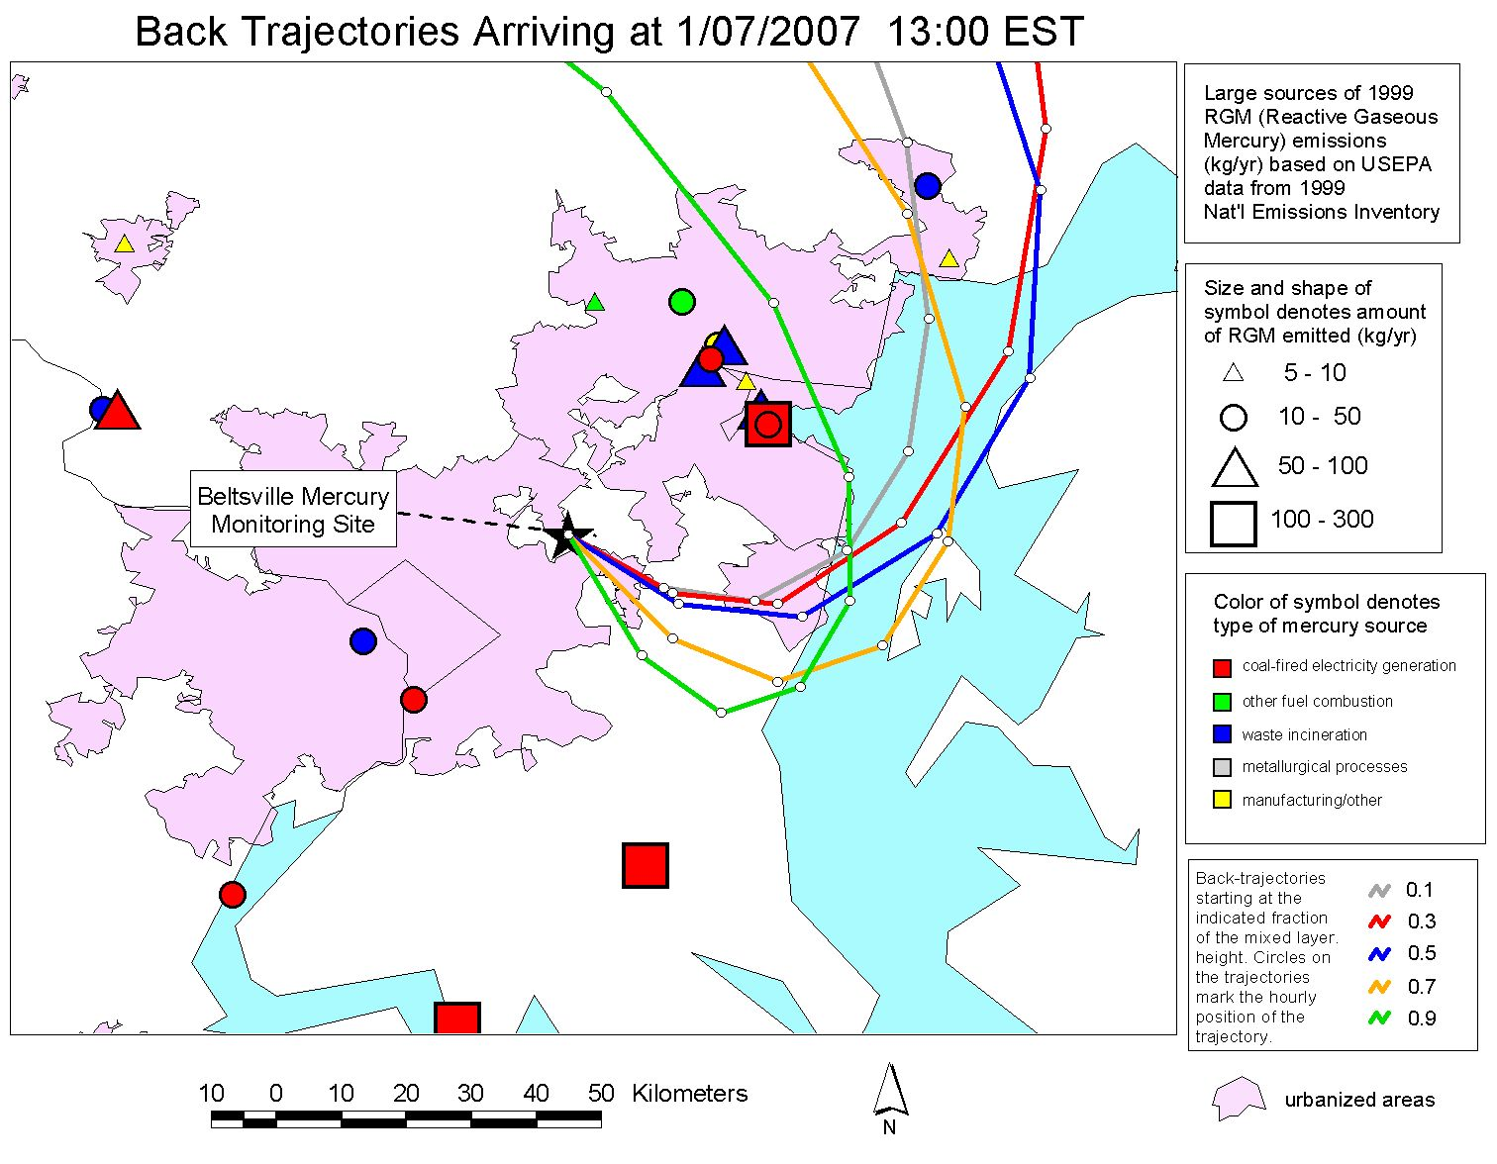
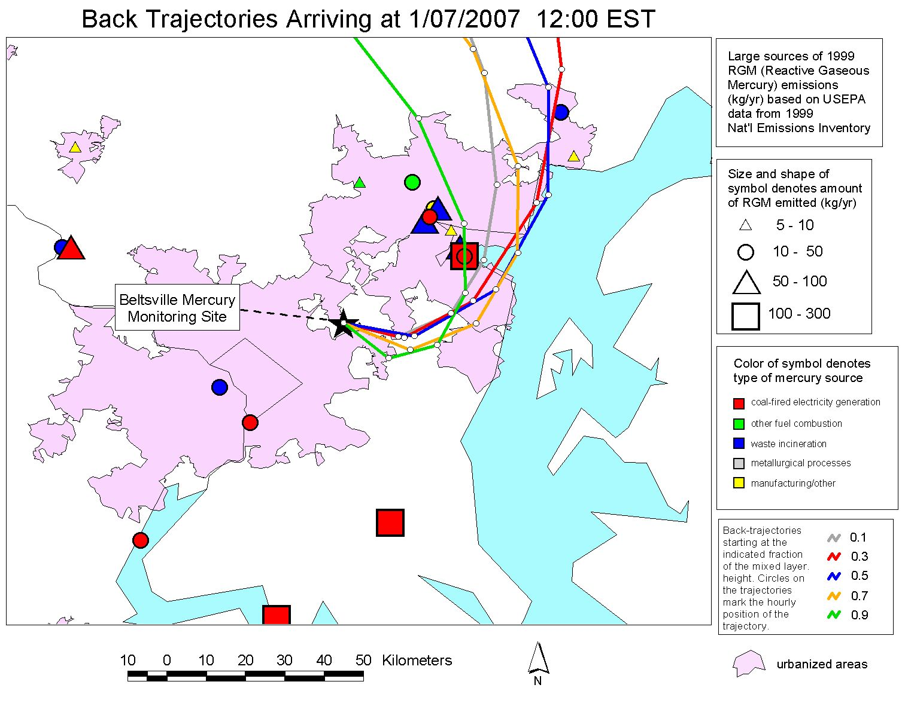
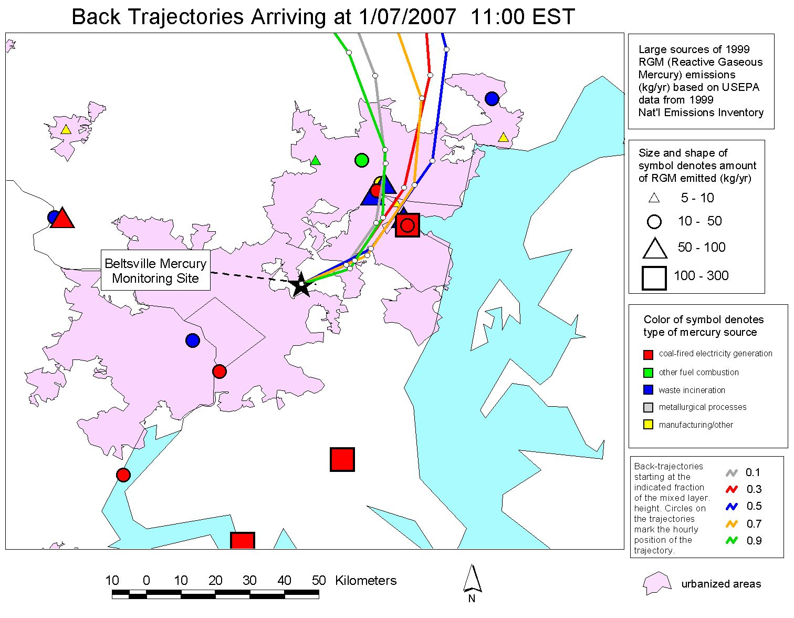

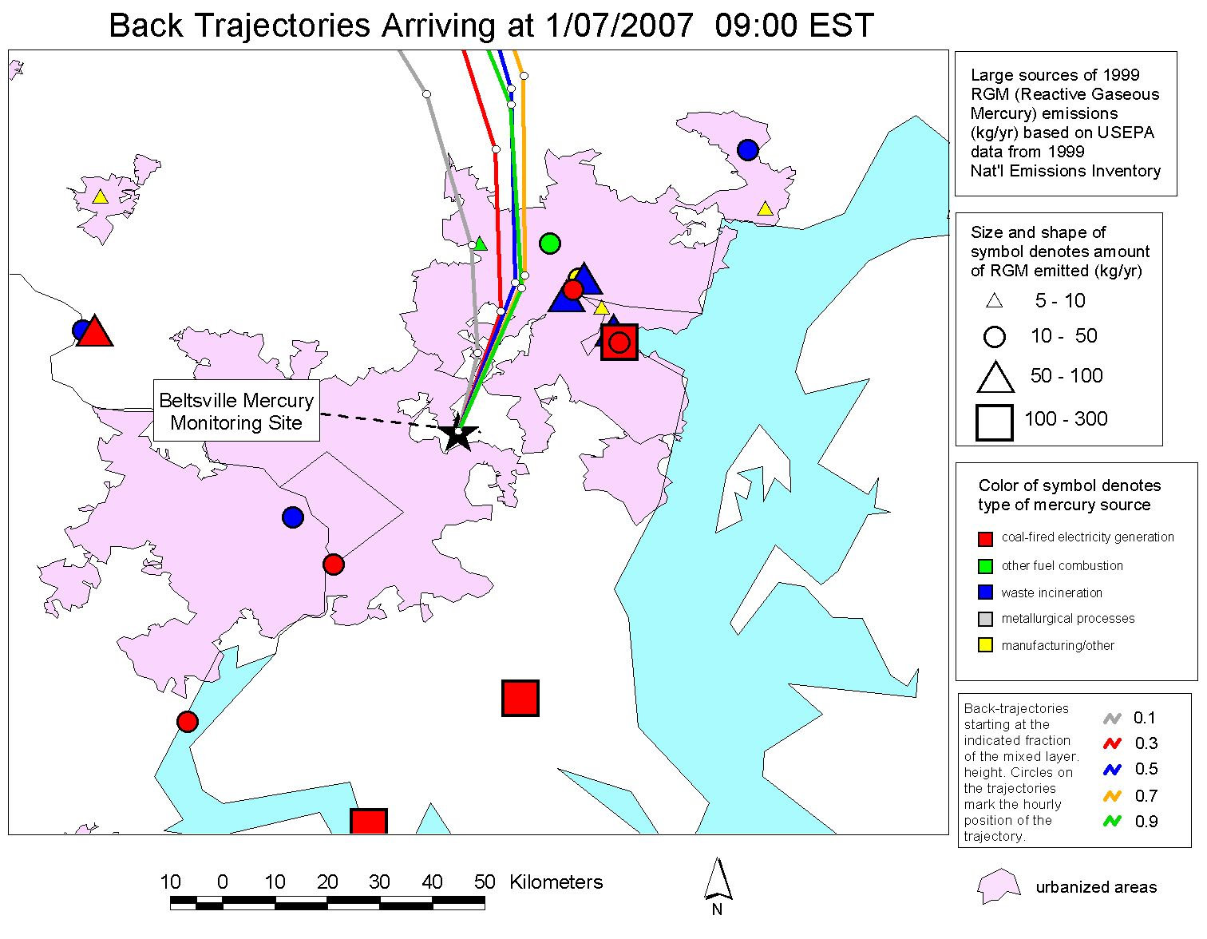
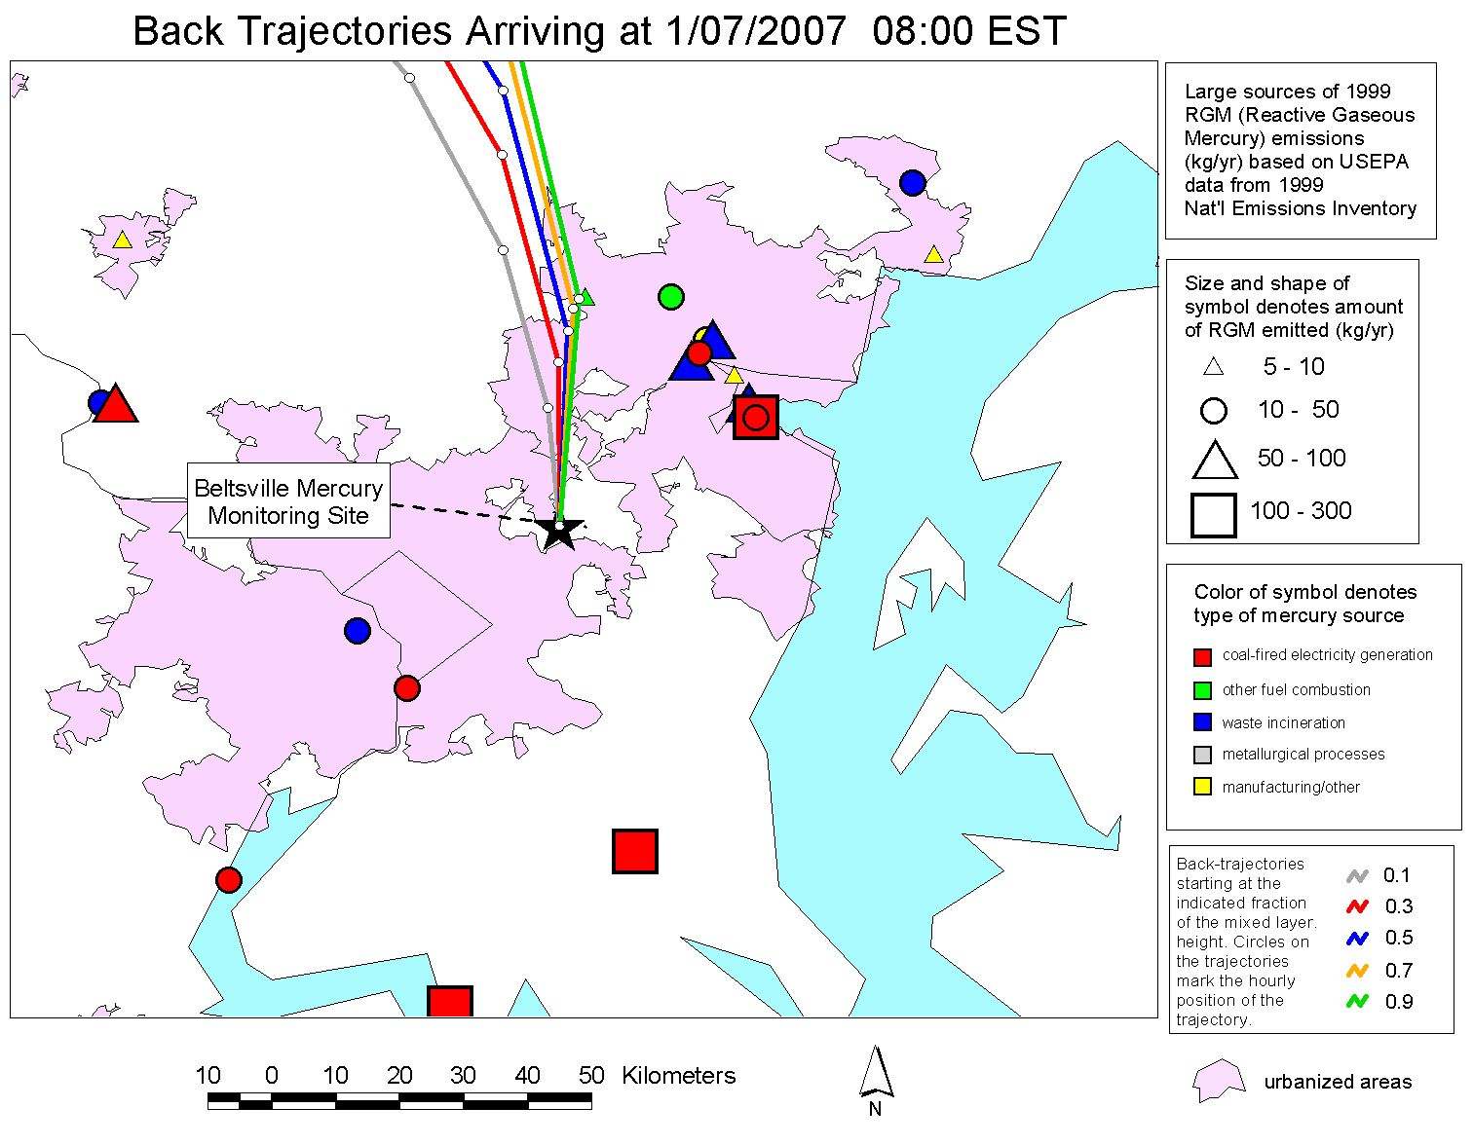
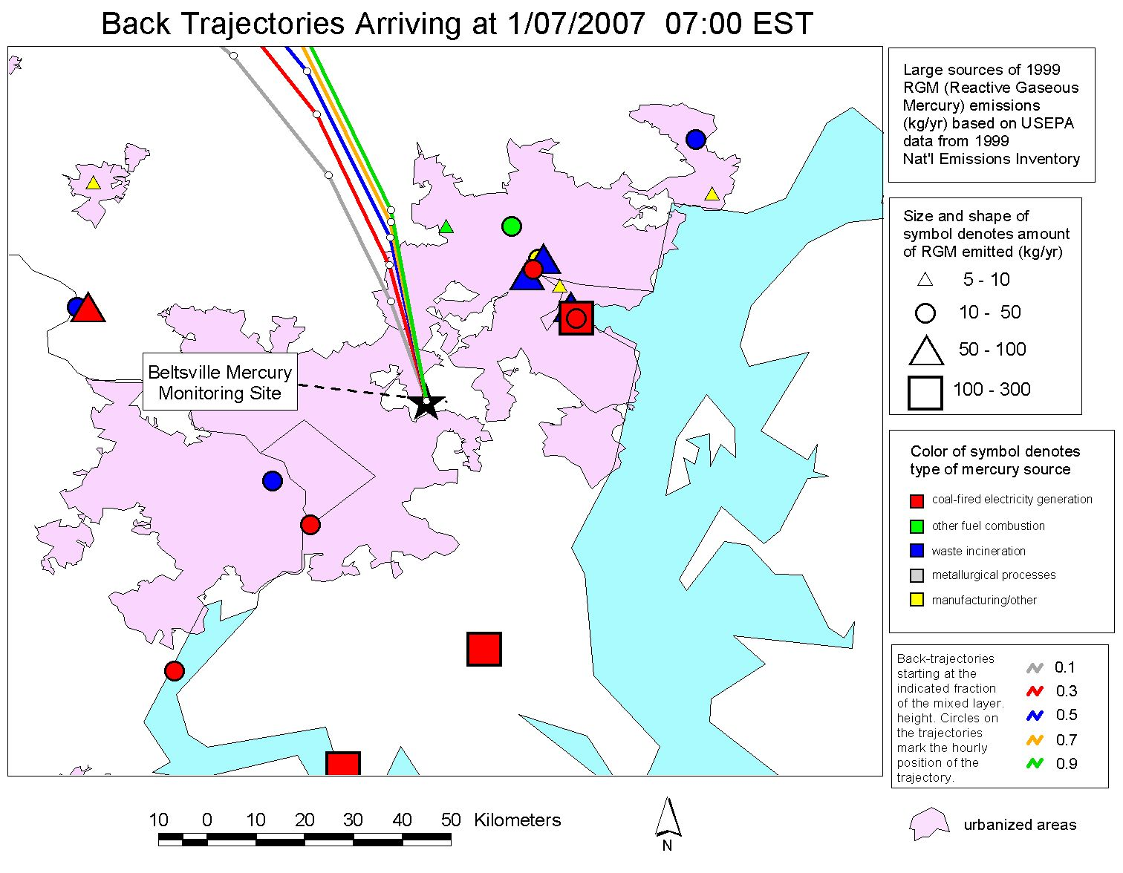
Baltimore
Chesapeake Bay
Washington D.C.
Notes:
When the concentration was high, the air masses appeared to be from a group of significant sources in the Baltimore region northeast of the site.
We have MANY examples of this kind of analysis.
This kind of analysis does not prove that the sources impacted the site and caused the episode, but it is suggestive.
Coupled with other information, this can contribute to a weight-of-evidence approach.

Slide 6
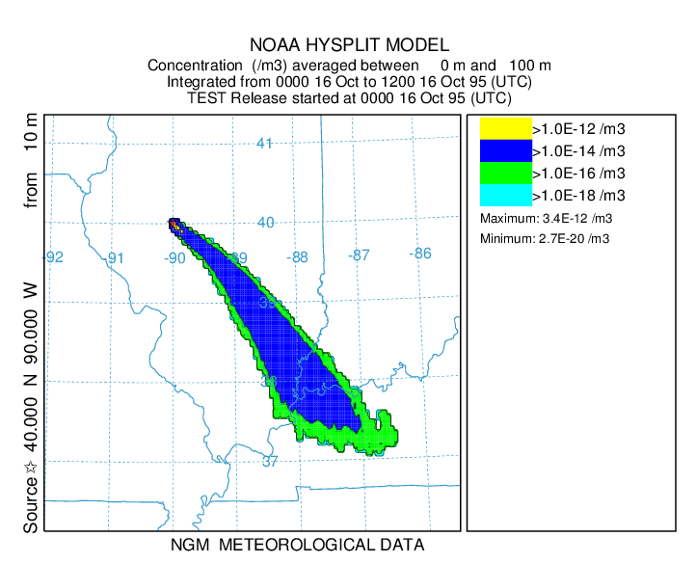
What is the HYSPLIT model?
also an Atmospheric Fate and Transport Model
Simulates the 3-D dispersion of materials emitted to the air
Can also simulate:
Wet and Dry Deposition
Chemical Transformations
Radioactive Decay

Slide 7
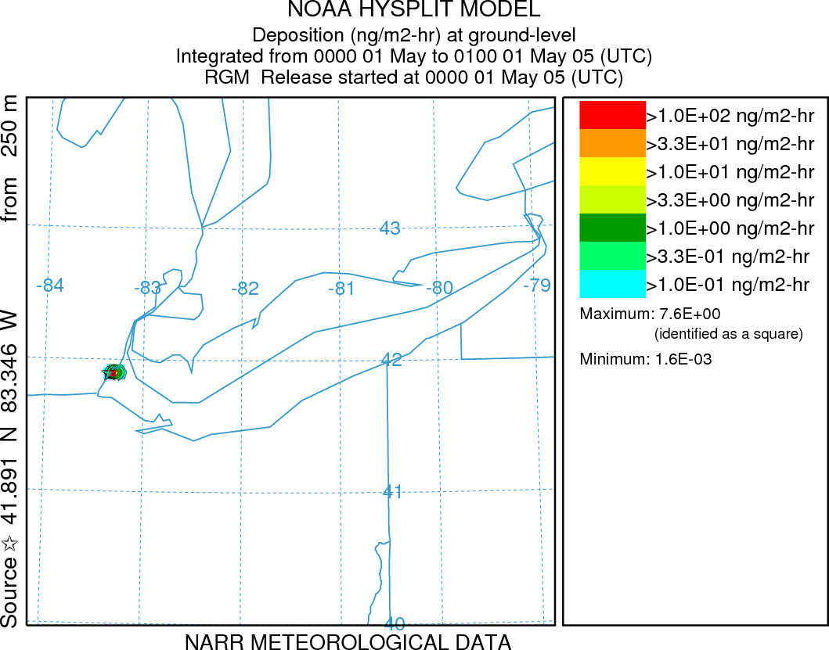
Simulation of atmospheric mercury deposition from Gaseous Oxidized Mercury (GOM) emissions from one power plant on the shore of Lake Erie:
hourly deposition estimates for the first two weeks in May 2005
Lake Erie
Results scaled to actual GOM emissions of 43.6 g/hr
1 ng/m2-hr = 8.8 ug/m2-yr
(if it persisted the entire year)
Total deposition to Lake Erie is ~20 ug/m2-yr
Notes:
RGM emissions from Monroe plant are 43.61 g/hr according to the 2005 NEI
Elem emissions are 16.44 g/hr, Hgpt emissions are 3.9 g/hr, and total emissions are 64.04 g/hr
Monroe 2005 NEI:
Elem 144.00 kg/yr
RGM 382.00 kg/yr
Hgpt 34.20 kg/yr
Total Hg 561.00 kg/yr

Slide 8
What is the HYSPLIT model?
Dispersion Modes
3-D Lagrangian computational point "particles", transported and dispersed via turbulence
3-D Lagrangian "puffs", representing a cloud of the above "particles", transported and "grown" via turbulence
Eulerian Grid

Slide 9

When puffs grow to sizes large relative to the meteorological data grid, they split, horizontally and/or vertically
To simulate the global transport of mercury, puffs are transferred to Eulerian grid after a specified time downwind (~3 weeks), and the mercury is simulated on that grid from then on…
This is how we model the local & regional impacts.
But for global modeling,
puff splitting overwhelms
computational resources
Puffs of pollutant are emitted and dispersed downwind
Atmospheric chemistry and deposition simulated for each puff
9
Notes:
Incorporation of the mercury modeling algorithms into the new GEM-HYSPLIT code was a large scientific programming task.

Slide 10
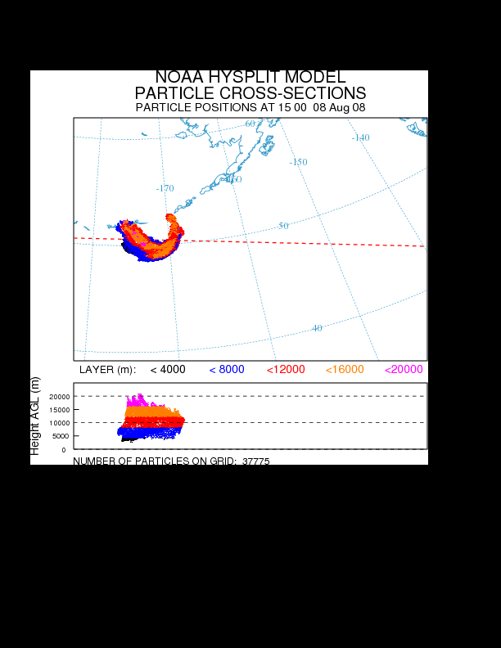
What is the HYSPLIT model?
ALSO: a suite of pre- and post-processing graphics and statistical programs, including visualization via Google Earth
Kasatochi volcanic eruption, Aleutian Islands,
August 2008
Notes:
NOAA HYSPLIT forecast with source term constructed from satellite retrievals.

Slide 11
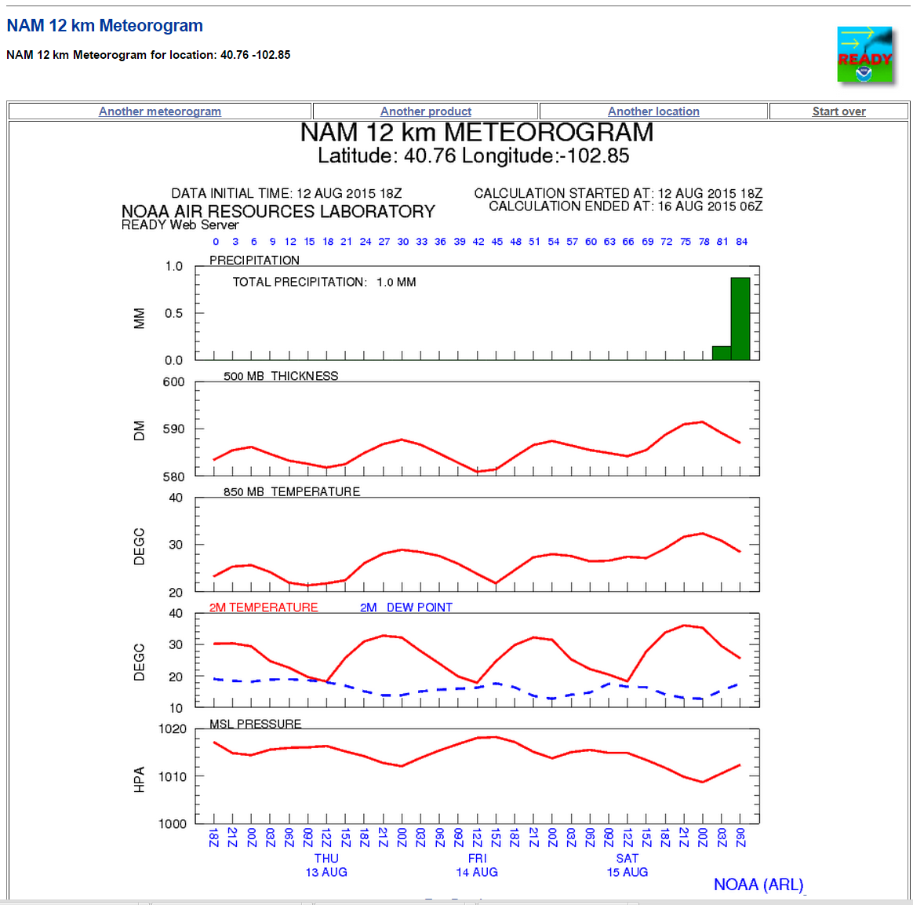
What is the HYSPLIT model?
Also: a suite of meteorological data conversion, analysis, and visualization tools

Slide 12
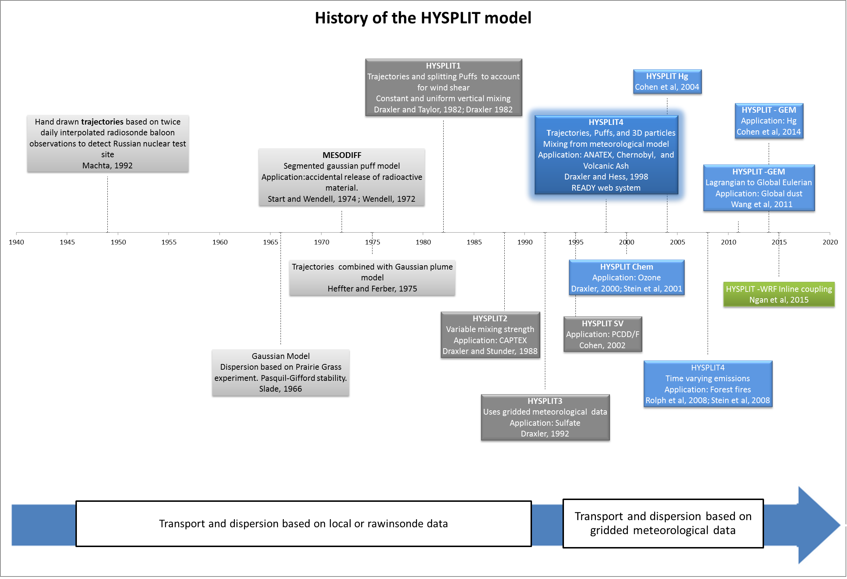
NOAA’s HYSPLIT atmospheric transport and dispersion modeling system
Stein, A.F., Draxler, R.R., Rolph, G.D, Stunder, B.J.B., Cohen, M.D., and Ngan, F.
Bulletin of the American Meteorological Society, 2015, in press.
http://journals.ametsoc.org/doi/abs/10.1175/BAMS-D-14-00110.1
1940
1950
1960
1970
1980
1990
2000
2010
2020
HYSPLIT can do more than just back-trajectories
Notes:
Although similar developments were taking place elsewhere in the world, the U.K. in particular, within NOAA, the early development of computerized numerical methods to compute transport and dispersion in a time-varying wind field (in contrast to steady-state Gaussian plume models) started at ARL’s field division in Idaho that supported the emergency operations center at what was called at the time the National Reactor Testing Station. The MESODIFF model interpolated winds and temperatures from a network of towers over the test site to compute the transport of a series of sequentially released puffs that grow with time to estimate the dispersion. Later this approach was expanded to more regional applications at ARL Headquarters by Heffter and Ferber (1975) by using the data from the weather observing rawindsonde network. This model was then restructured to more realistically simulate the diurnal variations in mixing and the resulting differences in dispersion due to the effects of wind shear especially during stable conditions, modeled by the use of splitting puffs that would each transport with their own wind vector rather than a layer-average wind. This prototype modeling approach became HYSPLIT. Subsequent versions incorporated more sophisticated mixing schemes, gridded meteorological data, and improvements in mixing and turbulence parameterizations. The prime focus in the last ten years has been to apply the model to a variety of different applications.

Slide 13
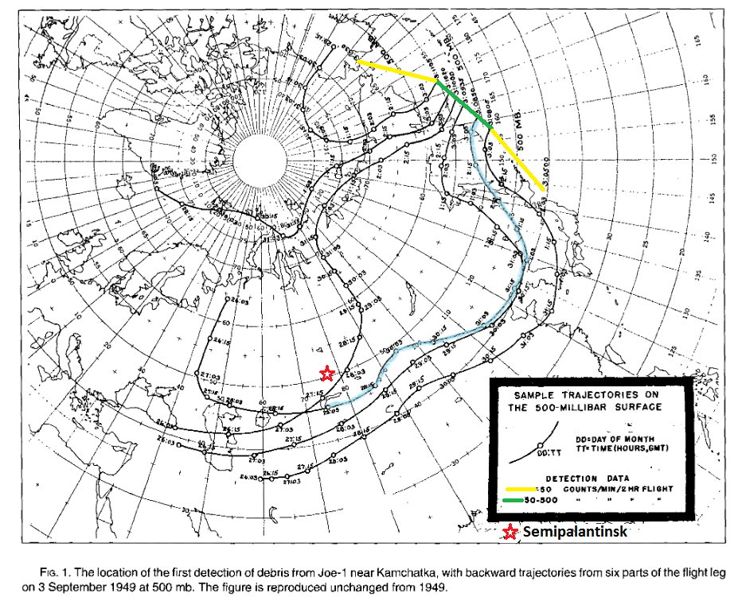
Hand drawn trajectories: 1949
Machta, 1992 BAMS
Notes:
The scientific foundation and inspiration for HYSPLIT’s trajectory capabilities can be traced back to 1949, when the Special Project Section (SPS, ARL’s predecessor) of the U.S. Weather Bureau (now NOAA’s National Weather Service [NWS]) was charged with trying to find the source of radioactive debris originating from the first Soviet atomic test and detected by a reconnaissance aircraft (green section of flight path) near the Kamchatka Peninsula. For that purpose, back trajectories were calculated by hand based on wind data derived from twice-daily radiosonde balloon measurements. These trajectories followed 500 mb height isolines assuming a geostrophic wind flow. Although these back trajectories were calculated more than 60 years ago, the percentage error between the calculated (light blue line) and actual source location (red star at Semipalantinsk) relative to the distance covered by the trajectories was remarkably low (about 5%; Machta, 1992) for the trajectory endpoint early on 29 August (detonation time). The exact detonation time was unknown at that time due to the errors in determining the fission product ratios when daughter products were involved. Since then, trajectory calculations, in one form or another, have been one of the backbones of ARL’s research activities (e.g. Angell et al, 1966; 1972; 1976).

Slide 14
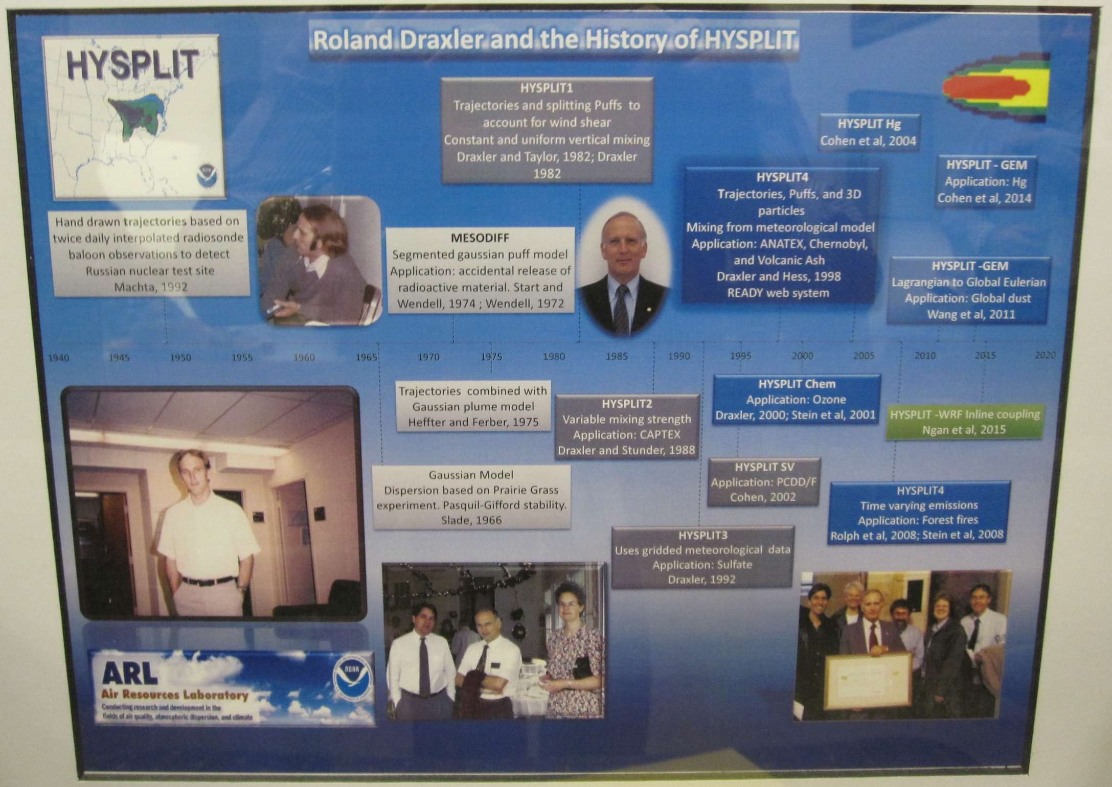
Roland Draxler and the History of HYSPLIT
Machta, 1992 BAMS
Notes:
The scientific foundation and inspiration for HYSPLIT’s trajectory capabilities can be traced back to 1949, when the Special Project Section (SPS, ARL’s predecessor) of the U.S. Weather Bureau (now NOAA’s National Weather Service [NWS]) was charged with trying to find the source of radioactive debris originating from the first Soviet atomic test and detected by a reconnaissance aircraft (green section of flight path) near the Kamchatka Peninsula. For that purpose, back trajectories were calculated by hand based on wind data derived from twice-daily radiosonde balloon measurements. These trajectories followed 500 mb height isolines assuming a geostrophic wind flow. Although these back trajectories were calculated more than 60 years ago, the percentage error between the calculated (light blue line) and actual source location (red star at Semipalantinsk) relative to the distance covered by the trajectories was remarkably low (about 5%; Machta, 1992) for the trajectory endpoint early on 29 August (detonation time). The exact detonation time was unknown at that time due to the errors in determining the fission product ratios when daughter products were involved. Since then, trajectory calculations, in one form or another, have been one of the backbones of ARL’s research activities (e.g. Angell et al, 1966; 1972; 1976).

Slide 15
Meteorological data drives the HYSPLIT model
HYSPLIT uses specially formatted meteorological data to estimate the transport and dispersion of atmospheric constituents
Both Forecast and Archived met data can be used
NOAA Air Resources Laboratory converts meteorological model ouputs (e.g., from NOAA weather models) to this HYSPLIT format, and makes them avaialble freely via the web
Numerous North American and Global datasets (primarily NOAA-based) are available to run HYSPLIT
The HYSPLIT suite also includes conversion programs to convert other meteorological model output to the correct format (WRF, ECMWF, MM5, RAMS, etc.)

Slide 16
Meteorological data drives the HYSPLIT model
HYSPLIT-Format Met Model Output Dataset | Spatial Resolution (km) (approximate) | Domain | Full-grid dimensions | Temporal resolution | Vertical Levels | Period of each full-grid HYSPLIT format files | HYSPLIT format file-size for one month
EDAS | 40 | North America | 185 x 129 | 3 hrs | 27 | ½ month | 1.2 GB
NARR | 32 |  | 309 x 237 | 3 hrs | 24 | 1 month | 2.9 GB
NAM12 | 12 |  | 614 x 428 | 3 hrs | 27 | 1 day | 133 GB
Global Reanalysis | 278 | Global | 144 x 73 | 6 hrs | 18 | 1 month | 0.11 GB
GDAS 1 degree | 111 |  | 360 x 181 | 3 hrs | 24 | 1 week | 2.5 GB
GDAS 0.5 degree | 55 |  | 720 x 361 | 3 hrs | 56 | 1 day | 212 GB

Slide 17
How can the HYSPLIT model be used?
Online, via the READY website
Can download the entire model to your local computer – Windows, Mac, or Linux – and run the model locally
  Graphical User Interface
  from the Command Line
  Scripts
To use Forecast Meteorological data, you have to be a registered user

Slide 18
Running
HYSPLIT
On-Line

Slide 19
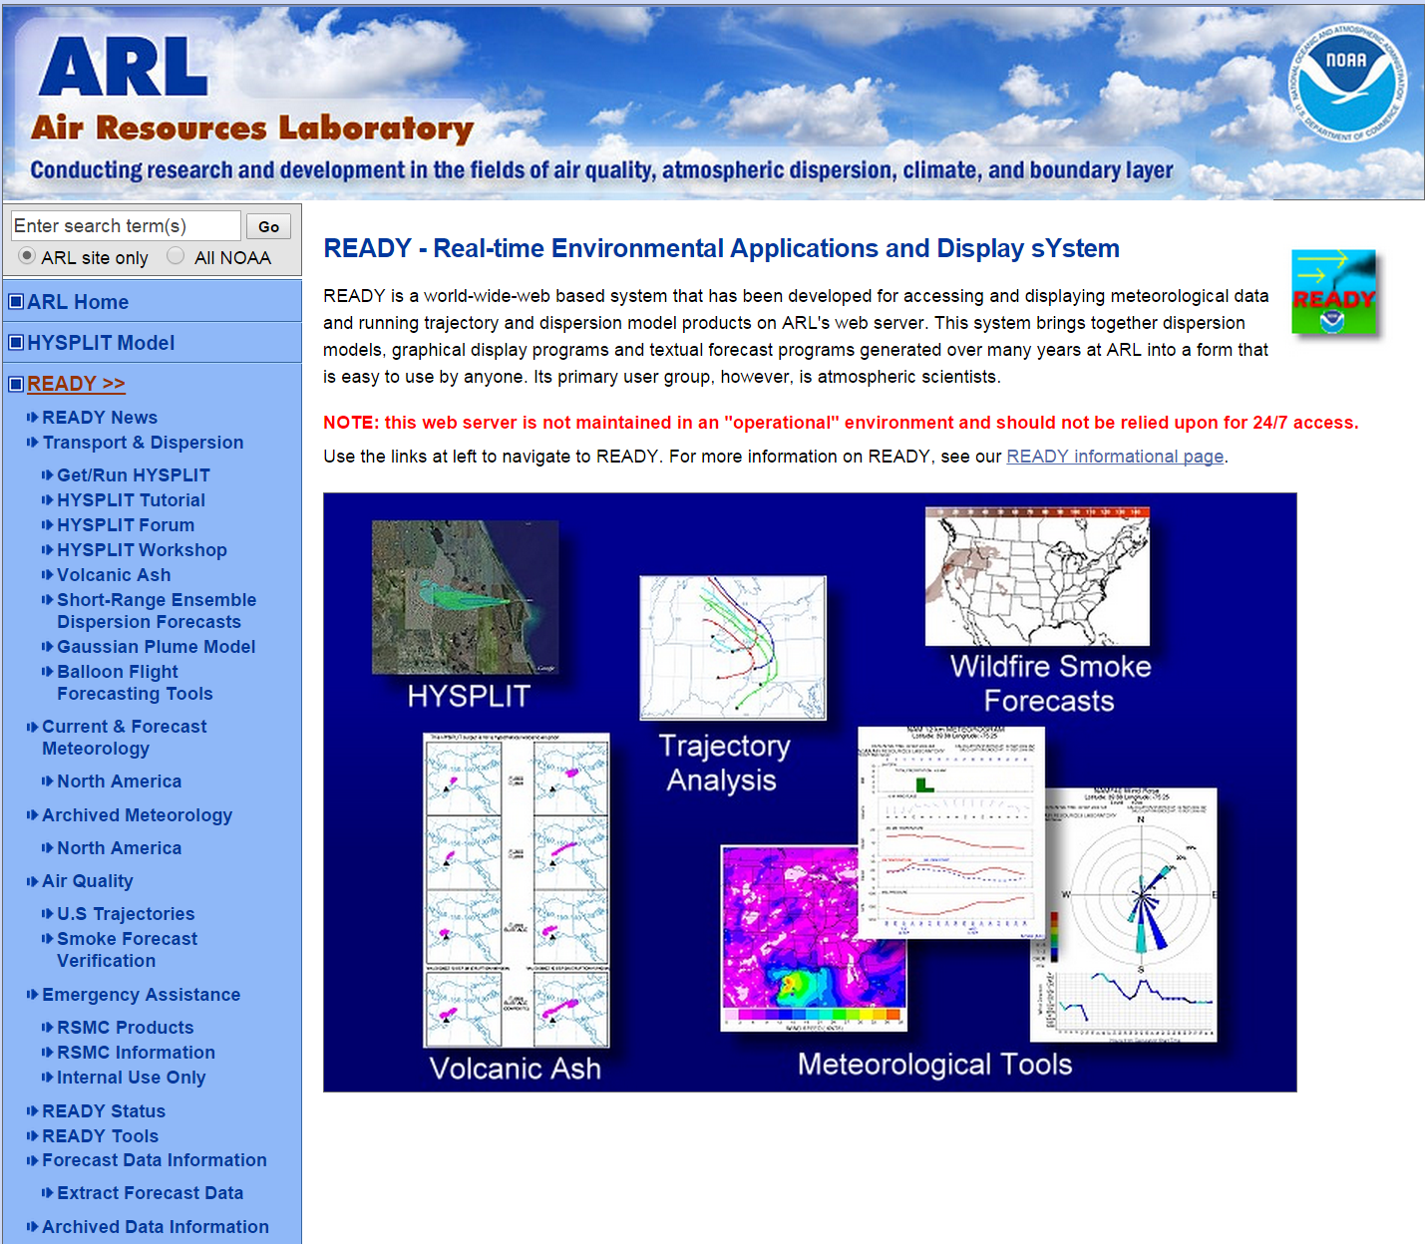
Running HYSPLIT On-Line
https://www.ready.noaa.gov/

Slide 20
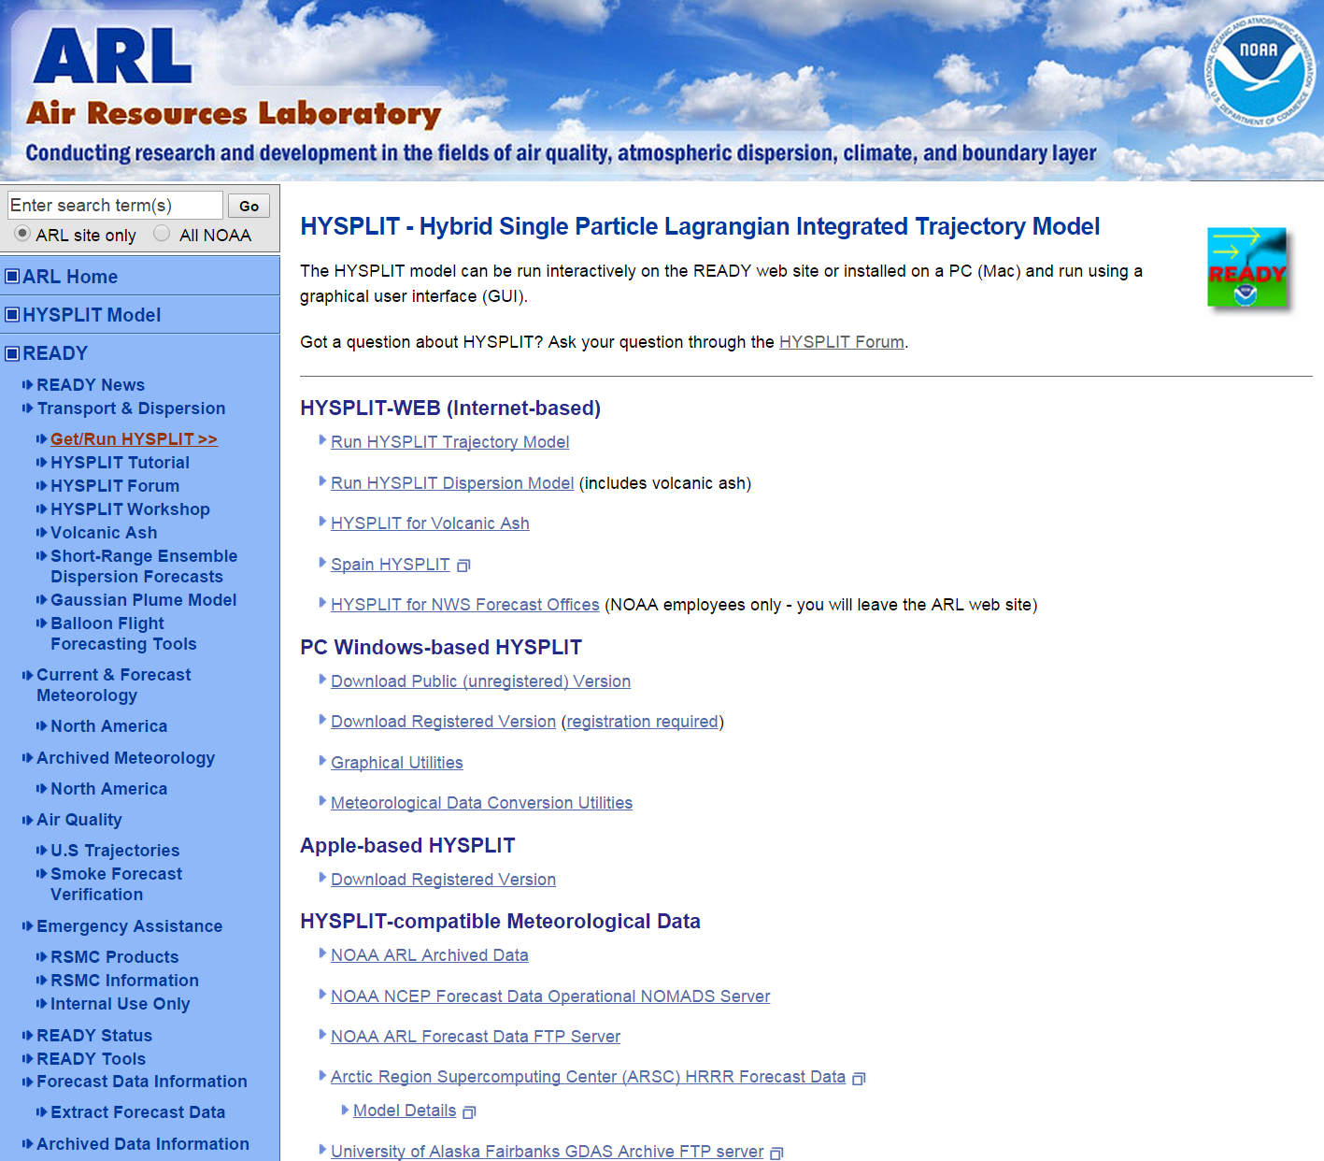
Running HYSPLIT On-Line
https://www.ready.noaa.gov/HYSPLIT.php

Slide 21
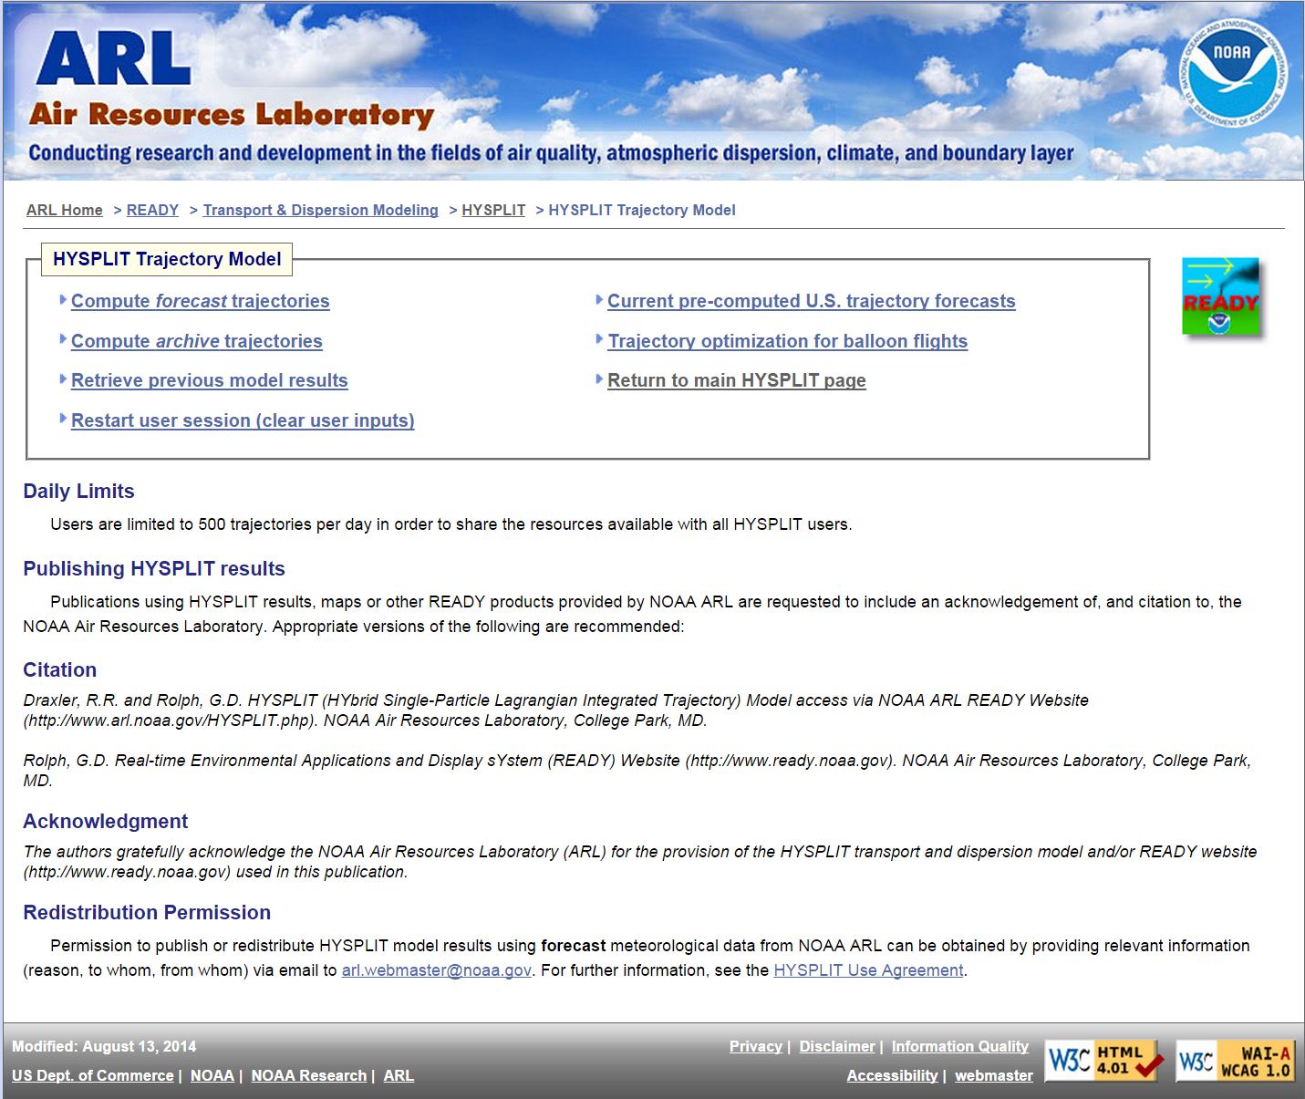
Running HYSPLIT On-Line
https://www.ready.noaa.gov/HYSPLIT_traj.php

Slide 22
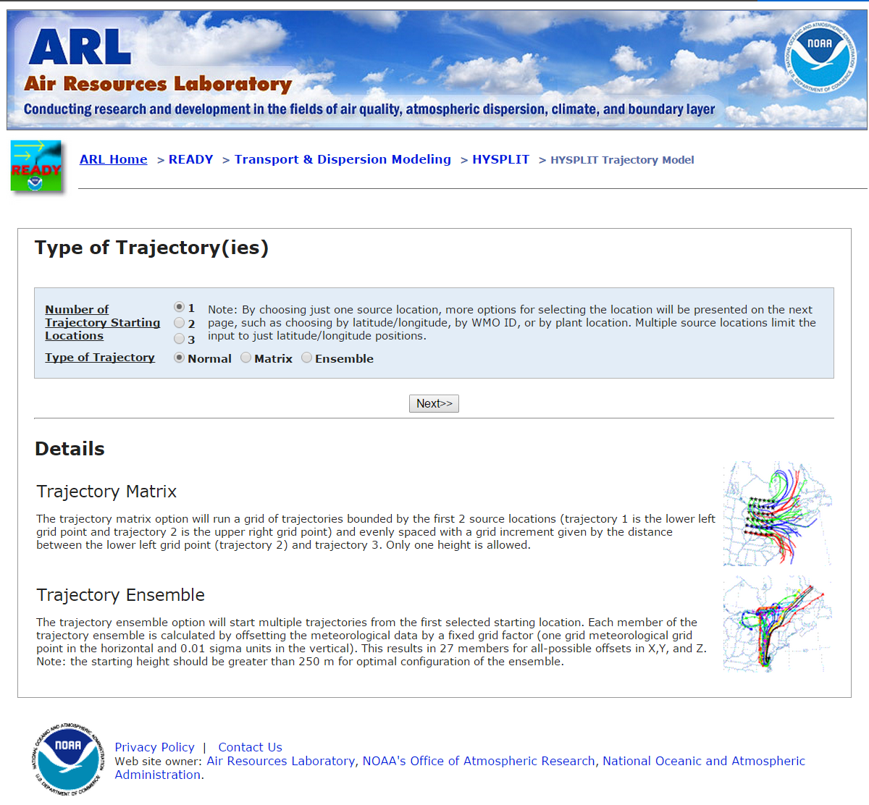
Running HYSPLIT On-Line

Slide 23
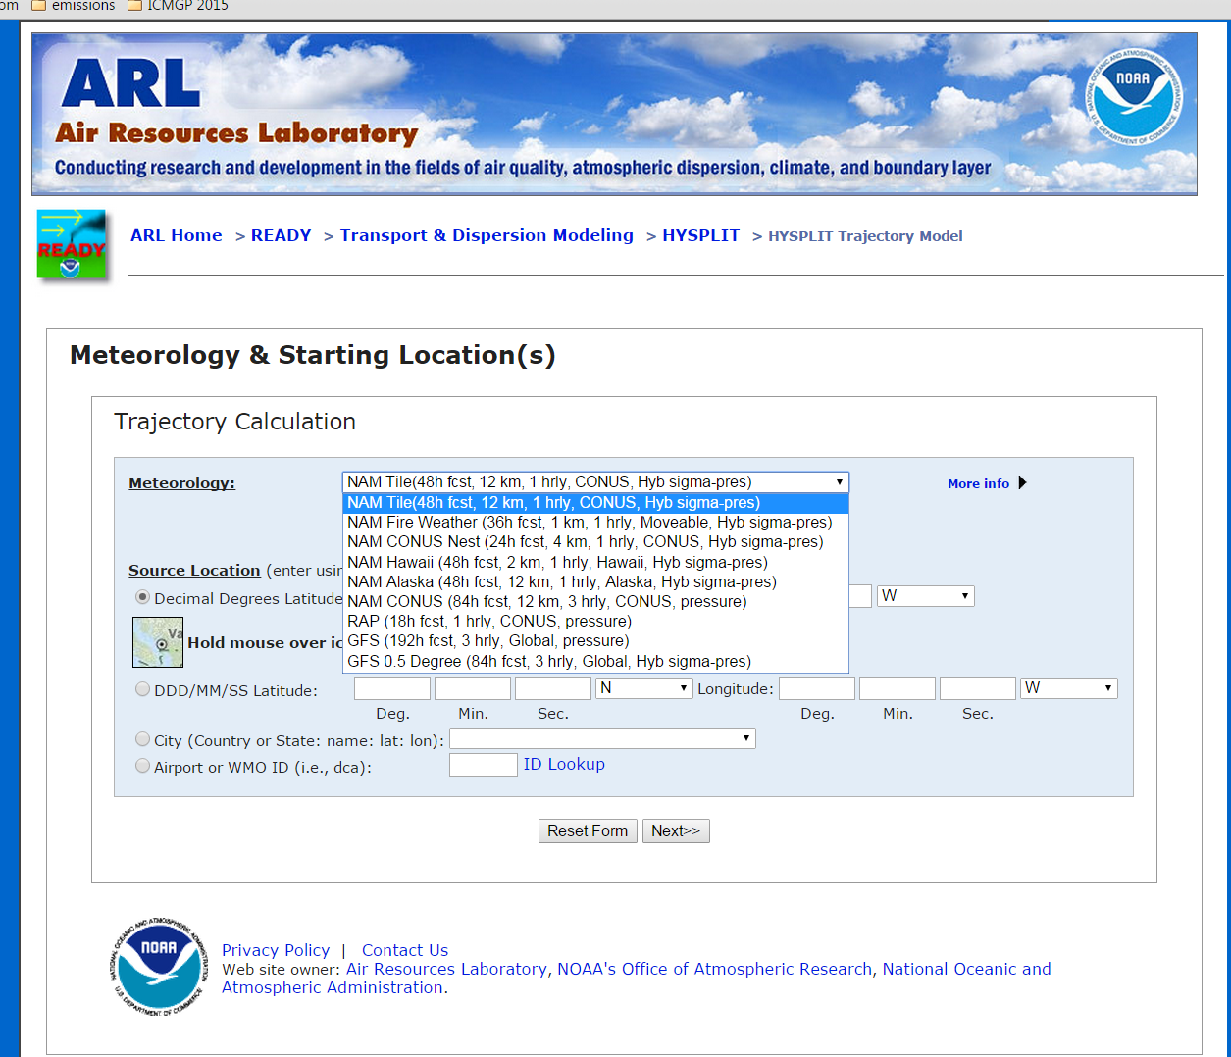
Running HYSPLIT On-Line

Slide 24
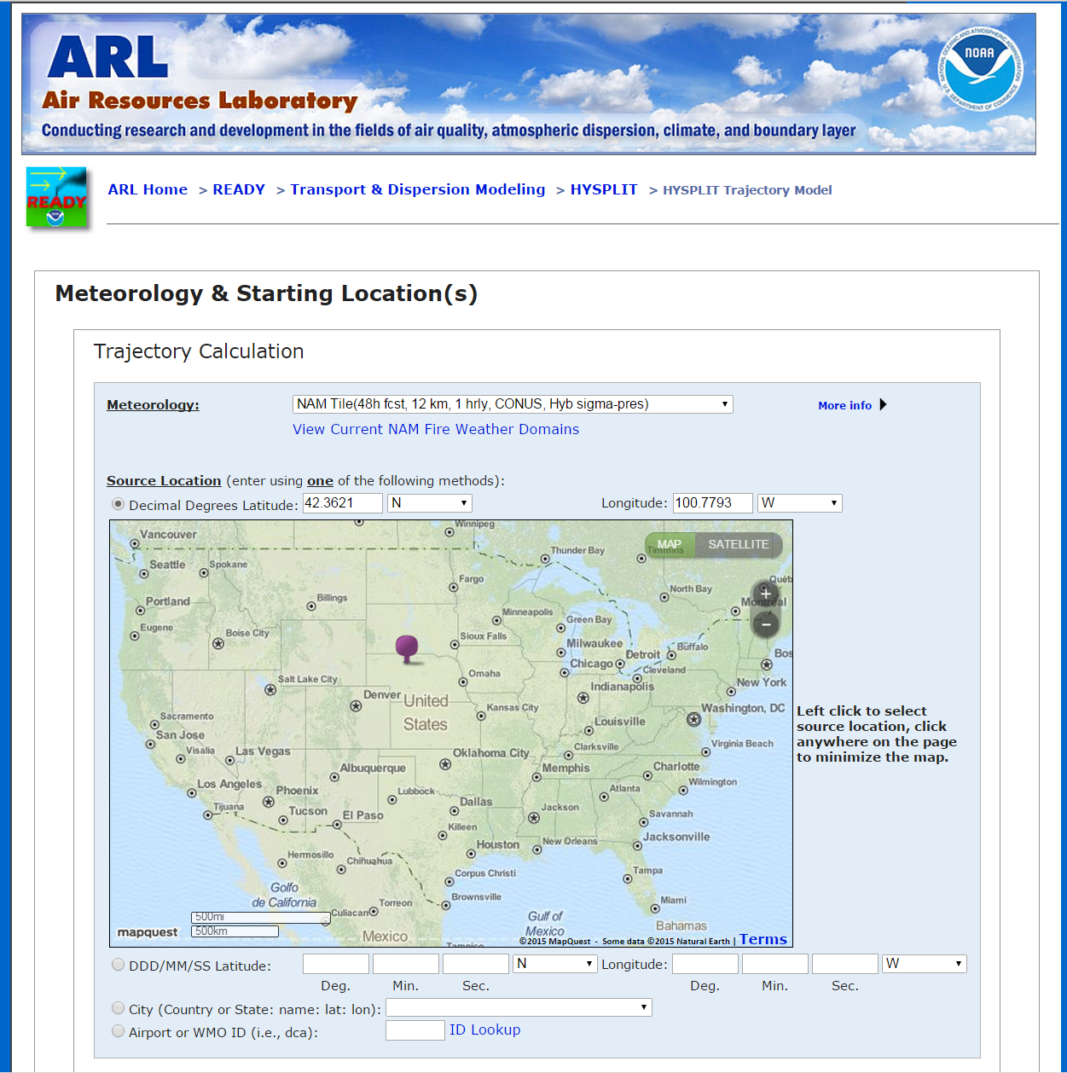
Running HYSPLIT On-Line

Slide 25
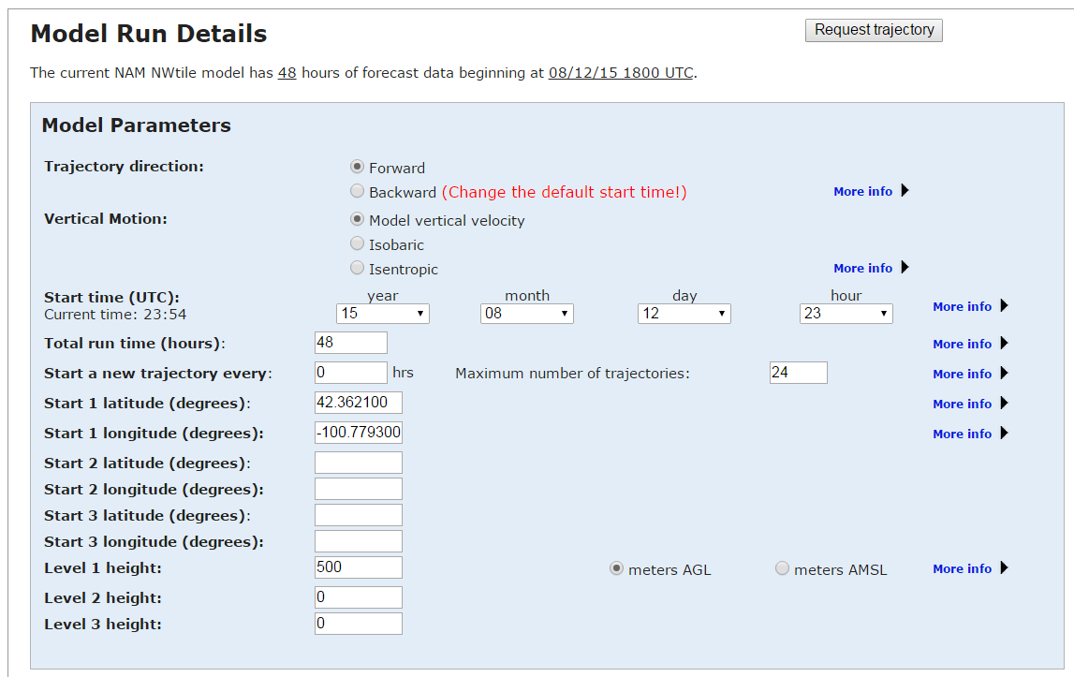
Running HYSPLIT On-Line

Slide 26
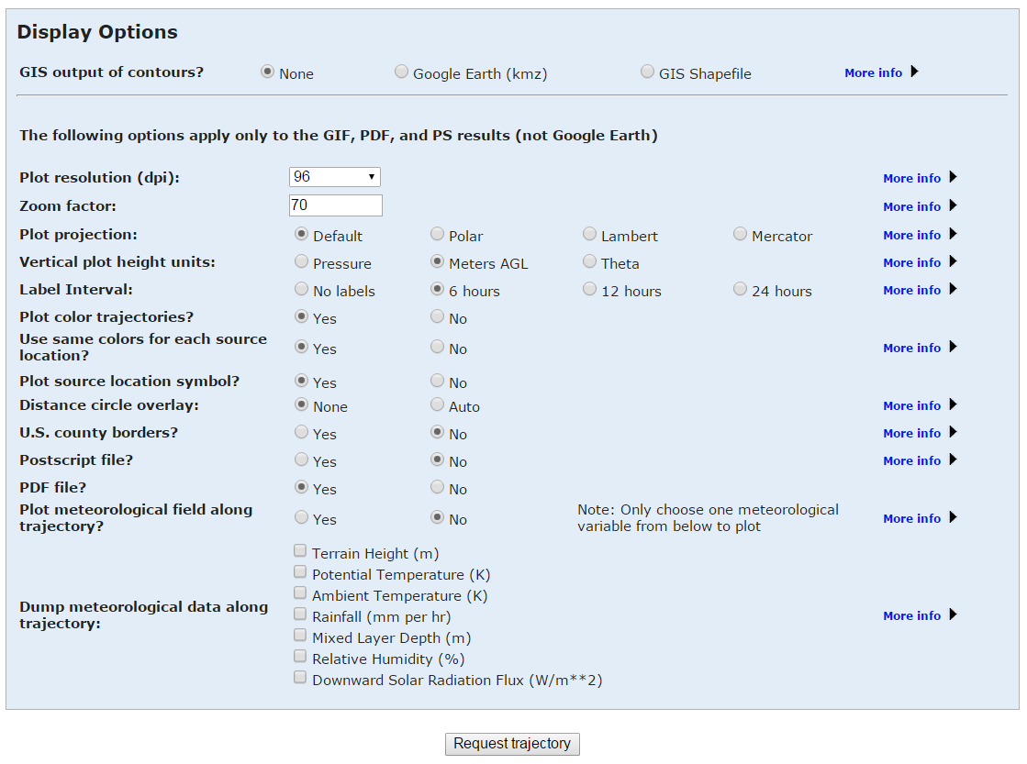
Running HYSPLIT On-Line

Slide 27
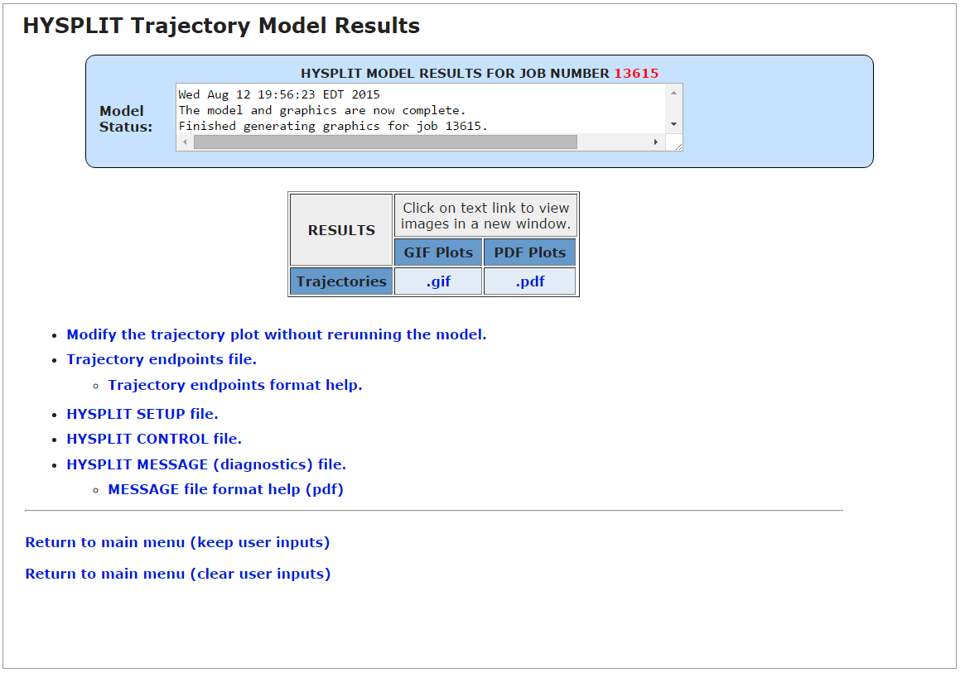
Running HYSPLIT On-Line

Slide 28
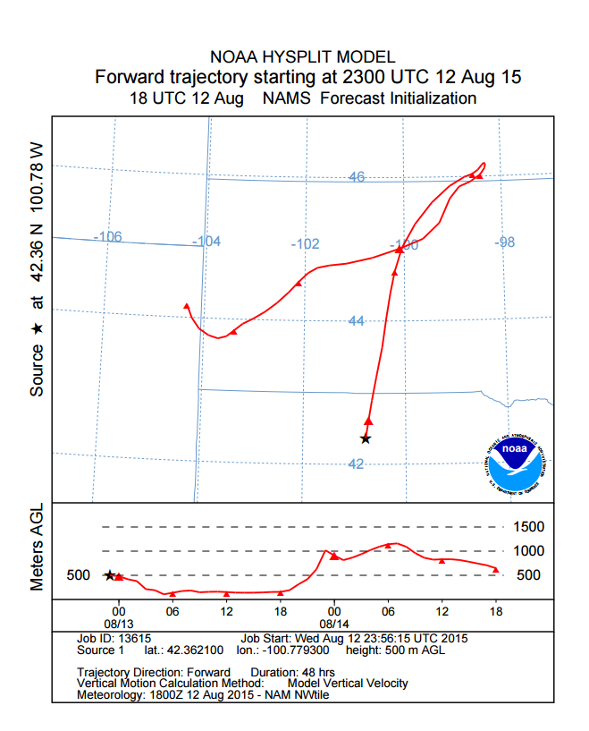
Running HYSPLIT On-Line

Slide 29
Running HYSPLIT On-Line
https://www.ready.noaa.gov/HYSPLIT.php
Am not going to show any examples of this today

Slide 30
Running HYSPLIT On-Line
https://www.ready.noaa.gov/HYSPLIT.php

Slide 31
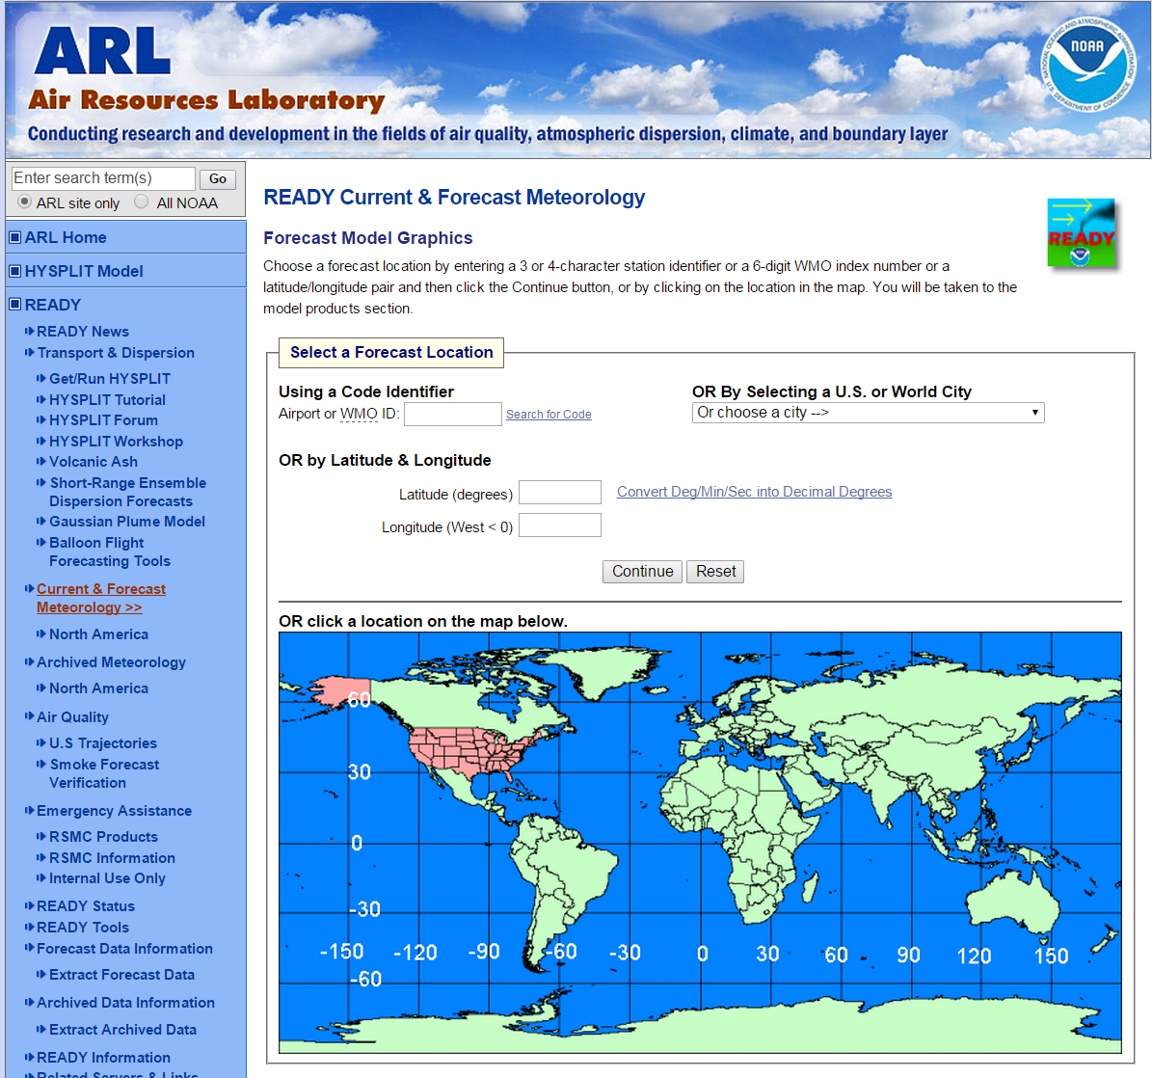
Running HYSPLIT On-Line

Slide 32
Running HYSPLIT On-Line

Slide 33
More than a million simulations were run with HYSPLIT on-line in 2014!

Slide 34
Downloading and running HYSPLIT on your local computer using the Graphical User Interface ("GUI")

Slide 35
Downloading and Running HYSPLIT Locally
https://www.ready.noaa.gov/HYSPLIT.php

Slide 36
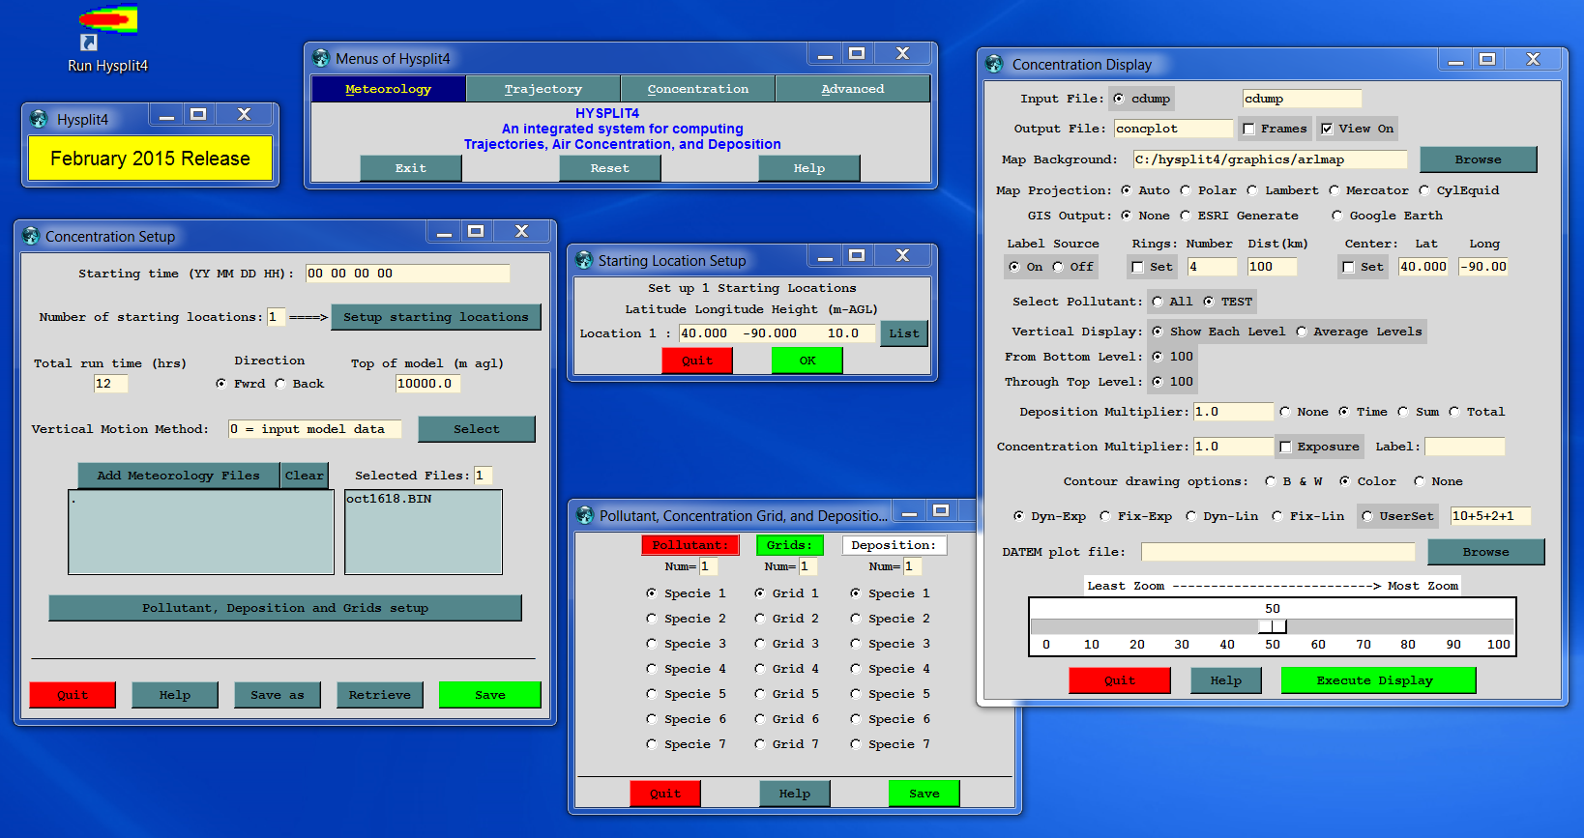
Downloading and Running HYSPLIT Locally
Using the Graphical User Interface

Slide 37
Downloading and Running HYSPLIT Locally
Using the Command Line
C:\hysplit4\working>..\exec\trajplot
USAGE: trajplot -[options (default)]
-a[GIS output: (0)-none 1-GENERATE_points 3-KML 4-partial_KML 5-GENERATE_lines]
-A[KML options: 0-none 1-no extra overlays 2-no endpoints 3-Both 1&2]
-e[End hour to plot: #, (all) ]
-f[Frames: (0)-all files on one 1-one per file]
-g[Circle overlay: ( )-auto, #circ(4), #circ:dist_km]
-h[Hold map at center lat-lon: (source point), lat:lon]
-i[Input files: name1+name2+... or +listfile or (tdump)]
-j[Map background file: (arlmap) or shapefiles.<(txt)|process suffix>]
-k[Kolor: 0-B&W, (1)-Color, N:colortraj1,...colortrajN]
1=red,2=blue,3=green,4=cyan,5=magenta,6=yellow,7=olive
-l[Label interval: ... -12, -6, 0, (6), 12, ... hrs
<0=with respect to traj start, >0=synoptic times)]
-L[LatLonLabels: none=0 auto=(1) set=2:value(tenths)]
-m[Map proj: (0)-Auto 1-Polar 2-Lambert 3-Merc 4-CylEqu]
-o[Output file name: (trajplot.ps)]
-p[Process file name suffix: (ps) or process ID]
-s[Symbol at trajectory origin: 0-no (1)-yes]
-v[Vertical: 0-pressure (1)-agl, 2-theta 3-meteo 4-none]
-z[Zoom factor: 0-least zoom, (50), 100-most zoom]
NOTE: leave no space between option and value

Slide 38
Downloading and Running HYSPLIT Locally
@echo off
echo 14 06 04 17 > CONTROL
echo 1 >> CONTROL
echo 39.028 -76.817 0.5 >> CONTROL
echo -24 >> CONTROL
echo 0 >> CONTROL
echo 25000.0 >> CONTROL
echo 2 >> CONTROL
echo C:/hysplit4/metdata/ >> CONTROL
echo nam12.bin >> CONTROL
echo C:/hysplit4/metdata/ >> CONTROL
echo global2p5.bin >> CONTROL
echo ./ >> CONTROL
echo tdump >> CONTROL
echo ^&setup > SETUP.CFG
echo kmsl = 2, >> SETUP.CFG
echo TM_RAIN = 1 >> SETUP.CFG
echo / >> SETUP.CFG
..\exec\hyts_std
..\exec\trajplot –itdump –g0:400 –h39:-77 –l1 –v1 trajplot.ps
Using Scripts
Here is a very simple Windows DOS BATCH script that writes the CONTROL and SETUP.CFG files, runs HYSPLIT, and creates a map.

Slide 39
Comparison of Different Methods of Running HYSPLIT
Method |  | Advantages
On-Line |  | Don't need to download any met data The most user friendly interface Specialized met-data visualization features
Local Computer | Graphical User Interface (GUI) | User-friendly interface More model features available than on-line No computational-resource limits imposed Many specialized post-processing operations built-in (e.g. clustering trajectories, source geolocation, etc.)
 | Command Line | Even more model features available (not all are available on-line or from the GUI)
 | Scripts | Can automate processing of met data, running simulations and post-processing operations, e.g., to carry out a number of runs

Slide 40

Learning How to Use HYSPLIT

Slide 41

Learning How to Use HYSPLIT
Method |  | Learning Methods
On-Line |  | Very intuitive Context-sensitive Help available at every step
Local Computer | Graphical User Interface (GUI) | Context-sensitive Help with every menu User-Guide On-line Tutorial Users Forum - Bulletin Board Workshops
 | Command Line | User-Guide Can type the name of any program and its options will be displayed
 | Scripts | Script examples for all operations in the Tutorial are included in the On-LineTutorial

Slide 42
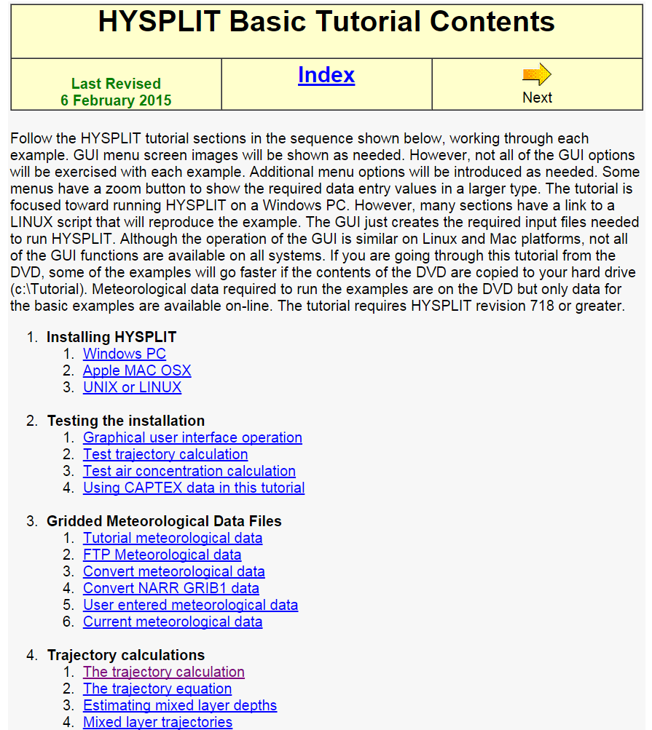
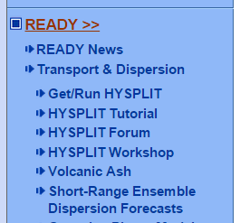

Learning How to Use HYSPLIT
http://www.ready.
noaa.gov/documents /Tutorial/html/ index.html

Slide 43
Model Evaluation: How well does the model really work?

Slide 44
Model Evaluation
Data Archive of Tracer Experiments and Meteorology
Cross Appalachian Tracer Experiment (CAPTEX)
Dayton, OH, and Sudbury, ONT, Sep., Oct., 1983
Atlantic Coast Unique Regional Atmospheric Tracer Experiment (ACURATE), Savannah River Plant, SC, Spring 1982 – Summer 1983
Across North America Tracer Experiment (ANATEX), Glasgow, MT, and St. Cloud, MN, January through March 1987
Oklahoma Tracer Experiment, Norman, OK, July, 08 1980
Metropolitan Tracer Experiment (METREX) , Washington, DC, January – December 1984
European Tracer Experiment (ETEX), Rennes, France, October 23, 1994
Savannah River Plant Experiment , Aiken, SC, Aug. 1975 through Sep. 1977
Atmospheric Studies in Complex Terrain (ASCOT) , California, September 12-25, 1980
Colorado Springs Tracer Experiment (COSTEX), October 18, 21, 23, 2010
Approach
  North American Regional Reanalysis (NARR) and several with WRF runs
  Common statistical evaluation protocols
Accomplishments
  Web access to run HYSPLIT for each experiment
  Standardized model change testing in conjunction with version control
Air Resources Laboratory
44
Notes:
A common theme for decision support is that individual model users need to understand the effects of changing model parameters, meteorological data, and other assumptions. The first step of this process was accomplished some time ago by standardizing the format of each of the ARL-HQ tracer experiments and providing model ready meteorological data for each experiment. This project was called Data Archive of Tracer Experiments and Meteorology (DATEM) and initially provided public anonymous FTP access to all the data files. The experiments available include a wide range of durations and distances: from the urban scale Metropolitan Tracer Experiment (METREX), to the continental scale Across North America Tracer Experiment (ANATEX). More recently, we have updated the web interface, to permit anyone to actually run HYSPLIT against any of the experiments. With the availability of the higher resolution 32-km North American Regional Reanalysis, these simulations become more realistic than what was available previously (2.5 degree data). As part of the web evaluation, a common set of statistical analyses are performed on the results of each simulation. Users can determine the sensitivity of changing model parameters and determine the accuracy of the calculation for experiments that approximate their interests.

Slide 45
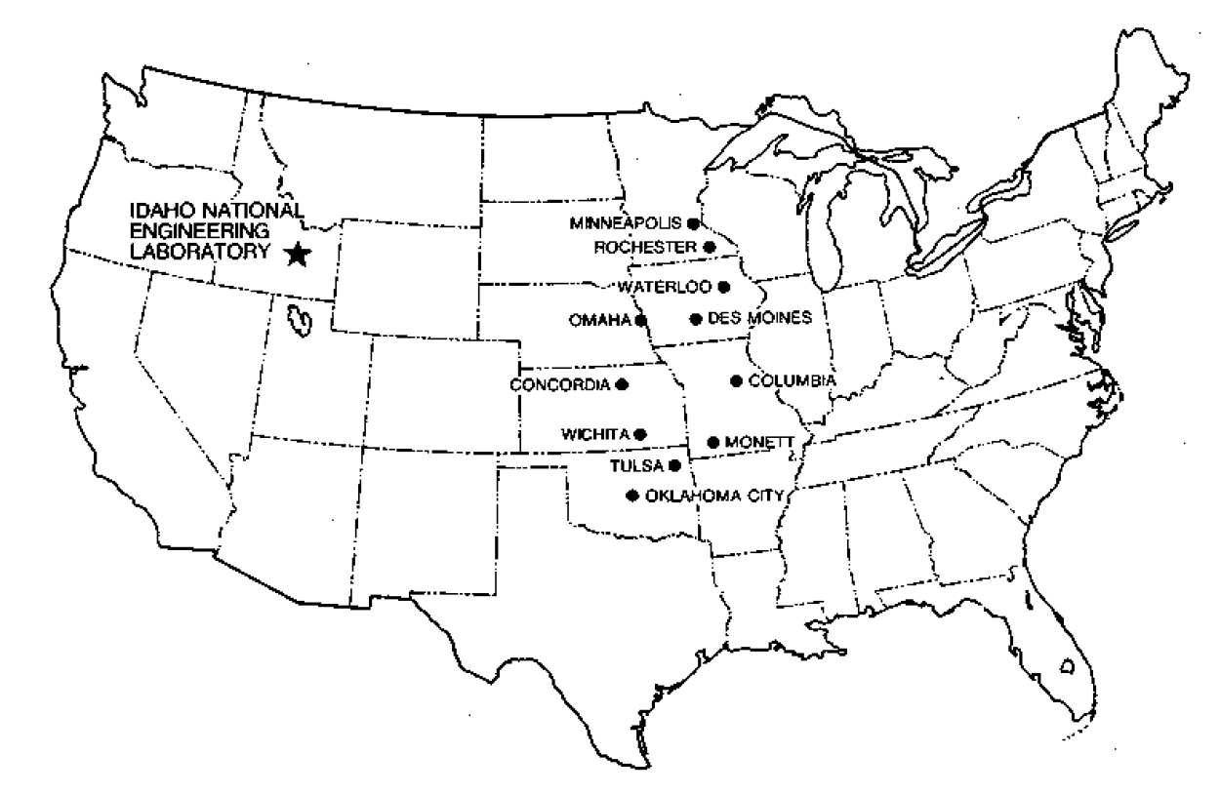
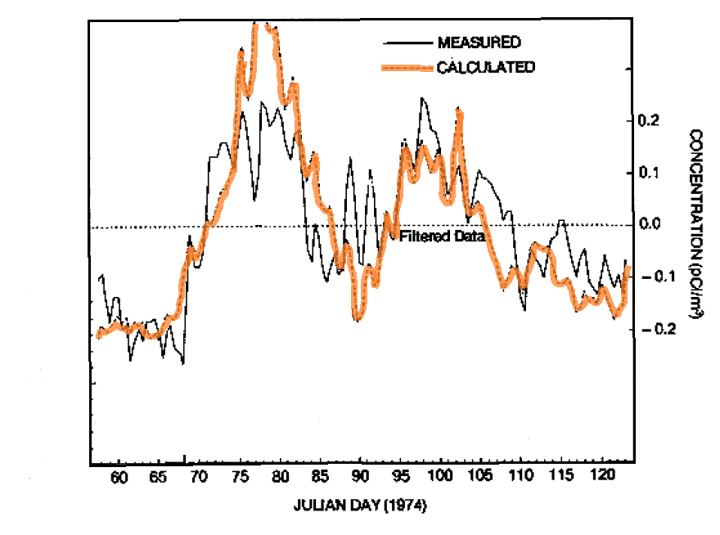
HYSPLIT1: 1500 km Verification
Kr-85 released to the atmosphere and sampled at multiple locations in the Midwestern U.S. during a two-month field experiment
Northern sampling sites showed evidence of local sources
Southern sites (ICT, TUL,OKC) are well correlated with emissions from INEL
Average concentrations: ICT, TUL, OKC
Draxler, 1982 Atmospheric Environment
Notes:
The model was used to simulate Kr-85 released to the atmosphere and sampled at multiple locations in the midwestern U.S. during a two-month field experiment (Draxler, 1982) in 1974. Previous calculations with a single segmented puff model consistently over-predicted air concentrations (by a factor of six). The splitting puff approach showed no bias and good correlation after uncorrelated local sources were removed from the sampling data (filtered data); the lower frequency concentration trends were well captured by the model. Note that the background concentration at that time was about 14 pCi/m³ while the strongest plume signal was only 0.3 pCi/m³. Background concentrations could change by as much as 1 pCi/m³ with a change in air mass.

Slide 46
Model Evaluation
Cross-Appalachian Tracer Experiment (CAPTEX)
A total of six near surface releases of the inert tracer perfluro-monomethylcyclohexane (PMCH) took place between September 18th and October 29th 1983
Dayton, Ohio, USA starting on:
  September 18 at 1700 UTC (CAPTEX #1)
  September 25 at 1700 UTC (CAPTEX #2)
  October 2 at 1900 UTC (CAPTEX #3)
  October 14 at 1600 UTC (CAPTEX #4)
Sudbury, Ontario, Canada starting on:
  October 26 at 0345 UTC (CAPTEX #5)
  October 29 at 0600 UTC (CAPTEX #7)
The releases lasted three hours
Samples were collected at 84 different measurement sites distributed from 300 to 800 km downwind of the emission source.
Samples were collected as either 3- or 6-hour averages up to 60 hours after each release.
CAPTEX #1 to #4 occurred during daytime when vertical mixing was well developed
CAPTEX #5 and #7 releases were at night after the passage of a front associated with strong wind conditions
Notes:
In the last few years, there has been a resurgence in reëvaluating the experimental data from CAPTEX. This is in part due to the recent availability of the North American Regional Reanalysis meteorological data but also the now more common application of mesoscale models such as WRF to generate high-resolution archival meteorological data fields (Hegarty et al., 2013). In addition to ground-based tracer measurements, there were multiple simultaneous aircraft sampling missions, as well as multiple rawindsonde and profiler sites. Furthermore, the data from release #2 are part of the HYSPLIT distribution to permit anyone to evaluate the effect on the model’s performance when changing simulation parameters.
Hegarty, J., R.R. Draxler, A.F. Stein, J. Brioude, M. Mountain, J. Eluszkiewicz, T. Nehrkorn, F. Ngan, A. Andrews, 2013, Evaluation of Lagrangian Particle Dispersion Models with Measurements from Controlled Tracer Releases, Journal of Applied Meteorology and Climatology, 52, No. 12, 2623-2637, DOI: 10.1175/JAMC-D-13-0125.1

Slide 47
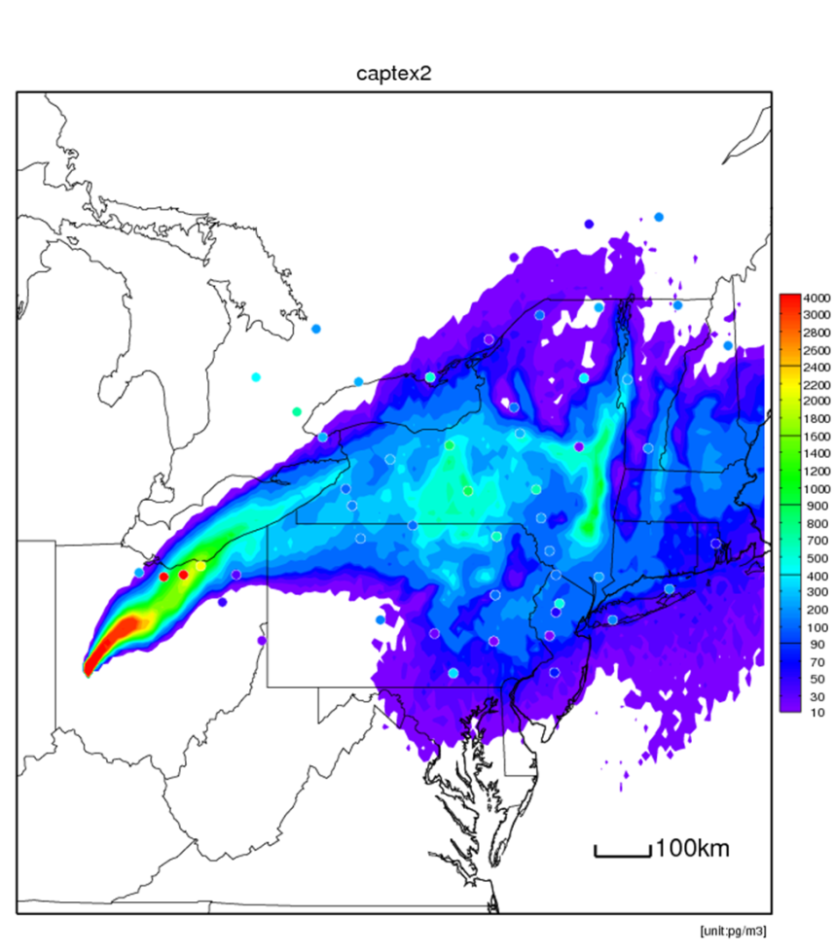
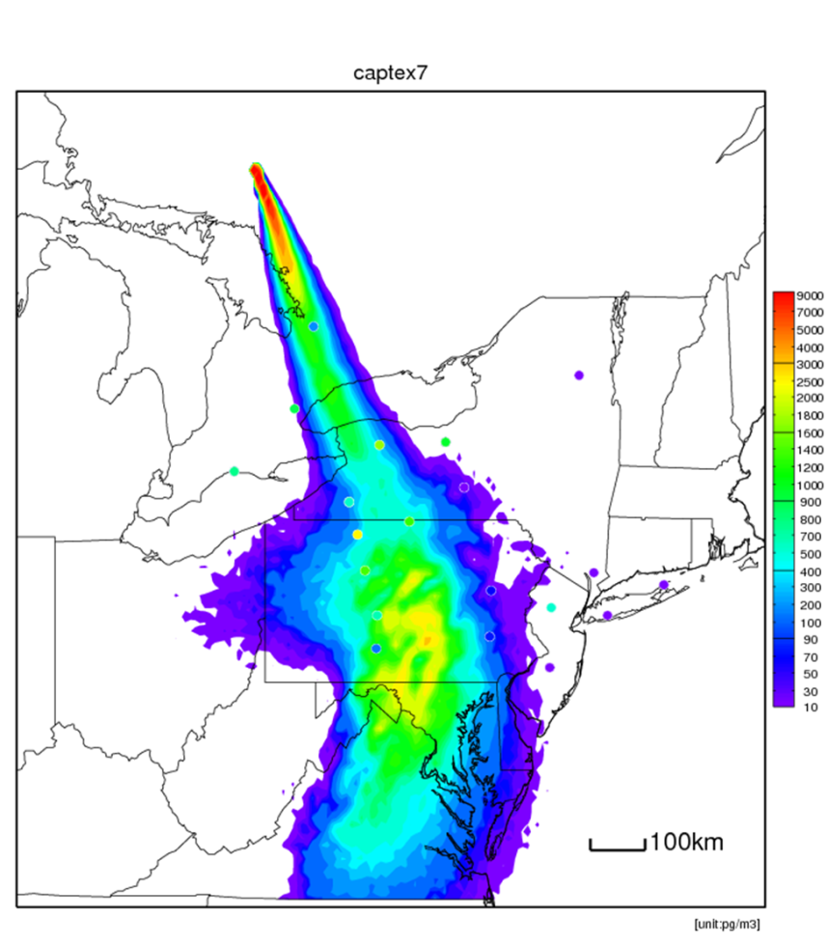
Model Evaluation
CAPTEX Average Concentration from HYSPLIT
Release #2
Release #7
Notes:
The average calculated concentrations for a release from DAY and SUD are shown here to illustrate the type of dispersion data available from CAPTEX.

Slide 48
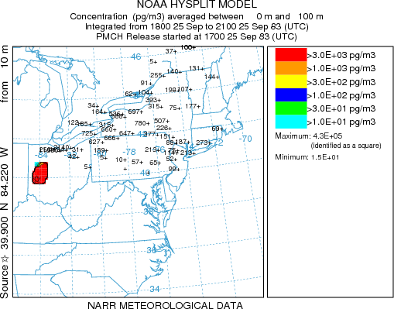
Model Evaluation
CAPTEX: Release #2 Model Performance
Air Resources Laboratory
48
Notes:
The example animation shows the tracer plume from CAPTEX release #2 and the 3-day averaged measured concentrations at each of the sampling locations. Note how the plume fails to reach the most distant samplers in the northeast and southern Canada; indicating that improvements to the model or the meteorological data are still possible.

Slide 49
plus, the model is evaluated constantly through comparisons with ambient data in specific applications...
modeled vs. measured 2005 Hg wet deposition for Mercury Deposition Network (MDN) sites in different regions

Slide 50
Some Examples of HYSPLIT Applications

Slide 51
HYSPLIT4: Current Applications
Emergency Response
  Radiological releases
  Improvised nuclear devices
  Chemical releases
  Volcanic eruptions
Decision Support
  Dispersion model training
  Real-time Environmental Applications and Display sYstem
  Comprehensive Nuclear Test Ban Treaty
Air Quality
  Fire smoke
  Mercury and dioxins
  Wind-blown dust
Air Resources Laboratory
51
Notes:
The main research goal is to adapt HYSPLIT to the widest variety of simulation problems in emergency response and air quality that are optimal applications for the point-source based strengths of Lagrangian models. There is a parallel emphasis on decision support because otherwise the numeric model output fields of air concentration and deposition can not be used effectively by non-experts.

Slide 52
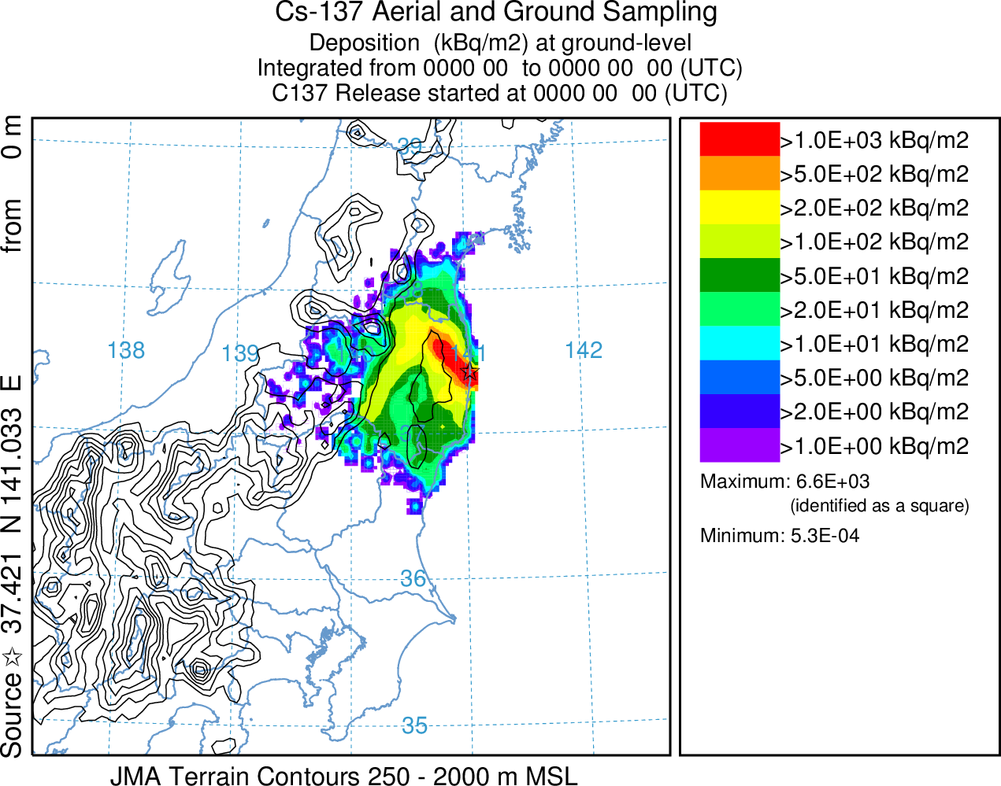
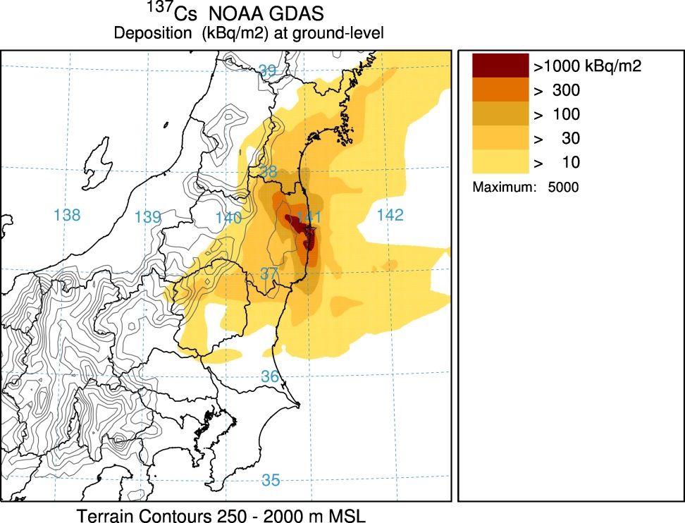
Emergency Response
Fukushima Local Deposition Verification
http://ready.arl.noaa.gov/READY_fdnppwmo.php
Notes:
Although the model’s performance for the Chernobyl accident was reasonable, soon after the first observational data started to come after the Fukushima accident, it was clear that HYSPLIT was substantially over-predicting the wet deposition. A simple reduction by about a factor of ten (3x10⁵ to 4x10⁴) of the in-cloud scavenging ratio reduced the over-prediction but did not address the cause. The main difference between the two accidents was that the Fukushima release was relatively near the ground compared with the Chernobyl release, where a continuing fire lofted material much higher into the atmosphere. The Cs-137 deposition measurements are shown in the left panel, averaged together from aircraft monitoring and ground based sampling and the model prediction is shown in the right panel. Although there are differences in the measured and observed patterns, the overall structure and magnitudes are comparable.

Slide 53
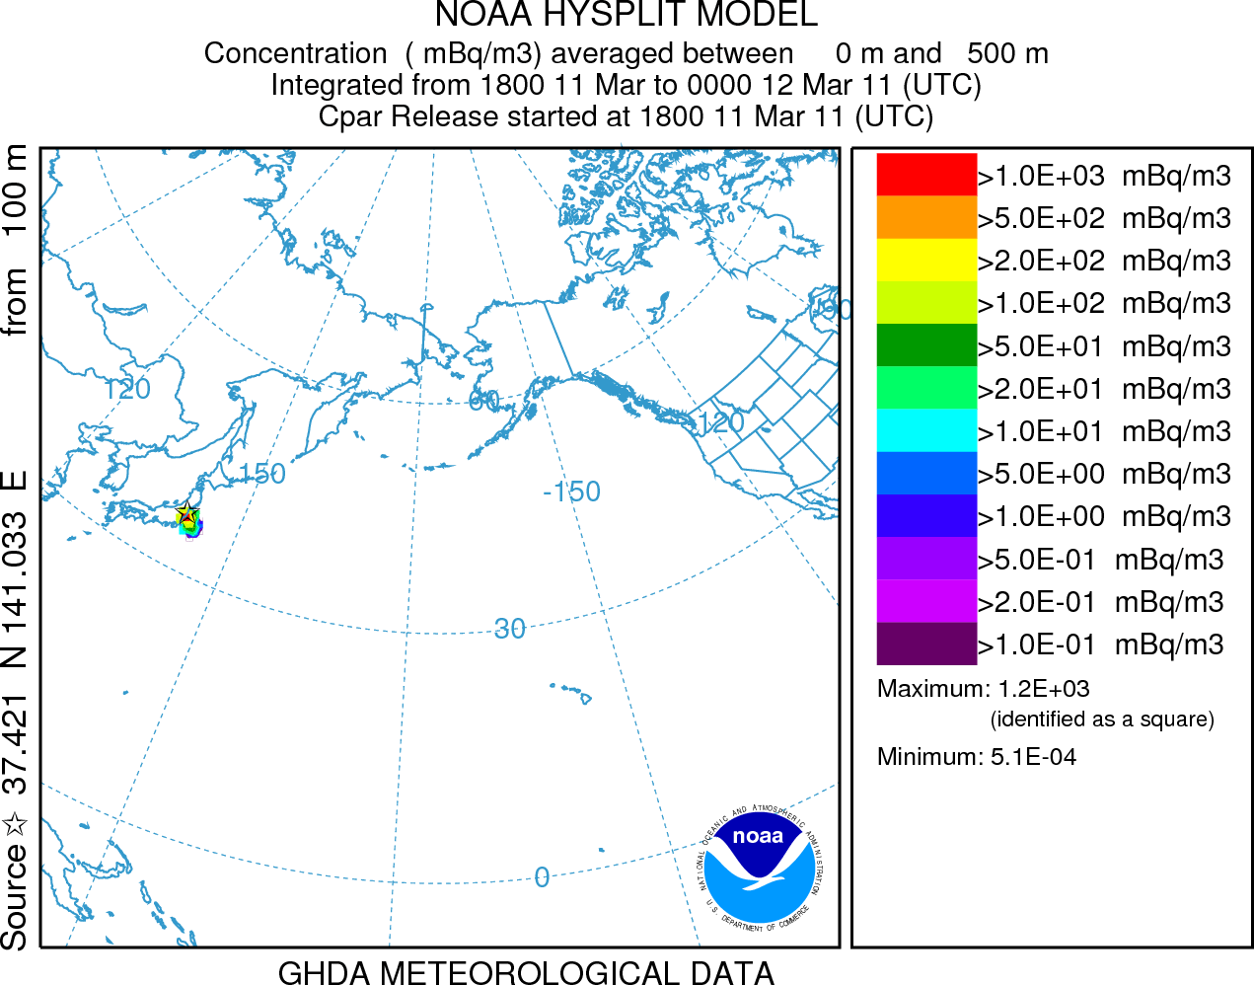
Emergency Response
Fukushima Global Simulation
Cs-137 air concentrations
100,000 particles per hour
0.5 degree NOAA GDAS meteorological data
http://ready.arl.noaa.gov/READY_fdnpp.php
Notes:
Subsequently the Fukushima accident calculations were re-run with more particles and a coarser resolution concentration grid that covered the globe. Transport patterns were more complex with transport to the north resulting from interactions with cyclonic systems (low pressure, counter-clockwise curvature, and more rainfall) while the transport to the south was the result of particles captured within anti-cyclonic systems (high pressure, clockwise curvature, and fair weather,).

Slide 54
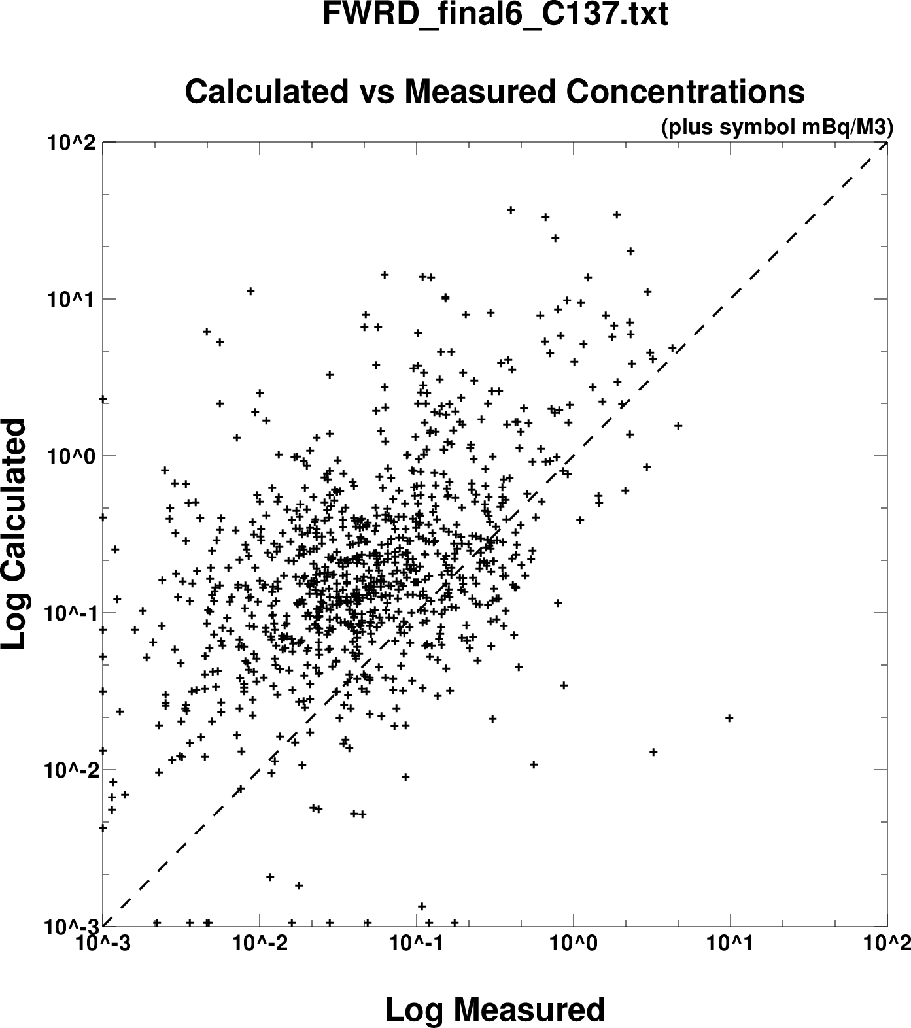
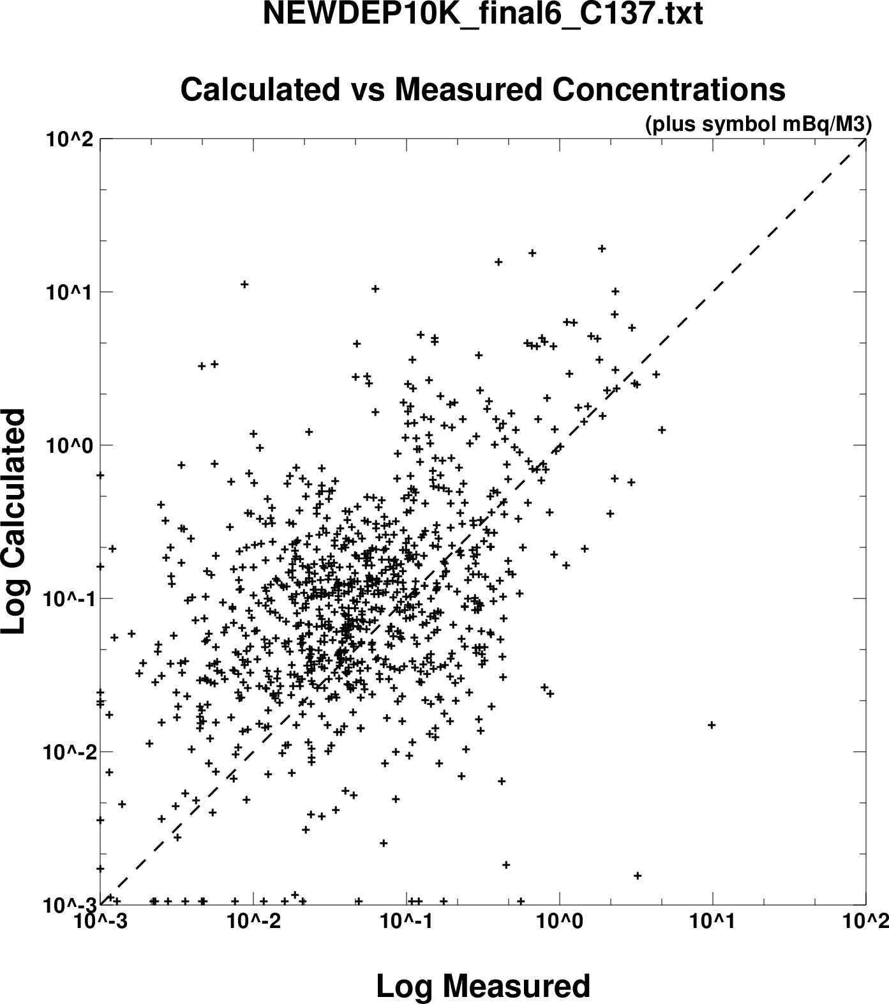
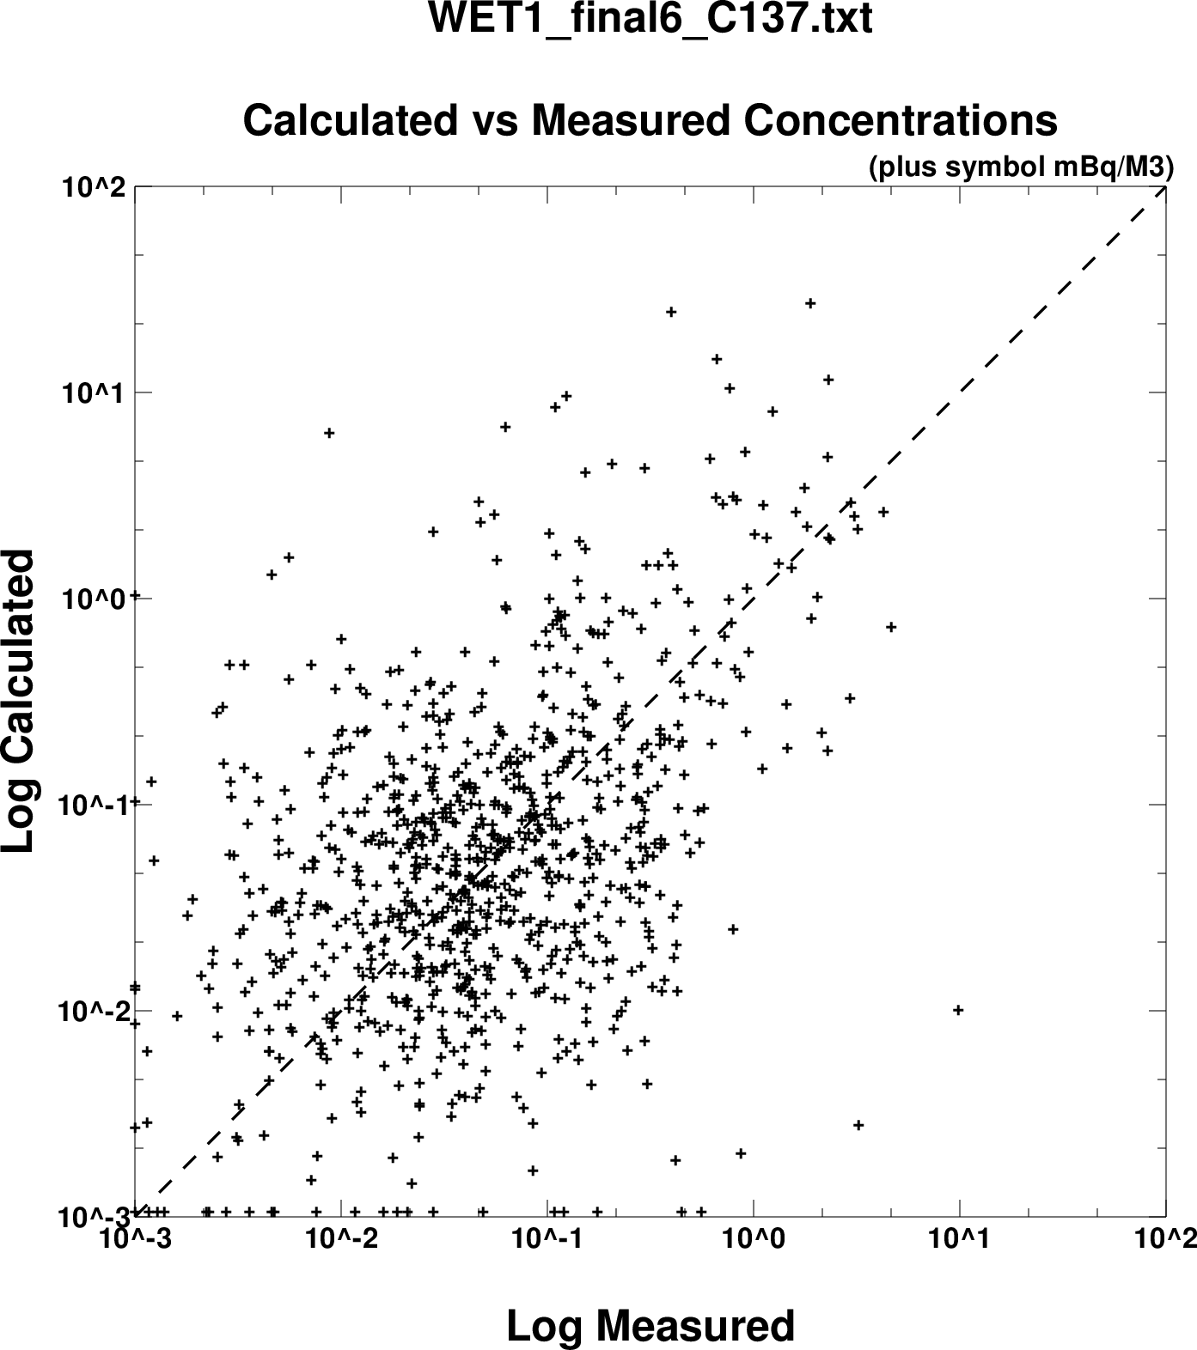
Emergency Response
Fukushima Global Concentrations Verification
Original – adjusted SR
Revised – cloud layer & adjusted SR
Final – SC method
Model predictions of Cs-137 for the global CTBTO, USEPA, and European sampling locations using different wet scavenging methods
Notes:
The global calculation permitted a comparison of the model’s predictions with measurements from the CTBTO’s global network, the U.S. EPA’s radiation monitoring network (RADNET), and the measurements from various European countries. The data shown here represent the original calculation (after adjustment of the scavenging ratio), the revised method (using cloud layer-depth), and the final method, where the scavenging ratio method was replaced by the scavenging coefficient approach (removal time-constant). Note that neither the revised or final method performed as well as the original for the local deposition over the Japanese mainland. The disparity between local and long-distance wet scavenging results is attributed to the inadequate spatial resolution in wind fields, precipitation, and the timing of the radionuclide releases.

Slide 55
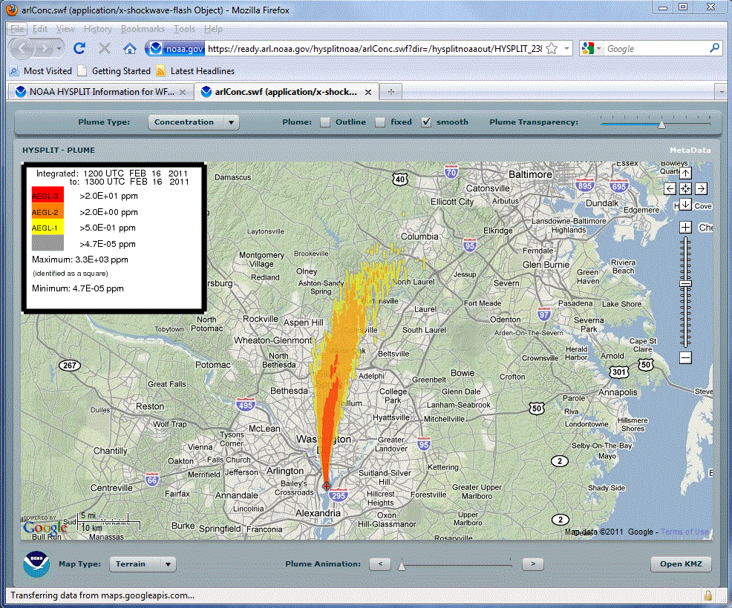
Emergency Response
Chemical Releases
Background
  Post 9/11 applications for forecast offices centrally run
  Initial web interface for weather forecast offices, locally run
Approaches
  Link to Computer-Aided Management of Emergency Operations (CAMEO) chemicals data
  Collaboration with OR&R to include Areal Locations of Hazardous Atmospheres (ALOHA) source model
Applications
  Incorporating real-time chemical plume modeling capability through the web
Air Resources Laboratory
55
Notes:
The interest in applying HYSPLIT to more shorter-range problems increased after 9/11 with a request by the National Weather Service for routine HYSPLIT forecasts at a number of fixed locations. At the same time an on-demand capability was established through the 24/7 desk of the Senior Duty Meteorologist at the National Centers for Environmental Prediction (NCEP). The response was initiated by a telephone call to the SDM, manual data entry, and the posting the results to a secure web page. The approach proved to be cumbersome and a dedicated system for Weather Forecast Office access was developed, hosted at NOAA’s 24/7 web portal. A unique feature of this interface is that it links the Computer-Aided Management of Emergency Operations (CAMEO) chemicals data base with HYSPLIT, permitting the WFO to select a realistic emission scenario and create output graphics linked with human exposure guidelines. A newer version exists that was developed in collaboration with the National Ocean Service’s Office of Response and Restoration to include the source modeling features of their Areal Locations of Hazardous Atmospheres (ALOHA) model as part of the HYSPLIT chemical modeling package.
CAMEO - http://cameochemicals.noaa.gov/
ALOHA - http://www.epa.gov/emergenciescontent/cameo/aloha.htm

Slide 56
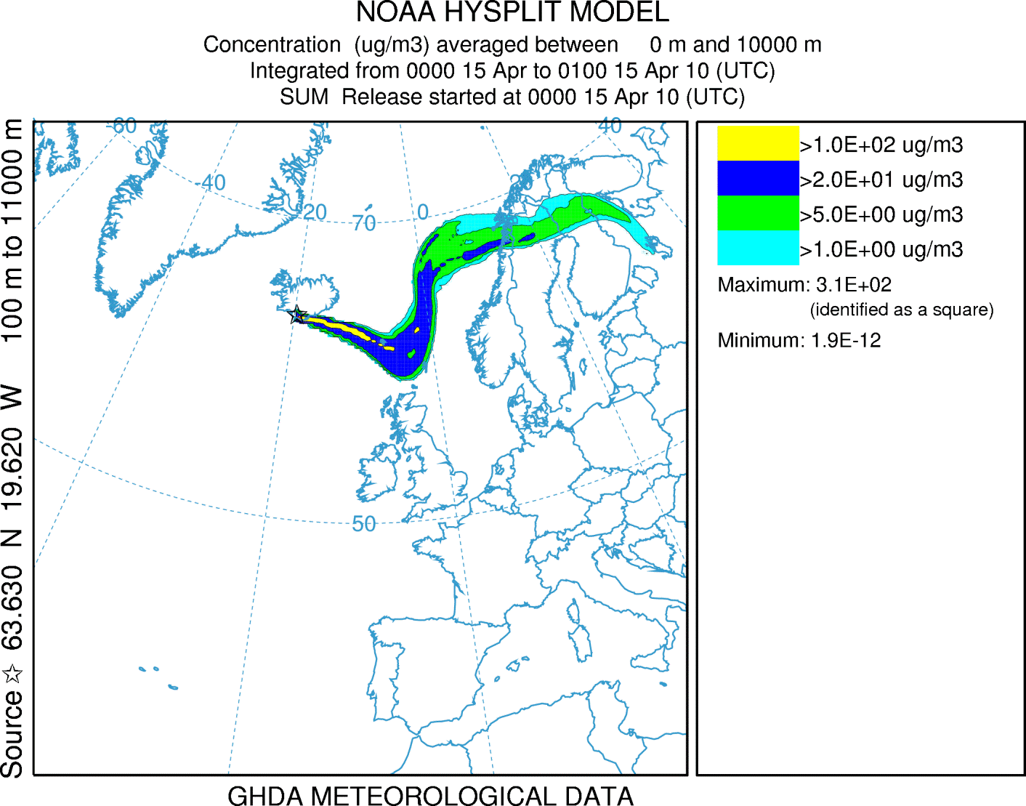
Emergency Response
Volcanic Eruptions
Background
  Mt. St. Helens – forecast trajectories to the USGS
  Mt. Redoubt – KLM encounter
Approaches
  Source term uncertainty (mass, particle size, height)
  Quantitative air concentration
Applications
  Primary customer is the Washington Volcanic Ash Advisory Center (NCEP and NESDIS)
  HYSPLIT installed in Australia, Argentina, and AFWA
Air Resources Laboratory
56
Notes:
ARL’s involvement with modelling the ash and other debris from a volcanic eruption goes back to Mt. St. Helens, where we just provided trajectory forecasts (using the Limited Fine Mesh (LFM) model. The concerns with forecasting ash movement became more serious after the KML aircraft encounter with the Mt. Redoubt plume and the arrangements became more formal. HYSPLIT is the current plume model for the Washington Volcanic Ash Advisory Center (VAAC), the Air Force Weather Agency (AFWA), as well as for the VAACs in Australia and Argentina.
Although volcanic ash modelling easily lends itself to Lagrangian approaches due to the point-source nature of the problem, there is considerable uncertainty in the source term mass, particles sizes, and plume heights. These can affect the transport direction and limit the development of a more quantitative prediction, a potential new requirement as a result of the large scale shutdown of air traffic as a result of the Eyjafjallajokull eruption. We are collaborating with the National Environmental Satellite Data Information Service (NESDIS) to toward incorporating better satellite based eruption and ash cloud distribution data for model initialization.
Barbara J.B. Stunder, Jerome L. Heffter, Roland R. Draxler, 2007, Airborne Volcanic Ash Forecast Area Reliability, Weather and Forecasting, 22:1132-1139

Slide 57
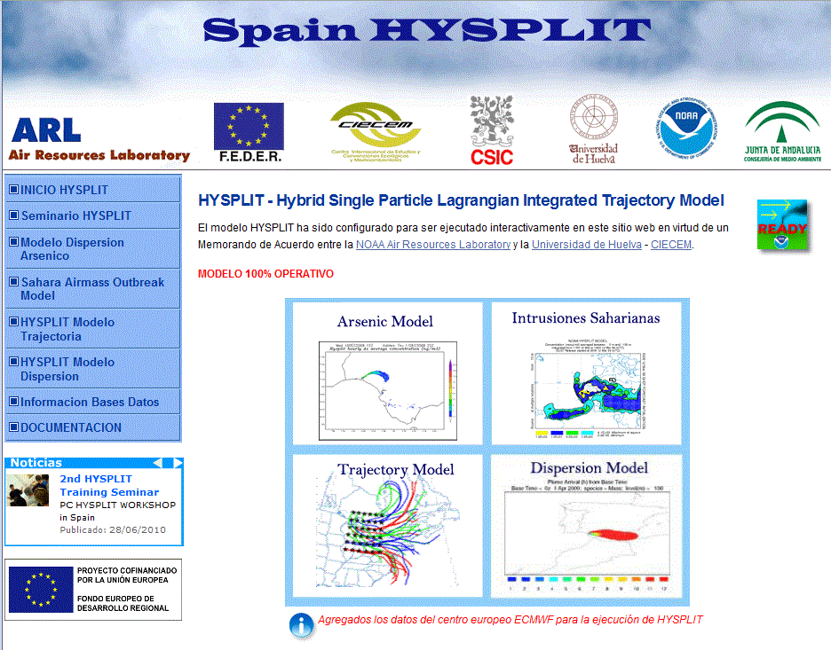
Decision Support
Real-time Environmental Applications and Display sYstem
Public Web Interface
  80,000 unregistered user runs on average per month
  Mirror and backup capabilities (only one in Spain)
Training
  Participants from US and international governments, private industry, and academia
  Web Forum with more than 1,000 participants
  COMET
Air Resources Laboratory
Notes:
Another aspect to decision support is to provide dispersion products in formats that are compatible with other commonly used Geographic Information Systems (GIS) so that emergency and air quality planners can overlay our dispersion products with their own data. The original HYSPLIT system used National Center for Atmospheric Research (NCAR) graphics as the base for all display applications. However, extreme latency by NCAR in updating map backgrounds, especially as international borders were rapidly changing, led to the development of an in-house graphical system that relies upon a public library to create Postscript output files. These are vector files, and again using public libraries, they can be converted to almost any other format, such as the currently popular Google Earth (.kmz), Environmental Systems Research Institute (ESRI) shapefiles (.shp), and Adobe scalable vector graphics (.svg). More recent developments are focused on improving the HYSPLIT interface using Flash with MapQuest Maps. A continuing challenge to this approach is keeping up with rapidly changing standards and new display options and trying to maintain current up-to-date links with these externally driven changes.
Google Maps example - http://www.noaa.inel.gov/examples/hysplit.html
We are also collaborating with the Cooperative Program for Operational Meteorology, Education, and Training (COMET) to develop modules to assist the NWS forecaster in interpretation of the plume dispersion products.
https://www.meted.ucar.edu/training_module.php?id=33#.VTUQ25Mel2U
https://www.meted.ucar.edu/training_module.php?id=773#.VTUQ_pMel2U

Slide 58
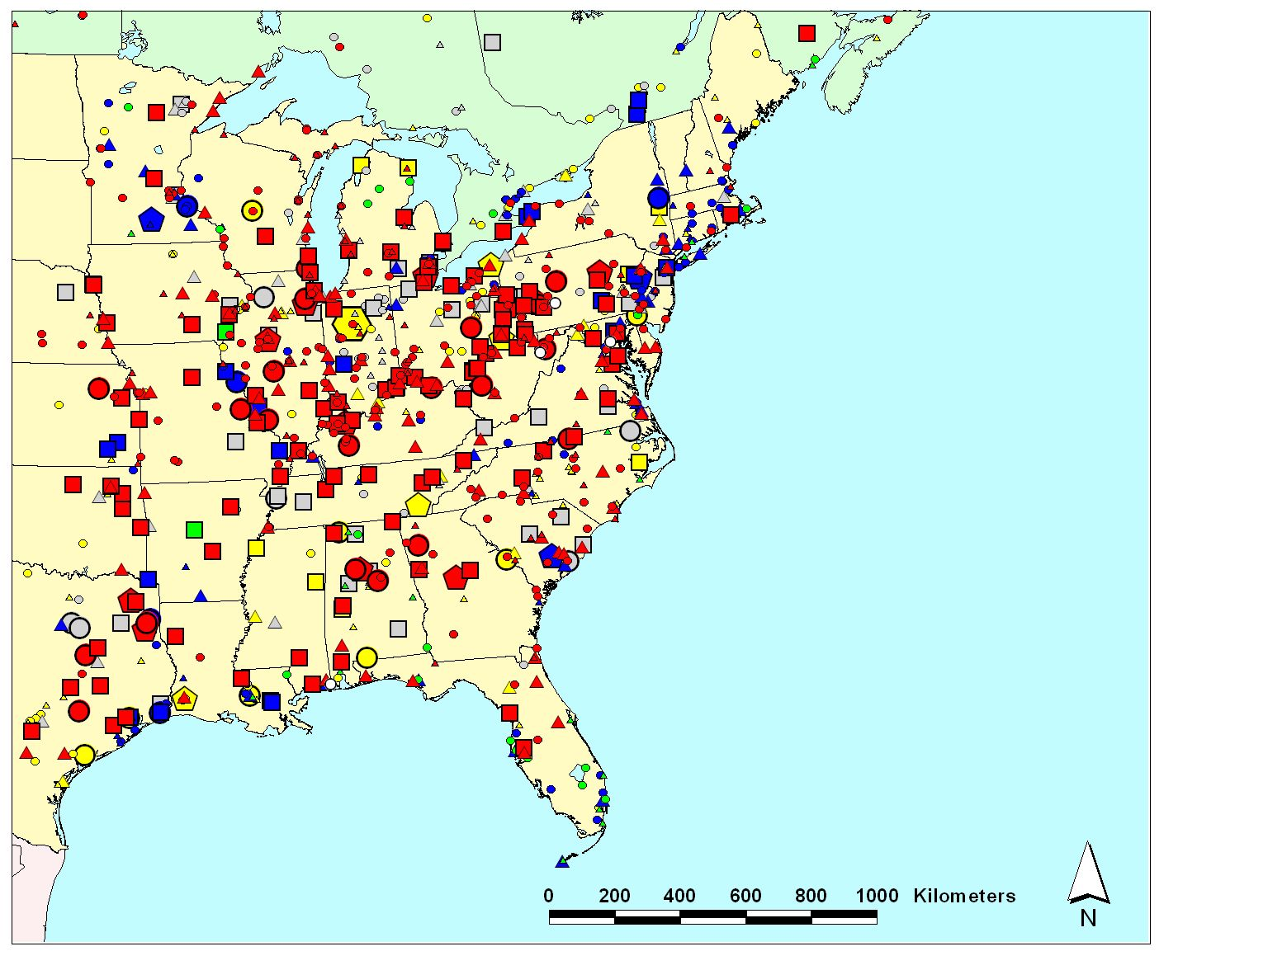
Air Quality
Source-Receptor Analysis: Expansion to Mercury
Approaches
  Lagrangian focus to optimize source-receptor capability
  Specialized receptor accounting algorithms
  Emission based analyses
Applications
  Extension to global domain to compute background values
Emissions
(kg/yr)
5-10
10-50
50-100
100–300
300–500
500–1000
1000–3500
Type of Emissions Source
coal-fired power plants
other fuel combustion
waste incineration
metallurgical
manufacturing & other
Air Resources Laboratory
58
Notes:
A unique approach was developed for Dioxin using HYSPLIT3 to create the source to receptor dilution factors was expanded to model Mercury with HYSPLIT4. The concentration grid represents the receptors, while multiple source locations are chosen to best represent the gradients in the dilution factors. Dilution factors from all other locations are interpolated from the existing source-receptor array. As an example, the dilution factors for the eastern US may be adequately represented by several hundred sources, but there may be thousands of emission points, as illustrated in the figure shown above. When the interpolated dilution factors are multiplied by the detailed emission inventory, a detailed concentration pattern will emerge that retains the information about which sources contributed to the concentration at each receptor point. In addition, HYSPLIT4 contains the new Global Eulerian Module (GEM) to compute the global contribution to the regional simulations.

Slide 59
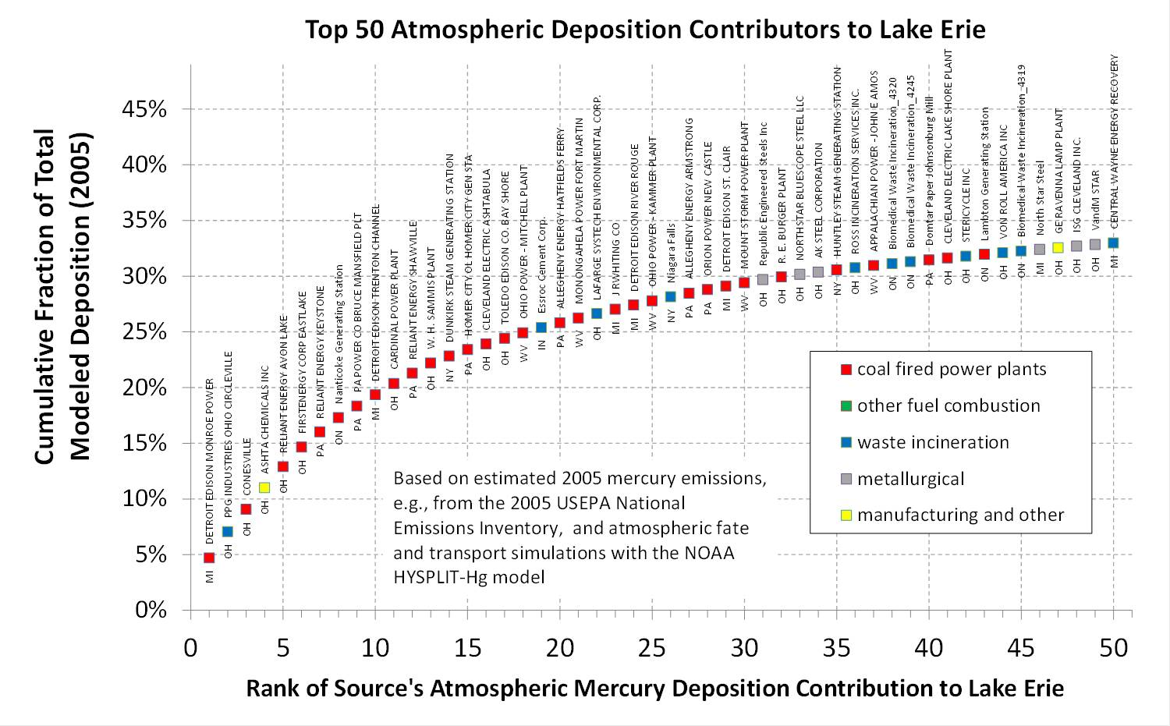
HYSPLIT 4 (Mercury)
Notes:
This graph shows detailed source-receptor results for Lake Erie. With the ATC approach, the impact of each source in the emissions inventory can be estimated for each receptor.
Cohen, M., Artz, R., Draxler, R., Miller, P., Poissant, L., Niemi, D., Ratte, D., Deslauriers, M., Duval, R., Laurin, R., Slotnick, J., Nettesheim, T., and McDonald, J. (2004). Modeling the Atmospheric Transport and Deposition of Mercury to the Great Lakes. Environmental Research 95, 247-265. http://www.arl.noaa.gov/documents/reports/Env_Res_2004.pdf
Cohen, M., R. Artz, R. Draxler. NOAA Report to Congress: Mercury Contamination in the Great Lakes. Air Resources Laboratory, Silver Spring MD. Submitted to Congress on May 14, 2007. 162 pages. Available at: http://www.arl.noaa.gov/documents/reports/NOAA_GL_Hg.pdf

Slide 60
HYSPLIT4: Some of the Research in Progress
Inline versus Offline
  HYSPLIT integrated into WRF
Dispersion Model Ensembles
  HYSPLIT meteorological grid, turbulence, physics
  WRF physics
  Reduction techniques
Air Resources Laboratory
60
Notes:
Current research is focused on more closely coupling the dispersion calculation with the meteorological model by calling the dispersion model during the meteorological data calculation. In this way, the full resolution of the meteorological data is available at every time step and grid point to the dispersion calculation rather than having to rely upon archival data at rather infrequent intervals or coarse vertical resolution (historically standard pressure levels). This approach also removes the need to compute temporally averaged wind fields.
The second research effort is focused on providing not just one deterministic solution to a simulation but a range of answers that can be used to bracket model predictions with an uncertainty estimate.

Slide 61

WRF-HYSPLIT coupling
 | Inline HYSPLIT | Offline HYSPLIT
Source of met. input | WRF-ARW No conversion | Varying met data (WRF, NARR, etc); Need conversion programs for each
Met. input frequency | At WRF’s time step No temporal interpolation | WRF’s output (hourly or minutely) Need interpolation
Vertical grid | Using WRF’s terrain-following hydrostatic vertical coordinate No vertical interpolation | HYSPLIT internal terrain-following coordinate Need interpolation
Horizontal grid | Following WRF’s grid | Following the grid of met input
Disk usage | Dispersion output and WRF output based on users’ request | Large cost of data storage if high temporal resolution data are needed
Multiple simulations | Requires repeating met simulation | Met simulation is run only once
Fong Ngan, Ariel Stein, and Roland Draxler, 2015: Inline Coupling of WRF–HYSPLIT: Model Development and Evaluation Using Tracer Experiments. J. Appl. Meteor. Climatol., 54, 1162–1176. doi: http://dx.doi.org/10.1175/JAMC-D-14-0247.1
Notes:
A Lagrangian dispersion model, HYSPLIT, has been coupled (inline) to the WRF model. The inline HYSPLIT includes dispersion, trajectory, deposition (dry and wet) and radioactive decay.
Compared to the offline approach, the inline HYSPLIT takes advantage of higher temporal frequency of meteorological variables, with no time interpolation required between WRF’s output hours , and it uses the same vertical coordinate as the WRF model.

Slide 62


Experiment data - ASCOT
Atmospheric Studies in Complex Terrain
Mid-September 1980
Study transport and diffusion of pollutant associated with nocturnal drainage flows
Five releases on a different night at Anderson Creek Valley in Northern California
Notes:
The ASCOT focused on nocturnal drainage flows in a mountain area in Northern California. The sampling network measured tracer concentrations for about 10 hours after the release of the tracer.
The inline HYSPLIT simulation for ASCOT, we used 333-m grid spacing, 1st mid-layer at 8m, WRF’s time step at 1 second. The offline simulation used the same setup and 5 minutes WRF output.

Slide 63

Inline versus Offline
ASCOT predicted and measured plumes
Air Resources Laboratory
Notes:
Spatial plots between inline and offline plumes for ASCOT #2 (top) and #4 (bottom). Left panel: the difference plot of tracer concentration (pg/m³) for inline and offline plumes. Right panel: the inline plume (pink), offline plume (light blue), and their overlap (gray). The black dot is the tracer release site. Gray lines are contours of terrain height. The illustration shows a comparable number of offline (blue) and inline (pink) grid cells extending beyond the overlap region. The inline calculation tends to keep the plume more intact closer to the release site and therefore maintains higher concentrations at the center of the plume that better matched the observations which showed a narrow tracer plume moving toward southeast. The primary cause of the improved correlation coefficient for the inline simulations.

Slide 64


Comparison for ASCOT
#1 #2 #3 #4 #5
inline
offline
inline
offline
inline
offline
inline
offline
inline
offline
$Rank=R^{2}+1−\left|\frac{FB}{2}\right|+\frac{FMS}{100}+\left(1−\frac{KSP}{100}\right)$
Notes:
The evaluation shows that the inline HYSPLIT is especially beneficial for an ASCOT type application in which the drainage flow occurs over an area of complex terrain and in fine spatial/temporal resolution.
The improvement of the inline over the offline calculation is attributed to the elimination of temporal and vertical interpolation of the meteorological data compared to the offline version.

Slide 65
HYSPLIT5?
Closer coupling of internal variables between WRF and HYSPLIT
Maintain compatibility between offline & inline versions
Develop consistent algorithms to create WRF like dispersion variables for any offline meteorological data
Develop ensembles & reduction as standard output products
Automatically incorporate data assimilation for measurements
Notes:
Once the internal structure of HYSPLIT becomes more compatible with the internal physics options available in a meteorological model such as WRF, it may be possible to restructure the whole concept of dispersion modeling to include consistent atmospheric physics between meteorological and dispersion parameterizations, automatic generation of WRF and HYSPLIT (dispersion) ensembles, as well as data assimilation of measurements (concentration or meteorological) to dynamically change the simulation to account for changing conditions into a single simulation with probabilistic output.

Slide 66

Thanks!

Slide 67
Extra Slides

Slide 68
Hybrid Single Particle
Lagrangian Integrated Trajectory Model
History of HYSPLIT
  Version #1 {unnamed}
  Version #2 {HYSPLIT}
  Version #3 {HYSPLIT3}
Current Applications
  HYSPLIT4
Future Directions
  HYSPLIT5?
http://www.ready.noaa.gov/HYSPLIT.php
Notes:
The original splitting puff trajectory model did not have an acronym. The development of the next version was named HYSPLIT. With the continuing evolution of the model, it soon became apparent that another version was required, but this time, it was named version #3 in recognition of the first unnamed version. Although in terms of naming conventions, the version #4 name has been stable since 1997, it also has continued to evolve, but the numbering scheme is now linked to a subversion repository revision number – currently at 749. A new version number (#5?) is planned when there are significant changes to the input and output formats and the model physics.

Slide 69
A Brief History of Trajectory Analysis
Exner, F.M., 1907, W.N. Shaw’s Untersuchungen über die Lebensgeschichte von Luftströmungen an der Erdoberflache, Met. Zeit., Vol 24, p. 520.
Durward, J., 1925, Trajectories of upper air currents, Met. Mag., Vol. 60, pp. 217 ff.
Petterssen, S., 1940, Weather analysis and forecasting, McGraw-Hill Book Company, New York, pp 221-223.
Machta, L., 1992, Finding the site of the first Soviet nuclear test in 1949, Bul. Am. Meteorol. Soc., Vol. 73, 11, 1797-1806.
Thompson, R., 1971, Numeric calculation of turbulent diffusion, Q. J. Royal Meteorol. Soc., 97, 411, 93–98.
Notes:
Trajectory analysis had a long history from the beginning of the 20th century. Some of the earliest papers were concerned with balloon flights. By 1940, Petterssen had described the integration computation used to this day to compute a trajectory in a temporally and spatially changing wind field. This culminated with the use of backward trajectories in 1949 to determine the location of the first Soviet nuclear test. By the early 1970’s the use of trajectories was expanded to follow an expanding cluster of particles to represent atmospheric transport and dispersion, the basis of all the current Lagrangian dispersion models.

Slide 70

Computer Drawn Trajectories: 2015
Trajectories started along mid-point flight path segments for each filter collection
Notes:
The trajectory calculation from 1949 can be repeated using today’s reanalysis data (2.5 degree) for the same time period. Although the trajectory from the northern leg of the sampling flight that ends up in Greenland (red) and the trajectory from the southern leg of the flight that goes through Kazakhstan (coincidently also red) appear to be identical to the 1949 calculation, the majority of the trajectories do not go near the Semipalatinsk Nuclear Test Site. It is interesting how in this case, small changes in starting position made a huge difference in the trajectory path leading to a higher level of uncertainty that would not have led to the same conclusion had this computerized approach been used in 1949. The one trajectory that goes through Kazakhstan arrives there about 29 August, the actual day of the test.

Slide 71
Calculated Trajectories with Dispersion MESODIFF
Start and Wendell, 1974
Notes:
During the mid-1960s, work by Pasquill (1961) and Gifford (1961) describing the estimation of the horizontal and vertical standard deviation of a continuous plume concentration distribution constituted the basis for the construction of the so called Gaussian dispersion models. One such model was developed at ARL (Slade, 1966; Slade, 1968) based on data from the well-known Project Prairie Grass (Barad, 1958) and several other dispersion experiments. Using this Gaussian approach and assuming steady-state with homogeneous and stationary turbulence, air concentrations were estimated based on wind data collected at a single site. Extending this work in the late 1960s and early 1970s to handle more realistic (changing) weather conditions, ARL scientists developed the Mesoscale Diffusion (MESODIFF) model (Start and Wendell, 1974) in response to concerns at the Idaho National Reactor Testing Station (NRTS) related to planned or accidental releases of radioactive material into the atmosphere. This segmented Gaussian puff model used gridded data interpolated from a network of 21 tower-mounted wind sensors located within the boundaries of the NRTS (Wendell, 1972) to account for spatial variability of the horizontal wind flow near the surface. The simulations used a maximum of 400 puffs and incorporated time varying diffusion rates

Slide 72

Replication of MESODIFF using HYSPLIT
Notes:
A calculation using the reanalysis data for the same time as the previous slide and the most recent version of HYSPLIT configured to replicate the MESODIFF computational approach by releasing a series of non-splitting Top-Hat puff puffs (but with much less temporal frequency to improve clarity of the illustration). The puff overlap region indicates how multiple puffs are used to build up the air concentration at a receptor location. The initial reanalysis data winds were from the north, a similar direction as indicated by the tower network in the previous slide, but turned more westward, rather than moving toward the east as shown in the previous slide.

Slide 73

Model (no name) with Puff Splitting: HYSPLIT1
Segmented pollutant puffs released near the surface and trajectories were followed for several days
Transport calculated from wind observations based on rawinsonde data (not interpolated) taken twice daily
No vertical mixing assumed at night and complete mixing over the planetary boundary layer (PBL) during the day
Nocturnal wind shear modeled by vertically splitting the puffs that extended throughout the PBL into 300m sub-puffs during the nighttime transport phase of the calculation
Notes:
The predecessor to HYSPLIT with many of the same features had no acronym. It consisted of a simple scheme that assumed complete mixing within the PBL during the daytime and no mixing at night. During the daytime all puffs could contribute to surface air concentrations while at night only those puffs in the lowest layer contributed to surface air concentrations. With typically only two rawinsonde observations available per day (0000 and 1200 UTC) over the U.S., daytime was assigned to 0000 UTC and nighttime was represented by 1200 UTC. Nocturnal wind shear was modeled by vertically splitting the puffs that extended throughout the PBL into 300 m sub-puffs (300 m is approximately the vertical resolution of the sounding) during the nighttime transport phase of the calculation. This could be adjusted if the model were run over other longitudes.

Slide 74
HYSPLIT1: 1500 km Verification
Kr-85 released to the atmosphere and sampled at multiple locations in the Midwestern U.S. during a two-month field experiment
Northern sampling sites showed evidence of local sources
Southern sites (ICT, TUL,OKC) are well correlated with emissions from INEL
Average concentrations: ICT, TUL, OKC
Draxler, 1982 Atmospheric Environment
Notes:
The model was used to simulate Kr-85 released to the atmosphere and sampled at multiple locations in the midwestern U.S. during a two-month field experiment (Draxler, 1982) in 1974. Previous calculations with a single segmented puff model consistently over-predicted air concentrations (by a factor of six). The splitting puff approach showed no bias and good correlation after uncorrelated local sources were removed from the sampling data (filtered data); the lower frequency concentration trends were well captured by the model. Note that the background concentration at that time was about 14 pCi/m³ while the strongest plume signal was only 0.3 pCi/m³. Background concentrations could change by as much as 1 pCi/m³ with a change in air mass.

Slide 75



HYSPLIT2: Continuous Puff Splitting and Merging
Use of interpolated rawinsonde or any other available measured data to estimate vertical mixing coefficients that varied in space and time
Mixing coefficients were derived from Monin-Obukhov length, friction velocity, and surface friction potential temperature
Rather than arbitrary stable-unstable puff splitting algorithm, puffs could split at any time when their size exceed the spatial resolution of the meteorological data (vertical or horizontal)
Puffs are merged when the distance between them is less than their radius
Notes:
HYSPLIT version 2 included the use of interpolated rawinsondes or any other available measured data to estimate vertical mixing coefficients that varied in space and time (Draxler and Stunder, 1988). These mixing coefficients were derived from the Monin-Obukhov length, friction velocity, and surface friction potential temperature (Draxler, 1987). With mixing estimates available each time step, dispersion rates could vary continuously, and puffs would split when their size exceeded the meteorological grid size. In this way the transport calculation for a puff could be represented by only one meteorological data point.

Slide 76


HYSPLIT2 test: Norman, Oklahoma PFT
Single 3-hour release of a perflurocarbon tracer (PFT) July 8, 1980
Sampled for 3 days 600 km downwind
Initial transport was in the nocturnal jet
Subsequent low-level transport arrived 48 hours after initial release
Notes:
Although the HYSPLIT2 calculations for this experiment have been lost, the experimental data for this event are still available and are part of the DATEM archive. Calculations with the current model still find this event challenging because of the nocturnal jet the first night after the release and the subsequent arrival of a second wave of tracer, 24 hours after the initial plume had passed. None of the “rawindsonde” based transport and dispersion models were able to properly simulate this event because the nocturnal jet occurred between the sounding stations.

Slide 77



HYSPLIT 2 test: CAPTEX
The rawinsonde based HYSPLIT calculations were able to capture the gross vertical plume structure in a well mixed (#2) environment and a case with greater vertical stability (#3)
Aircraft paths for each release shown at right
Measured (dashed) and model (solid) cross-wind integrated concentrations (CWIC) are shown below
Notes:
The HYSPLIT2 version was applied to simulate the Cross Appalachian Tracer Experiment (CAPTEX; Ferber et al. 1986). Each trial consisted of a 3-h tracer (PFT) release from either Dayton, Ohio (DAY) or Sudbury, Ontario (SUD). CAPTEX will be discussed in more detail later. But one of the unique aspects of this experiment was the deployment of multiple sampling aircraft to obtain concentration profiles within the PBL (see Draxler and Stunder, 1988, J. of Appl. Met.) . The aircraft sampling paths for each experiment are shown above right. Releases #2 and #3 illustrate the modeling challenge with a relatively well mixed boundary layer during experiment #2 but a decoupled elevated tracer layer in experiment #3. In each case, the rawinsonde based HYSPLIT calculation was able to capture the gross vertical structure. Both releases were from DAY.

Slide 78

CAPTEX: Summary of Aircraft Results
Although each release provided a unique environment …
The cross-wind integrated concentrations (CWIC) normalized to the PBL depth provided consistent results
Results show a simple PBL average concentration is incorrect
Notes:
Although each release provide a unique meteorological environment, overall when the results are normalized by the boundary layer depth, the cross-wind integrated concentrations showed considerable complexity and suggested that a simple PBL average concentration, as implied by HYSPLIT1 was not sufficient to represent the PBL concentration profile.

Slide 79


HYSPLIT3: Gridded Meteorological Data
Similar to HYSPLIT2, the calculation followed cylindrical puffs that grow in time along a trajectory and split when they reach the meteorological grid size.
However, HYSPLIT3 was designed to utilize gridded meteorological model outputs such as from the Nested Grid Model (NGM)
Most of the initial development and testing was conducted using data from the Across North America Tracer Experiment (ANATEX) and the NGM
The NGM was re-run for ANATEX to create a data archive at 2 hour intervals at a resolution of 90 km, a challenging data storage problem for the PC’s 20 MB internal disk drive
Notes:
It wasn’t until the development of HYSPLIT version 3 that the model utilized gridded data from meteorological model outputs such as the Nested Grid Model (NGM), NOAA’s regional forecast model at that time. The huge data volume created by the NGM archive (320 Mb/month) stimulated the development of the special 1-byte packed data format used by HYSPLIT (now called either the ARL or HYSPLIT data format) that preserved the precision by packing grid-point differences rather than absolute values. This reduced the monthly data volume to 80 Mb. The resolution of the initial data archive was reduced to every other grid point, resulting in a data volume of 20 Mb/month. This was then reduced again by creating semi-monthly files, of 10 Mb each. Calculations could then easily be performed on a state-of-the-art PC with all the data contained on its 20 Mb internal disk drive. In most other respects, HYSPLIT3 was very similar to HYSPLIT2. In addition, it allowed the calculation of trajectories as well as transport and dispersion of pollutants. HYSPLIT3 still used cylindrical puffs that grow in time and split when reaching the grid size of the meteorological data (Draxler, 1992). This version was applied to simulate the Across North America Tracer Experiment (ANATEX; Draxler and Heffter, 1989). The sampling sites, mostly co-located at National Weather Service observing stations collected 24-h air samples. The ground-level measurement data, after normalization by the tracer release rate, are summarized by travel time from source to sampler.

Slide 80


HYSPLIT3: Three-Month Average PFT Concentration
Measured
Calculated
Calculations using NGM meteorology showed about a factor of two over-prediction for the January-March (1987) average.
Most bias due to over-prediction at STC; cause unknown.
Notes:
During ANATEX, tracer releases occurred from two locations, Glasgow, MT (GGW - blue) and St. Cloud, MN (STC - red), each with a unique tracer. The above illustration shows the total predicted concentration from both locations using HYSPLIT3 using the NGM meteorological data for the calculation. The peak concentration contour over the STC release site shows how most of the over-prediction at all sampling locations was related to the releases from STC and not GGW. To date this difference has not yet been adequately explained.

Slide 81

HYSPLIT-Hg Atmospheric Fate & Transport Model:
Lagrangian Component
0
1
2
TIME (hours)
= mass of pollutant
(changes due to chemical transformations and deposition that occur at each time step)
The puff’s mass, size, and location are continuously tracked…
Phase partitioning and chemical transformations of pollutants within the puff are estimated at each time step
Initial puff location is at source, with mass depending on emissions rate
Centerline of puff motion determined by wind direction and velocity
Dry and wet deposition of the pollutants in the puff are estimated at each time step.
deposition 1
deposition 2
deposition to receptor
lake
Notes:
81

Slide 82
(Evolving) Atmospheric Chemical Reaction Scheme for Mercury
Reaction | Rate |  | Units | Reference
GAS PHASE REACTIONS
Hg⁰ + O₃ → Hg(p) | 3.0E-20 | cm³/molec-sec |  | Hall (1995)
Hg⁰ + HCl → HgCl₂ | 1.0E-19 | cm³/molec-sec |  | Hall and Bloom (1993)
Hg⁰ + H₂O₂ → Hg(p) | 8.5E-19 | cm³/molec-sec |  | Tokos et al. (1998) (upper limit based on experiments)
Hg⁰ + Cl₂ → HgCl₂ | 4.0E-18 | cm³/molec-sec |  | Calhoun and Prestbo (2001)
Hg⁰ +OH → Hg(p) | 8.7E-14 | cm³/molec-sec |  | Sommar et al. (2001)
Hg⁰ + Br → HgBr₂
AQUEOUS PHASE REACTIONS
Hg⁰ + O₃ → Hg⁺² | 4.7E+7 | (molar-sec)⁻¹ |  | Munthe (1992)
Hg⁰ + OH → Hg⁺² | 2.0E+9 | (molar-sec)⁻¹ |  | Lin and Pehkonen(1997)
HgSO₃ → Hg⁰ | T*e^{((31.971*T)-12595.0)/T)} sec⁻¹ [T = temperature (K)] |  |  | Van Loon et al. (2002)
Hg(II) + HO₂ → Hg⁰ | ~ 0 | (molar-sec)⁻¹ |  | Gardfeldt & Jonnson (2003)
Hg⁰ + HOCl → Hg⁺² | 2.1E+6 | (molar-sec)⁻¹ |  | Lin and Pehkonen(1998)
Hg⁰ + OCl⁻¹ → Hg⁺² | 2.0E+6 | (molar-sec)⁻¹ |  | Lin and Pehkonen(1998)
Hg(II) ↔ Hg(II) _{(soot)} | 9.0E+2 | liters/gram; t = 1/hour |  | eqlbrm: Seigneur et al. (1998) rate: Bullock & Brehme (2002).
Hg⁺² + hv → Hg⁰ | 6.0E-7 | (sec)⁻¹ (maximum) |  | Xiao et al. (1994); Bullock and Brehme (2002)
?
?
new
?

Slide 83

Notes:
83
This is way we typically run the HYSPLIT model. We do a run for one particular source location, and we release puffs periodically throughout the year (e.g., once every 7 hours). We follow each puff and keep track of the dispersion and the fate processes (deposition, transformation, etc.). The model uses the physical-chemical properties of the pollutant we are modeling, of course. By the end of the year, we have a good idea of the average impact that a source in this location would have on the receptors of interest (e.g., the Great Lakes).

Slide 84

HYSPLIT3: Linear Chemistry
Chemical formation and deposition of sulfate was incorporated into HYSPLIT3 in a first attempt to include a chemical module into the system.
The application incorporated gas- and aqueous-phase oxidation of sulfur dioxide, and dry and wet removal of SO₂ and aerosol SO₄²⁻.
Chemical transformations occurred within each Lagrangian puff without any interaction with other puffs.
NGM predicted precipitation was used for all removal and chemical conversion calculations.
Sulfur dioxide air concentrations
Rolph et al, 1992 Atmospheric Environment
Notes:
At the same time, the chemical formation and deposition of sulfate (SO₄²⁻); Rolph et al., 1992; 1993) was incorporated into HYSPLIT3 in a first attempt to include a chemical module into the modeling system. This application incorporated gas- and aqueous-phase oxidation of sulfur dioxide (SO₂), and dry and wet removal of SO₂ and aerosol (SO₄²⁻). Chemical transformations occurred within each Lagrangian puff without any interaction with the rest (a linear system). The model was applied over the eastern United States for the 1987 ANATEX period and compared against seasonal patterns of SO₂ and (SO₄²⁻) concentrations in air and the wet deposition of (SO₄²⁻) from observed precipitation.

Slide 85

SO₂ Air Concentration Time Series
Notes:
The HYSPLIT3 sulfur model calculations were carried out for the same time period as the ANATEX experiment because the high-resolution NGM meteorological data were available for that period. Although the model showed some over-prediction for the tracer, the SO₂ air concentration predictions were quite good, as shown in the above illustration for the Penn State sampling location.

Slide 86


HYSPLIT 3 for Semi-Volatile (SV) Pollutants
HYSPLIT-3 modified with vapor particle partitioning and OH oxidation of PCDD/F
Simulations of unit source emissions of specific congeners from “standard source” locations to develop an Air Transfer Coefficient (ATC) matrix
Estimate actual impact of each source in a U.S./Canadian dioxin emissions inventory using chemical and spatial interpolation
Compare measured and modeled air concentrations
Estimate detailed source-receptor information for atmospheric deposition
Notes:
HYSPLIT 3 was modified to include dynamic vapor-particle partitioning and OH oxidation of PCDD/F congeners (Cohen et al 1995, 2002). Applied to estimate the source-attribution for dioxin deposition to the Great Lakes, using spatial and chemical interpolation scheme based on unit emissions simulations from standard source locations. In the spatial interpolation scheme, the impact of an actual source at a given location on a given receptor (e.g., Lake Michigan) was estimated based on a weighted average of the impacts of the nearest standard source locations. “Nearness” was estimated both by distance and degree of similarity in orientation. In the chemical interpolation scheme, the impact of emissions of a particular congener of PCDD/F (there are 209 of them) was estimated based on interpolating impacts from four different congeners that spanned the range of physical chemical properties exhibited by the full set of congeners: 2,3,7,8-TCDF (mostly gas phase), 2,3,7,8-TCDD (both gas and particle phases), 2,3,4,7,8-PeCDF (mostly particle phase), and OCDD (primarily particle phase)
Cohen, M., et al. 1995. Quantitative Estimation of the Entry of Dioxins, Furans, and Hexachlorobenzene into the Great Lakes from Airborne and Waterborne Sources. Flushing, NY: CBNS, Queens College, CUNY. Final Report to the Joyce Foundation.
Cohen, M., Draxler, R., Artz, R., et al., 2002. Modeling the Atmospheric Transport and Deposition of PCDD/F to the Great Lakes. Environ. Sci. Technol. 36, 4831-4845. http://www.arl.noaa.gov/data/web/reports/cohen/13_cohen_et_al.pdf

Slide 87


HYSPLIT 3 for Semi-Volatile (SV) Pollutants
Lake
Superior
Geographical Distribution of U.S. and Canadian 1996 dioxin emissions
Geographical distribution of the estimated contributions to the 1996 atmospheric deposition of dioxin to Lake Superior
Notes:
Here’s an example of some of the input data (emissions) and output data (deposition contribution) from an analysis in which HYSPLIT-SV was combined with an Air Transfer Coefficient (ATC) methodology. The ATC approach utilized spatial and chemical interpolation, as discussed in the previous slide
Cohen, M., et al. 1995. Quantitative Estimation of the Entry of Dioxins, Furans, and Hexachlorobenzene into the Great Lakes from Airborne and Waterborne Sources. Flushing, NY: CBNS, Queens College, CUNY. Final Report to the Joyce Foundation.
Cohen, M., Draxler, R., Artz, R., et al., 2002. Modeling the Atmospheric Transport and Deposition of PCDD/F to the Great Lakes. Environ. Sci. Technol. 36, 4831-4845. http://www.arl.noaa.gov/data/web/reports/cohen/13_cohen_et_al.pdf

Slide 88
HYSPLIT 4: Including 3D Particle Dispersion
Includes an automated method of simultaneously using multiple meteorological grids such that the computation always uses the finest spatial resolution available at the time and location of the puff
Pre-processors were developed for many different meteorological models (WRF, RAMS, MM5, ECMWF) to convert data to the ARL format, in addition to the archives of existing NOAA models
Multiple parameterizations to estimate the stability from gradients of meteorological variables
Multiple options to convert stability into dispersion values (diffusivity profiles, turbulent kinetic energy, velocity variance)
Modeling the turbulent particle motion directly (3D) or the change in the statistic of the particle distribution (puffs)
Different Lagrangian representations: 3D particles, Top Hat or Gaussian puffs, or combinations of the previous two: puffs with a planar mass having vertical particle characteristics
Version 4 of HYSPLIT has been the basis for the construction of essentially all model applications for the last 15 years
Notes:
By the end of the 1990s, many significant new features had been incorporated into the modeling system. HYSPLIT version 4 (HYSPLIT4; Draxler and Hess, 1998), which is the basis for current model versions, includes an automated method of sequentially using multiple meteorological grids going from finer to coarser horizontal resolution and the calculation of the dispersion rate from the vertical diffusivity profile, wind shear, and horizontal deformation of the wind field. HYSPLIT4 allows the use of different kinds of Lagrangian representations of the transported air masses: 3-dimensional (3D) particles, puffs, or a hybrid of both. A 3D “particle” is a point, computational mass – representing a gaseous or particulate-phase pollutant – moved by the wind field with a mean and a random component. Individual 3D particles never grow or split, but a sufficient number needs to be released to represent the downwind horizontal and vertical pollutant distribution. A single puff, on the other hand, represents the distribution of a large number of 3D particles by assuming a pre-defined concentration distribution (Gaussian or Top-Hat) in the vertical and horizontal directions. Puffs grow horizontally and vertically according to the dispersion algorithms for puffs (see Draxler and Hess (1998) for details), equivalent to the evolving distribution of particles in a comparable 3D particle calculation. Furthermore, puffs split if they become too large (i.e. cannot be represented by a single meteorological data point). To avoid the puff number quickly reaching the computational array limits, puffs of the same age occupying the same location may be merged. An alternative approach is to simulate the dispersion with a 2D object (planar mass, having zero vertical depth), in which the horizontal contaminant has a puff distribution, growing according to the dispersion rules for puffs and splitting if it gets too large. In the vertical, however, they are treated as Lagrangian particles. This option permits the model to represent the more complex vertical structure of the atmosphere with the higher fidelity possible when using particles while representing the more uniform horizontal structure using puffs.

Slide 89
HYSPLIT4: Evolution since 1998
Wilson non-homogeneous turbulence correction
Modified Gaussian random number scheme
Backward dispersion option (oxymoron?)
Integrated meteorological grid ensemble options
Turbulence ensemble by varying random number seed
Surface water transport module
The use of Turbulent Kinetic Energy (TKE) if available
Pre-computed random numbers
Variable Lagrangian time scale (stable or unstable)
CAPE enhanced vertical mixing
Enhanced precision for certain meteorological fields
Embedded Eulerian model for pollutant background
Notes:
Although the basic elements of HYSPLIT4 have remained the same over the last 15 years, multiple improvements have been taking place on a regular basis. When major changes to the mixing or transport algorithms are introduced, the model changes are always tested and compared with experimental data to insure that the model performance has not degraded. The verification procedures will be discussed in more detail in a later section.

Slide 90
HYSPLIT4: Basic Equations
Mean Trajectory Equation
  P'(t+Δt) = P(t) + V(P,t) Δt
  P (t+Δt) = P(t) + 0.5 [ V(P,t) + V(P',t+Δt) ] Δt
Turbulent Trajectory Equation
  P_{final}(t+Δt) = P_{mean}(t+Δt) + U'(t+Δt) Δt
Turbulent Velocity
  U'(t+Δt) = R(Δt) U'(t) + U" ( 1-R(Δt)²)^{0.5}
    U'(t) at the previous time
      R(Δt) = exp ( -Δt / T_{Li}) autocorrelation
      T_{Li} Lagrangian time scale
    U" = σ_{u} λ random component
      λ Gaussian random number
      σ_{u} velocity standard deviation
Notes:
The basic trajectory equation applies to all versions of HYSPLIT. The turbulence equations have been introduced with version #4.

Slide 91


Emergency Response
Chernobyl ¹³⁷Cs Deposition
Draxler and Hess, 1998
Australian Meteorological Magazine
ATMES Report
Notes:
One of the original HYSPLIT emergency response applications was in the support of accidental radionuclide releases. This was prompted by the Chernobyl accident where a lack of communication among European countries prompted the International Atomic Energy Agency (IAEA) to request the World Meteorological Organization (WMO) to establish a group of operational National Meteorological Services (NMS) that could provide dispersion forecast products. The above illustration shows how the HYSPLIT calculation of the peak deposition over the North Sea matched the measured peak for the initial release period using ECMWF forecast data. The deposition in southern Europe from subsequent releases was shown in the measurements but not modeled for this example. There are now eight Regional Specialized Meteorological Centers (RSMC) for transport model products host by various countries. NOAA operates one of those. HYSPLIT is also the primary RSMC dispersion model at the Australian Bureau of Meteorology (BoM) and the China Meteorological Administration (CMA). A relatively new HYSPLIT application is to use an above-background measurement value as a starting point for an adjoint (backward integration of the dispersion model) to identify potential source locations. This is the approach taken by the Comprehensive Test Ban Treaty Organization (CTBTO) to analyze their monitoring network data. HYSPLIT is one of the models available to the CTBTO.

Slide 92



Air Quality
Dust from North Africa
Part of a Memorandum of Agreement with the University of Huelva, Spain
Air Resources Laboratory
92
Notes:
As part of a Memorandum of Agreement between ARL and the University of Huelva, Spain, the Hybrid Single-Particle Lagrangian Integrated Trajectories (HY-SPLIT) model has been applied to calculate the spatial and temporal distribution of dust originating from North Africa. The model has been configured to forecast hourly PM10 dust concentrations focusing on the impact over the Southern Iberian Peninsula. Two full years (2008 and 2009) have been simulated and compared against surface background measurement sites. The model is able to simulate the occurrence of Saharan dust episodes as observed at the measurement stations and captures the generally higher levels observed in Eastern Andalusia with respect to the Western Andalusia station. But the simulation tends to under predict the magnitude of the dust concentration peaks. The model has also been qualitatively compared with satellite data showing generally good agreement in the spatial distribution of the dust column.
92

Slide 93
Dispersion Model Ensembles
Standard with the HYSPLIT distribution
Increasingly attractive approach to study atmospheric transport in the lower troposphere to improve plume simulations and assess their uncertainty
HYSPLIT has a built-in capability to produce three different simulation ensembles:
  “Meteorological Grid” ensemble, created by slightly offsetting the meteorological data to test the sensitivity of the advection calculation to the gradients in the meteorological data fields
  “Turbulence” ensemble, represents the uncertainty in the concentration calculation arising from the model’s characterization of the random motions created by atmospheric turbulence
  “Physics” ensemble, built by varying key physical model parameters and model options within the dispersion model
Notes:
The other issue currently under investigation is the development of methods to assess the uncertainty for a plume transport and dispersion prediction. The traditional approach to this problem is to generate ensembles; multiple simulations each with slightly different assumptions. Creating ensembles is only one step in the process. There are many ways ensembles can be created and the approach depends in part which component the user feels contributes the most uncertainty to the results for this particular application. This slide summarizes the three ensemble generation methods that are internal to HYSPLIT. In addition, a simple and very effective ensemble can also be constructed by simply using different sources of meteorological data.

Slide 94
Dispersion Model Ensembles
WRF-HYSPLIT hybrid Physics Ensemble
Ensemble member # | PBL parameterization | Min PBL [m] | Wind field | TKE | TLvs/TLvu [s] /[s]
1 | YSU | 250 | INS | NO | 200/200
2 | MYJ | 250 | INS | NO | 200/200
3 | YSU | 250 | FLX | NO | 200/200
4 | MYJ | 250 | FLX | NO | 200/200
5 | MYJ | 250 | INS | YES | 200/200
6 | MYJ | 250 | INS | YES | 5/200
7 | MYJ | 50 | INS | YES | 200/200
8 | YSU | 250 | INS | NO | 5/200
9 | MYJ | 250 | INS | NO | 5/200
10 | YSU | 50 | INS | NO | 200/200
11 | MYJ | 50 | INS | NO | 200/200
12 | YSU | 250 | FLX | NO | 5/200
13 | MYJ | 250 | FLX | NO | 5/200
14 | YSU | 50 | FLX | NO | 200/200
15 | MYJ | 50 | FLX | NO | 200/200
16 | MYJ | 250 | FLX | YES | 5/200
17 | MYJ | 250 | FLX | YES | 200/200
18 | MYJ | 50 | FLX | YES | 200/200
19 | MYJ | 50 | FLX | YES | 5/200
20 | YSU | 50 | INS | NO | 5/200
21 | MYJ | 50 | INS | NO | 5/200
22 | YSU | 50 | FLX | NO | 5/200
23 | MYJ | 50 | FLX | NO | 5/200
24 | MYJ | 50 | INS | YES | 5/200
Notes:
Another approach, in some ways parallel to the HYSPLIT ensemble, instead of creating an ensemble from different meteorological sources, it is possible to reconfigure the meteorological model, such as WRF to also use different model physics options to generate multiple realizations of the same event. In this example, we created a hybrid ensemble, of both WRF and HYSPLIT physics options. In WRF we used two different PBL schemes and either output the meteorological fields as instantaneous or time-averaged. In HYSPLIT, we permitted the minimum (usually at night) PBL depth to vary between 50 and 250 m and depending upon the WRF PBL scheme, turned on or off the use of the TKE field. The other HYSPLIT physics variation was to use a constant vertical Lagrangian time scale or let it vary with stability.

Slide 95
Member | WRF | Physics | Grid
1 | 3.1 | 2.9 | 2.9
2 | 3.0 | 2.7 | 3.0
3 | 3.2 | 2.7 | 2.9
4 | 3.0 | 2.7 | 2.8
5 | 2.8 | 2.8 | 2.9
6 | 2.6 | 2.8 | 2.8
7 | 2.8 | 2.6 | 2.9
8 | 3.1 | 2.8 | 3.0
9 | 3.1 | 2.8 | 2.9
10 | 3.0 | 3.1 | 1.5
11 | 3.0 | 2.8 | 1.7
12 | 3.5 | 2.6 | 1.5
13 | 3.3 | 3.1 | 1.5
14 | 3.1 | 2.6 | 1.6
15 | 3.0 | 2.9
16 | 2.7 | 2.9
17 | 2.9 | 3.0
18 | 2.6 | 2.8
19 | 2.7 | 2.8
20 | 3.0 | 2.9
21 | 3.0
22 | 3.4
23 | 3.2
24 | 2.6
Mean | 3.1 | 3.1 | 2.9
Dispersion Model Ensembles
CAPTEX #2 Ensemble Performance
Shown at right are the RANKS by member for the WRF ensemble, the HYSPLIT physics and meteorological data ensembles
The largest range in performance is for the meteorological grid ensemble
The best performing member came from the WRF ensemble
In no case did the all member ensemble mean performance exceed that of the best member!
Notes:
The table here summarizes the statistical results (Rank) for three different ensembles: the hybrid WRF-HYSPLIT ensemble, the HYSPLIT physics ensemble, and the internal meteorological grid ensemble. The point of this illustration is that although the all-member ensemble mean does reasonably well (2.9 - 3.1) for all three ensembles, there is also one member that is equal or better (3.5) in performance than any of the all-member means. If no other information is available, then selecting the ensemble mean is a safe choice, rather than any one member (the standard deterministic simulation result). Another approach, explored in the next few slides, is to see if reducing the number of members in the ensemble mean can yield better results.

Slide 96
Dispersion Model Ensembles
Evaluation Procedures
Issues
  Determining the optimum number of multi-model members and/or individual model physical features to vary is the primary difficulty to overcome when constructing ensembles
  In general, any ensemble might contain redundant information that overemphasizes certain transport and dispersion features suggests using a reduced ensemble over an “all-member” mean
  Reducing member redundancy reduces the chance that the mean result is biased toward an unrepresentative group of members
Including Observations
  Minimize Mean Square Error {accuracy – diversity}
  Optimal use of reduced ensemble is to improve forecasts
  Can be applied in a sequence of data assimilation – forecast cycles
Notes:
If there are no measurement data available, then the members can only be compared to each other to determine which members are most similar to eliminate redundant members so the ensemble mean is not overly weighted toward any one set of members because we do no know which are correct. In the event observations are available, then the approach would be to find which combination of members minimizes the Mean Square Error. The mean square error is composed of an accuracy term and a diversity term. The idea is to achieve an ensemble mean with members that provide for the maximum accuracy and diversity at the same time.

Slide 97
Dispersion Model Ensembles
Reduction Techniques
Solazzo and Galmarini (2014) demonstrated that an ensemble can be reduced by optimizing the skills of the mean taken among all the possible subsets of ensemble members.
Calculate the average of all the possible model combinations composed by an increasing number of sub ensemble members up to 24 and estimate their MSE
if M is the total number of ensemble members (i.e. 24) and n is the number of sub ensemble members, then the number of possible combinations is given by M!/(n!*(M-n)!). 276 pairs, 2024 trios, 10626 quartets….
Notes:
Most of the pioneering work on ensemble reduction techniques was done by Solazzo, Potempski, Riccio, and Galmarini in various papers.
Potempski, S., and S. Galmarini, 2009. Est modus in rebus: Analytical properties of multi-model ensembles, Atmos. Chem. Phys., 9 (24), 9471–9489, doi:10.5194/acp-9-9471-2009.
Riccio, A., A. Ciaramella, G. Giunta, S. Galmarini, E. Solazzo, and S. Potempski, 2012. On the systematic reduction of data complexity in multimodel atmospheric dispersion ensemble modeling, J. Geophys. Res., 117, D05314, doi:10.1029/2011JD016503.
Solazzo, E., Riccio, A., Kioutsioukis, I., and Galmarini, S.: Pauci ex tanto numero: reduce redundancy in multi-model ensembles, Atmos. Chem. Phys., 13, 8315-8333, doi:10.5194/acp-13-8315-2013, 2013.

Slide 98

Dispersion Model Ensembles
Reduction using the Minimum MSE
Notes:
For instance in the case of CAPTEX #3, the minimum MSE occurred with only two ensemble members.

Slide 99
Dispersion Model Ensembles
Reduction Results
Notes:
Unlike the previous slide, which showed that for all ensemble possibilities, that the individual members were either the same or better than the full ensemble, in the case of the ensemble reduction, for every CAPTEX release, the reduced ensemble shows better performance than the full ensemble. Note that member#13 appeared most frequently (3 times), the time-averaged WRF simulations using MYJ for the PBL and varying Lagrangian time scales for dispersion.

Slide 100


HYSPLIT 4 (Mercury)
Geographical distribution of mercury contributions to Lake Superior from anthropogenic sources in the United Sates and Canada during 1996
Standard Source Locations and Interpolated Air Transfer Coefficients for three forms of mercury emissions
Notes:
Here’s an example of some results from early application of HYSPLIT-4-Hg. Mercury chemistry and phase partitioning was added to HYSPLIT-4, and a comparable Air Transfer Coefficient approach as with HYSPLIT-3-SV was used.
Cohen, M., Artz, R., Draxler, R., Miller, P., Poissant, L., Niemi, D., Ratte, D., Deslauriers, M., Duval, R., Laurin, R., Slotnick, J., Nettesheim, T., and McDonald, J. (2004). Modeling the Atmospheric Transport and Deposition of Mercury to the Great Lakes. Environmental Research 95, 247-265. http://www.arl.noaa.gov/documents/reports/Env_Res_2004.pdf

Slide 101

Air Quality
Fire Smoke
Air Resources Laboratory
101
Notes:
HYSPLIT is also used to predict the movement of smoke from wildfires and prescribed burns that have been identified by automated satellite analysis of hot-spots and the visible movement of smoke. U.S. Forest Service (USFS) algorithms (Bluesky) are used to estimate biogenic fire emission rates.
ARL verification - http://ready.arl.noaa.gov/smoke_verifyall.php
NWS forecast - http://www.weather.gov/aq/
USFS Bluesky - http://blueskyframework.org/
USFS VSMOKE - http://webcam.srs.fs.fed.us/tools/vsmoke/index.shtml
Glenn D. Rolph, Roland R. Draxler, Ariel F. Stein, Albion Taylor, Mark G. Ruminski, Shobha Kondragunta, Jian Zeng, Ho-Chun Huang, Geoffrey Manikin, Jeffery T. McQueen, and Paula M. Davidson, 2009, Description and Verification of the NOAA Smoke Forecasting System: The 2007 Fire Season, Weather and Forecasting, 24:361-378, DOI: 10.1175/2008WAF2222165.1
Susan M. O’Neill, S.M., N.K. Larkin, J. Hoadley, G. Mills, J.K. Vaughan, R. Draxler, G. Rolph, M. Ruminski, S.A. Ferguson, Regional real-time smoke prediction systems. Wildland Fires and Air Pollution, A. Bytnerowicz et al., Eds., Developments in Environmental Science Series, Vol. 8, Elsevier, 499–534.

Slide 102

Emergency Response
Improvised Nuclear Devices
Backgroud
  ARL participated in early atmospheric testing
Approaches
  Dose based upon fission yields
  212 species considered
  Partitioned between gas and 60 particle size bins
  Activity distribution with height based upon yield
  Time-decayed dose post-processing
  WRF model for meteorology
Air Resources Laboratory
102
Notes:
ARL has a long history with atmospheric nuclear testing, with staff members on-site in Nevada and the Pacific providing fallout forecasts and more recently applying HYSPLIT in the re-calculation of doses resulting from some of the earlier atmospheric tests. A resurgent interest in this area resulted in the addition of a nuclear detonation (<50 kT) radiological dose capability to HYSPLIT. Our approach is different from other existing models, which rely on empirical relations between elapsed time and dose. We compute the dose directly from the 212 species resulting from nuclear fission by considering the dose conversion factor for each species. The model runs with about 25,000 particles distributed over 65 different size ranges including one for noble gases. In a post-processing step, the air concentrations and deposition are decayed for each radiological species to the time of interest before computing the dose.
The graphic shows the ground-level dose measurements from a Nevada test (Simon) in 1953.
Rolph, G.D., F. Ngan, and R.R. Draxler, 2014, Modeling the Fallout from Stabilized Nuclear Clouds using the HYSPLIT Atmospheric Dispersion Model, Journal of Environmental Radioactivity 136C, pp. 41-55, DOI: 10.1016/j.jenvrad.2014.05.006
Moroz, Brian E., Harold L. Beck, Andre´ Bouville, and Steven L. Simon, Predictions of dispersion and deposition of fallout from nuclear testing using the NOAA-HYSPLIT meteorological model,, 2010 Health Physics Society, DOI: 10.1097/HP.0b013e3181b43697

Slide 103




Emergency Response
Improvised Nuclear Devices
Air Resources Laboratory
103
Notes:
The radiological dose model is available to NOAA staff (but not the public) through a web interface. Although it is not immediately obvious from the web interface, the radiological dose model can be used to simulate any past event, rather than just computing a forecast, by using the archived reanalysis data which goes back to 1948. The above illustration shows the model dose prediction from the Simon test as well as model and measured dose cross-sections at various downwind distances. Most (5 out of 6) of the Nevada nuclear tests examined showed comparable performance in terms of the calculated dose magnitudes and plume sizes. Slight differences in the plume direction were observed in some of the other events (not shown here). There is considerable uncertainty in the particle size and height distribution.

