Slide 1
How to Use the VMIXING
Program in HYSPLIT
Oct 28, 2021
Dr. Mark Cohen
NOAA Air Resources Laboratory
College Park MD USA

Slide 2
There is a program called vmixing that is present in the exec directory of HYSPLIT
Its use is somewhat different than most other programs in the exec directory, as will be shown below
Here, a basic introduction to the use of the vmixing program is provided, along with some example scripts.
Previous versions of this tutorial only included Windows DOS Batch scripts, but in the Nov 2019 update, Linux Korn Shell script examples have also been included.
This tutorial has been carried out with HYSPLIT v5.3.0 (Nov 2021) but should also work with previous versions as well, although the relatively new TKE-output feature may not be present for very old versions, as it was added in 2018.
There is a related program in HYSPLIT called profile (see Appendix 1)

Slide 3
At present, the vmixing program can only be run from the command line (or via a script). There is no option to run the program from the Graphical User Interface (GUI)
Vmixing allows for six different command line arguments (-p, -s, -t, -a, -m, -w):
C:\hysplit4\working>..\exec\vmixing
Creates a time series of meteorological stability parameters
USAGE: vmixing (optional arguments)
-p[process ID]
-s[KBLS - stability method (1=default)]
-t[KBLT - PBL mixing scheme (2=default)]
-a[CAMEO optional variables (0[default]=No, 1=Yes, 2=Yes + Wind Direction]
-m[TKEMIN - minimum TKE limit for KBLT=3 (0.001=default)]
-w[an extra file for turbulent velocity variance 0[default]=No,1=Yes)]
Note that due to a typo in the vmixing code, the newly added –w option does not work as intended.
  Now, with –w0, a fort.50 output file is written with no header
  And now, with –w1, a header file vmix.process_id.txt is written but does not have the requested data.
The problem is now fixed. A fully functional vmixing program (i.e., with the –w option working) will be included in the next release.

Slide 4
One crucial argument is "-p" (the process id).
Whatever is given as the process id governs the execution of the program by determining what CONTROL and SETUP file are used
If the process id is given as "nothing"*, then the program looks in the working directory for CONTROL and if its present, SETUP.CFG
..\exec\vmixing –p
* note that in this case, you still must include the –p
if you don't the program will just return the command line options
If the process id is specified, e.g., "RUN_01", then the program looks in the working directory for CONTROL.RUN_01 and if its present, SETUP.RUN_01
..\exec\vmixing –pRUN_01
A CONTROL file with the appropriate name (and corresponding SETUP.CFG file with the appropriate name, if desired) must be present, i.e., you have to establish this file (or files) one way or another before you run vmixing

Slide 5
In the following, we will run the vmixing program to analyze one month of data (June 2012) from the NCEP/NCAR 2.5 degree global reanalysis
If you want to try to duplicate this analysis, you will have to download the met data file from the ARL archive. Here is a direct URL to the data file (if you click the link, you can save the file to your local computer). You will need to know what directory you saved it in to include in the CONTROL file. This binary file is ~114 MB in size.
ftp://arlftp.arlhq.noaa.gov/pub/archives/reanalysis/RP201206.gbl
On the following page is a basic CONTROL file that can be used to run vmixing on this example file. You will need to adjust the 2nd to the last line in the file to match your met file directory

Slide 6
an example CONTROL file to analyze one month of NCEP/NCAR 2.5 degree global reanalysis data (June 2012)
00 00 00 00
1
39.028 -76.817 0.0
9999
0
25000.0
1
D:\METDATA\global_reanalysis\
RP201206.gbl
Starting year, month, day, hour – all zeros means start at beginning of met file
Number of starting locations
Lat, Long, Height of each starting location – As shown in Appendix 2, use a starting height of 0 m above ground level
Number of hours to create the vmixing output; this can be a large number to make sure you get all times in the met file
Vertical motion option
Top of model domain (meters)
Number of meteorological data files to use
Directory and then name of met file – the directory has to be adjusted for your particular situation, i.e., where you put this met data file

Slide 7
For most “executables” in the hysplit\exec\ directory,
if you “run” the program by typing in its name and hitting enter,
with no other “arguments” on the command line,
it will give you a list of the arguments that it either needs or could use!
These are the arguments that can (or must) be specified if running the program from the command line or from a script
C:\hysplit\working_vmixing_tutorial>..\exec\vmixing
Creates a time series of meteorological stability parameters
USAGE: vmixing (optional arguments)
-p[process ID]
-s[KBLS - stability method (1=default)]
-t[KBLT - PBL mixing scheme (2=default)]
-a[CAMEO optional variables (0[default]=No, 1=Yes, 2=Yes + Wind Direction]
-m[TKEMIN - minimum TKE limit for KBLT=3 (0.001=default)]
-w[an extra file for turbulent velocity variance (0[default]=No,1=Yes)]
C:\hysplit\working_vmixing_tutorial>

Slide 8
Here's the terminal session in Windows, where we run the vmixing program using the CONTROL file above. The items typed by the user are in red
C:\hysplit\working_vmixing_tutorial>dir CONTROL
Volume in drive C is OS
Volume Serial Number is 74EF-A490
Directory of C:\hysplit\working_vmixing_tutorial
11/19/2019 03:40 PM 106 CONTROL
1 File(s) 106 bytes
0 Dir(s) 219,560,742,912 bytes free
C:\hysplit\working_vmixing_tutorial>..\exec\vmixing –p
6 360.0000 9999 9999
12 6 1 0 0 59124960
12 6 1 6 0 59125320
.
.
.
12 6 30 6 0 59167080
12 6 30 12 0 59167440
C:\hysplit\working_vmixing_tutorial>dir stability.txt
Volume in drive C is OS
Volume Serial Number is 74EF-A490
Directory of C:\hysplit\working_vmixing_tutorial
11/19/2019 03:40 PM 12,960 STABILITY.txt
1 File(s) 12,960 bytes
0 Dir(s) 219,565,789,184 bytes free
C:\hysplit\working_vmixing_tutorial>
Output while vmixing is running, one line for each time in met file

Slide 9
On the next page is the output created, written to a file called "STABILITY.txt" (if we had specified a process id, it would have gone after the dot. For example, STABILITY.RUN_01.txt.)
You can see that there is a record for each 6 hr time period in the file*, and values are provided for the following variables:
parameter | abbrev | units | notes
Pasquill-Gifford Stability Category | PSQ
Mixing Height | Z_{i} | m
Vertical Mixing Coefficient | K_{z} | m²/s | the value written to the output file is 10x the actual Kz value
Friction Velocity | U* | m/s
Roughness Length | Z_{o} | m
Terrain Height | Z_{terr} | m
Horizontal Mixing Coefficient | K_{h} | m²/s
* There is not a record for the last time period in the file, June 30, 2012, 18z. This is because when vmixing runs (like HYSPLIT) it needs the next time period to be available to do any calculations for a given time period. So, if you want to get the "last" time period in a given file, you need to include the next file (or at least the next time step).

Slide 10
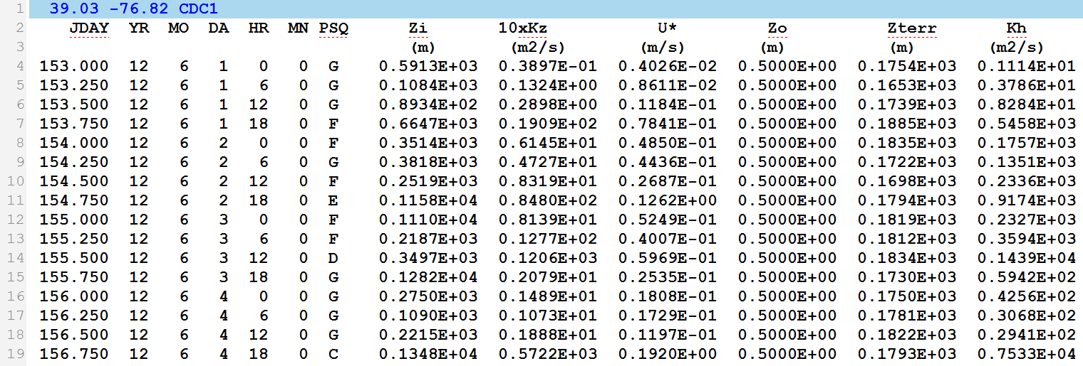
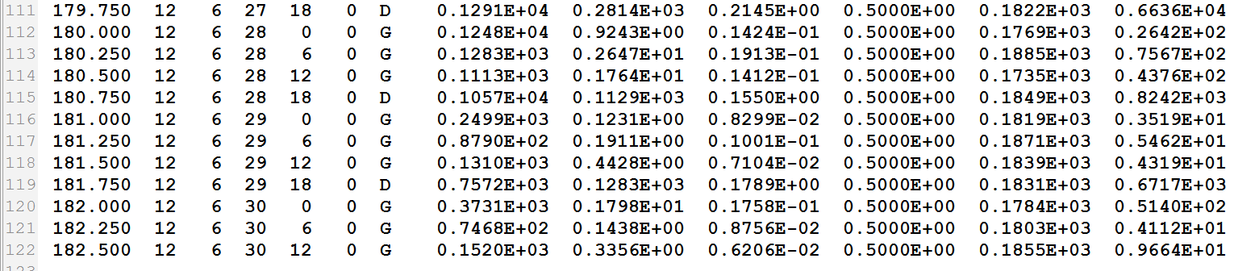
STABILITY.txt

Slide 11
Here's a graph showing the values for the selected site,
output from vmixing, for RP201206.gbl
The roughness length (Zo) and terrain height (Zterr) are essentially constant, as would be expected for a given site.
However, you can see a large diurnal (and day to day) variation for the mixing height (Zi) and mixing coefficients (Kz and Kh).

Slide 12
Here's a graph showing the same values for the selected site,
output from vmixing, for RP201206.gbl, for just one week
The roughness length (Zo) and terrain height (Zterr) are essentially constant, as would be expected for a given site.
However, you can see a large diurnal (and day to day) variation for the mixing height (Zi) and mixing coefficients (Kz and Kh).

Slide 13
In the above, we were running vmixing from the command line, and creating the CONTROL files with a text editor. However, vmixing can be run with scripts.
A few examples of running vmixing with scripts using a "RUN" and "SET" architecture were created and included in the "working_vmixing_001" files associated with this tutorial.
We have included DOS Batch script examples (.bat files that can be run with Windows), and we have included Korn Shell scripts which can be run on Linux and Mac environments.
As with the command line approach, scripts must be run from the terminal. If you are not familiar with the terminal, a brief introduction is given in Appendix 3.
In vmixing_run_001.bat (and .ksh) and vmixing_set_001.bat (and .ksh), a simple structure was used to run vmixing individually on two months of the NCEP/NCAR 2.5 deg global reanalysis dataset for 2012. In this example, each month's data were written to a separate file.
In order to run this script, which specifies all the met files for 2012, you’d have to first download the 12 files for 2012 from:
ftp://arlftp.arlhq.noaa.gov/pub/archives/reanalysis
(i.e., RP201201.gbl, RP201202.gbl, … RP201212.gbl)

Slide 14
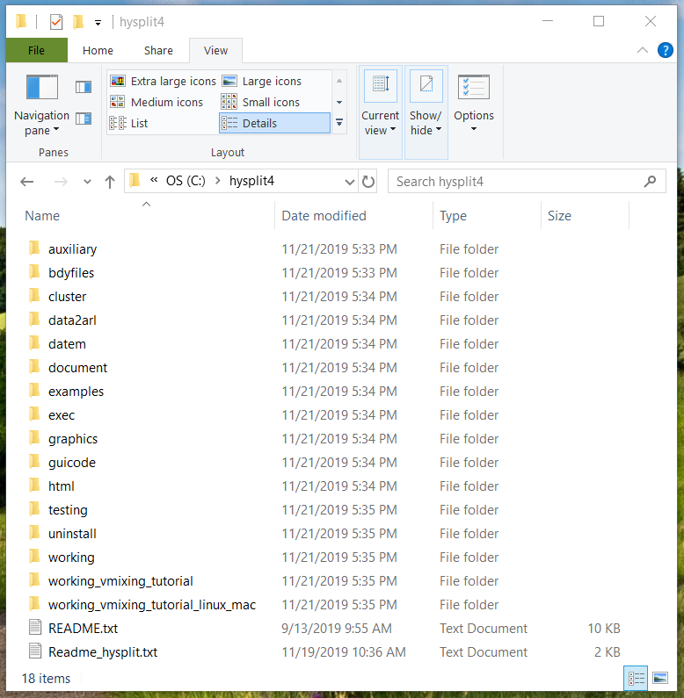
In order to carry out the runs described here, you can place the working directories in the hysplit folder, alongside the existing “main” working directory in the hysplit folder
  If you are working on a Windows computer, then you just need the “working_vmixing_tutorial” folder
  If you are working on a Linux or Mac computer, then you just need the “working_vmixing_tutorial_linux_mac” folder
Note that one can have a number of different working directories
When one is using the Graphical User Interface, output files are generally placed the main HYSPLIT working directory
But when is working from the command line or with scripts, it can be helpful to create a new working directory and run HYSPLIT from there
Having any new working directories on the same “level” as the main working directory is convenient because then all of the relative path references -- e.g., ../exec/ -- will work as intended.
Main HYSPLIT working directory
Added directories associated with this tutorial

Slide 15

Here’s the terminal input (red) and output when vmixing_run_001.bat is run in a Windows terminal
C:\Users\Mark.Cohen>cd C:\hysplit4
C:\hysplit>cd working_vmixing_tutorial
C:\hysplit\working_vmixing_tutorial>dir *.bat
Volume in drive C is OS
Volume Serial Number is 74EF-A490
Directory of C:\hysplit\working_vmixing_tutorial
11/20/2019 05:28 PM 808 profile_run_001.bat
11/20/2019 04:07 PM 2,801 profile_set_001.bat
11/21/2019 02:42 PM 2,056 vmixing_run_001.bat
11/20/2019 02:12 PM 960 vmixing_run_002.bat
11/20/2019 09:40 AM 11,667 vmixing_set_001.bat
11/20/2019 02:37 PM 12,215 vmixing_set_002.bat
6 File(s) 30,507 bytes
0 Dir(s) 219,566,465,024 bytes free
C:\hysplit\working_vmixing_tutorial>vmixing_run_001
latitude = 39.028
longitude = -76.817
height = 0.0
metdir = D:\METDATA\global_reanalysis\
metfile = RP201206.gbl
run_name = gbl2p5_06_2012_base
KBLS = 2
KBLT = 2
extra_variables = 2
start_year = 00
start_month = 00
start_day = 00
start_hour = 00
run_hrs = 9999
KMIXD = 0
KMIX0 = 50
1 file(s) copied.
1 file(s) copied.
finished creating CONTROL and SETUP.CFG
6 360.0000 9999 9999
12 6 1 0 0 59124960
12 6 1 6 0 59125320
12 6 1 12 0 59125680
  .
  .
  .
12 6 30 0 0 59166720
12 6 30 6 0 59167080
12 6 30 12 0 59167440
Press any key to continue . . .
C:\hysplit\working_vmixing_tutorial>
Navigating to the correct directory once the terminal is open, and making sure that the key scripts are present
Running the vmixing_run_001 DOS Batch Script
Output while the script is running
Output from the vmixing program while it is running in the script
Hit ENTER key to exit from the script, as a “pause” had been inserted at the end of the script

Slide 16
In these example scripts, we have utilized the –a2 option, which tells the vmixing program to output extra variables and include the true wind speed and direction, as opposed to the U and V components of the wind relative to the meteorological data grid.
We caution the user that the u10m and v10m wind vectors output are relative to the given met data grid.
If the grid is rotated relative to North-South and East-West (as in a lambert conformal or polar stereographic grid, for example), then these are not true cardinal-direction wind vectors.
For a global lat-long grid like the NCEP/NCAR global reanalysis, the u and v wind vector components may indeed represent true East-West and North-South wind vector components.
If one includes the –a2 option when running vmixing, one is assured of getting the true wind spend and direction

Slide 17
Here’s the first several, and last several lines of the stability output file from vmixing for the RP201206.gbl met data file, when the –a2 extra variables flag is set
You can see all the extra variables that one gets with this flag
39.03 -76.82 CDC1
JDAY YR MO DA HR MN PSQ MixHgt 10xKz U* Zo Zterr Kh 10mWSPD DSWF SFCP RH2m T02m Density Total Cld u10m v10m WDIR
(m) (m2/s) (m/s) (m) (m) (m2/s) (m/s) (W/m2) (HPa) (%) (K) (kg/m3) (%) (m/s) (m/s) deg
153.000 12 6 1 0 0 G 0.5913E+03 0.3897E-01 0.4026E-02 0.5000E+00 0.1754E+03 0.1114E+01 0.1990E+01 0.6795E+02 0.9906E+03 0.0000E+00 0.2956E+03 0.1158E+01 -0.1000E+03 -0.1407E+01 -0.1407E+01 0.4501E+02
153.250 12 6 1 6 0 G 0.1084E+03 0.1324E+00 0.8611E-02 0.5000E+00 0.1653E+03 0.3786E+01 0.4048E+01 0.0000E+00 0.9920E+03 0.0000E+00 0.2914E+03 0.1176E+01 -0.1000E+03 -0.3626E+01 0.1801E+01 0.1164E+03
153.500 12 6 1 12 0 G 0.8934E+02 0.2898E+00 0.1184E-01 0.5000E+00 0.1739E+03 0.8284E+01 0.4683E+01 0.4210E+03 0.9920E+03 0.0000E+00 0.2916E+03 0.1174E+01 -0.1000E+03 -0.3899E+01 0.2595E+01 0.1236E+03
153.750 12 6 1 18 0 F 0.6647E+03 0.1909E+02 0.7841E-01 0.5000E+00 0.1885E+03 0.5458E+03 0.7673E+01 0.1028E+04 0.9887E+03 0.0000E+00 0.2959E+03 0.1153E+01 -0.1000E+03 -0.5106E+01 0.5728E+01 0.1383E+03
  .
  .
  .
181.750 12 6 29 18 0 D 0.7572E+03 0.1283E+03 0.1789E+00 0.5000E+00 0.1831E+03 0.6717E+03 0.1556E+01 0.1043E+04 0.9873E+03 0.0000E+00 0.3049E+03 0.1116E+01 -0.1000E+03 0.9757E+00 -0.1212E+01 0.3212E+03
182.000 12 6 30 0 0 G 0.3731E+03 0.1798E+01 0.1758E-01 0.5000E+00 0.1784E+03 0.5140E+02 0.2161E+01 0.1025E+03 0.9859E+03 0.0000E+00 0.3046E+03 0.1116E+01 -0.1000E+03 0.1776E+01 0.1231E+01 0.2353E+03
182.250 12 6 30 6 0 G 0.7468E+02 0.1438E+00 0.8756E-02 0.5000E+00 0.1803E+03 0.4112E+01 0.3078E+01 0.0000E+00 0.9883E+03 0.0000E+00 0.2961E+03 0.1150E+01 -0.1000E+03 0.2867E+01 -0.1119E+01 0.2913E+03
182.500 12 6 30 12 0 G 0.1520E+03 0.3356E+00 0.6206E-02 0.5000E+00 0.1855E+03 0.9664E+01 0.3428E+01 0.4446E+03 0.9902E+03 0.0000E+00 0.2962E+03 0.1153E+01 -0.1000E+03 0.2827E+01 -0.1939E+01 0.3044E+03

Slide 18
These are just simple examples of scripts, with a number of items “hard-wired”. The scripts can be made more general if the user desires. Note that scripts must always be in “plain text”.
The basic structure of these script examples is that the user runs the “RUN” script, and the “RUN” script calls the “SET” script. The user sets the key parameters in the “RUN” script, and the “SET” script takes those parameters and carries out a set of specified actions.
The user can adjust the parameters supplied to the SET script as long as the RUN and SET scripts are coordinated, i.e., the SET script receives a set of parameters and the user has to make sure that it properly uses the parameters it receives, in the exact order that they are received.
In these examples, the following actions are carried out in the SET script, based on the parameters specified in the RUN script:
  The CONTROL file is written
  The SETUP.CFG file is written
  The vmixing program is run

Slide 19
In vmixing_run_002.bat and vmixing_set_002.bat, a very simple example is shown in which we specify 12 different met files in CONTROL, and run vmixing for the entire year 2012 all at once. There are several advantages to doing it this way:
The "next" data record is always available, so we don't miss out on the last record in each met file (in this case, the last record of each month)
We have all of the data for year combined for us into one file (eliminating the need to concatenate the data later)

Slide 20
Note that we have not demonstrated the use of other command line arguments here.
For KBLS and KBLT, the options from the HYSPLIT users guide are provided for reference on the following pages.
Note that these and other parameters can also be set via the SETUP namelist file. As noted earlier, if the SETUP.CFG (or SETUP.process_id) file is present, then the vmixing program will read it and use it to guide the calculation.

Slide 21
Vertical Turbulence
KBLT is a flag used to set the vertical turbulence computational method, that is how the turbulent velocity variances are computed from either the heat and momentum fluxes or the model profiles of wind and temperature.
Two different computational approaches (Beljaars/Holtslag and Kanthar/Clayson - see the technical documentation for details) are defined.
Another option is the use the TKE (Turbulent Kinetic Energy) output from the meteorological model provided in the input meteorological data file. Not all model data contain the TKE field.
The last option is a special case where the input meteorological data are assumed to contain the 3-dimensional component velocity variance fields, usually a measured component.
  1 - Beljaars/Holtslag and Betchov/Yaglom
  2 - Kanthar/Clayson (DEFAULT)
  3 - TKE field from the input meteorology data file
  4 - Measured velocity variances from the input meteorology

Slide 22
Boundary Layer Stability
KBLS defines how the stability is computed. Normally when turbulent fluxes (heat and momentum) are available from the meteorological data file, they are used to compute stability.
Sometimes it may be desirable to force the stability to be computed from the wind and temperature profiles, especially if the fluxes represent long-time period averages rather than instantaneous values. If fluxes are not present, the profiles are used for the stability computation.
1 - Heat and momentum fluxes (DEFAULT)
2 - Wind and temperature profiles

Slide 23
Appendix 1.
The profile program

Slide 24
HYSPLIT also has a program called profile that can be run from Graphical User Interface as well as the command line
  From the GUI: Meteorology → Display Data → Text Profile
  https://www.ready.noaa.gov/hysplitusersguide/S132.htm
The profile program outputs surface data and meteorological data aloft.
A simple set of scripts (run_profile_001 and set_profile_001) has been included that runs the profile program on the Jun 2012 global reanalysis dataset at the same location as vmixing has been run in the above examples
The profile program does not do any interpolation but simply outputs the meteorological values at the nearest grid point
So, since the location in these examples does not fall on a grid point, the vmixing and profile results for variables common to both outputs (e.g., wind speed and wind direction at the surface) do not match.
However, if vmixing is re-run at the nearest grid point – in this case, for the global reanalysis met data – then the profile and vmixing outputs for common variables do match. This is demonstrated in the plot on the next page (for Jan 2012).

Slide 25
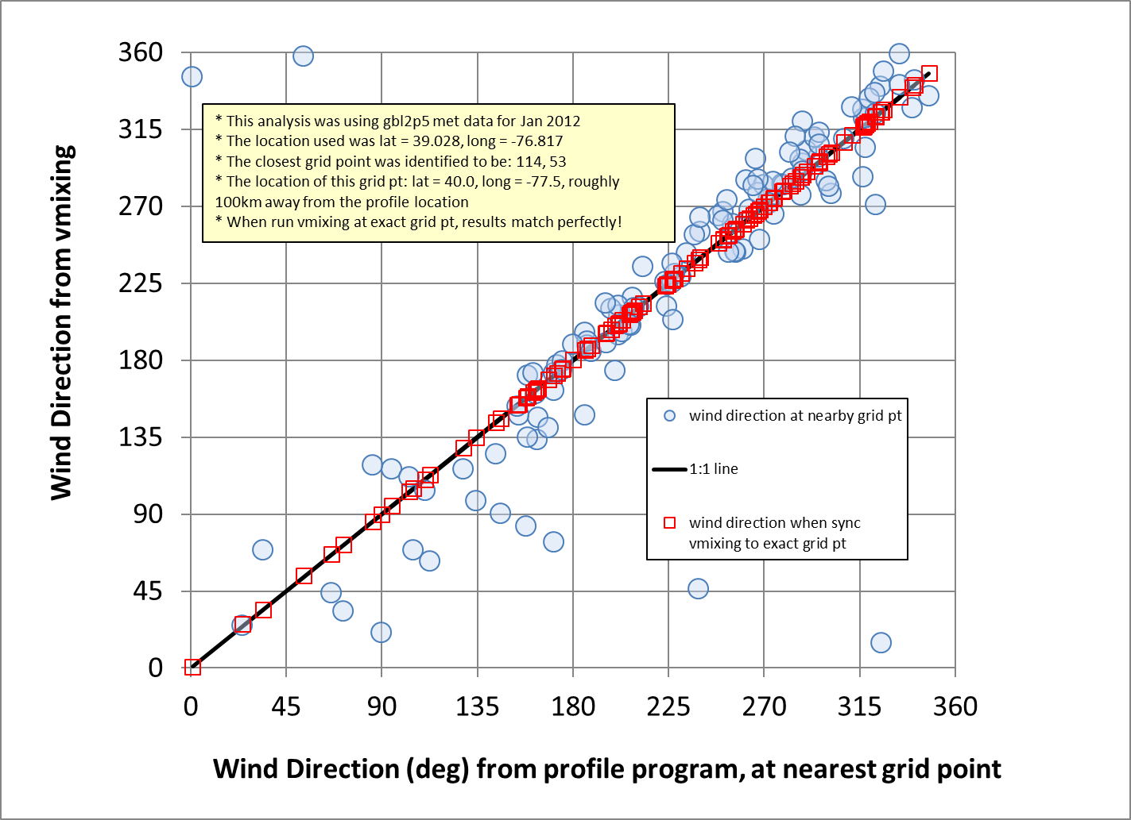

Slide 26
Appendix 2.
What starting height to use in vmixing CONTROL file?

Slide 27
The starting height is a parameter that must be set in the CONTROL file for the vmixing run to be carried out. In all of the above examples, a starting height of "0 m agl" was used.
What happens if a non-zero starting height is used?
In the following graphs, we show the results for starting heights of 0, 50, 500, and 5000 meters agl. It can be seen that:
For mixing height (Zi), the results are identical.
For the vertical mixing coefficient (Kz), the results are identical
For the friction velocity (U*), the results are identical
For the roughness length and terrain height, the results are not shown, but they are identical.
For the horizontal mixing coefficient (Kh), the results for 0 and 50m are identifical, but aside from a few output values at 500m, the 500m and 5000m Kh values were not output (they are shown as NaN in the output – a Fortran abbreviation for "Not a Number"
It seems that the best way to run vmixing to get boundary layer values is to use a starting height of 0 meters above ground level

Slide 32
Appendix 3.
Navigating the terminal in Windows, Mac, and Linux operating systems.

Slide 33
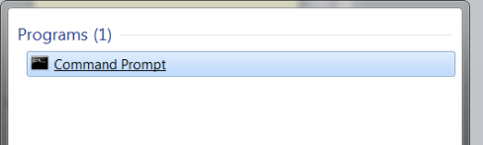
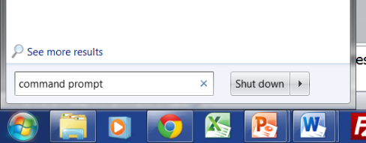
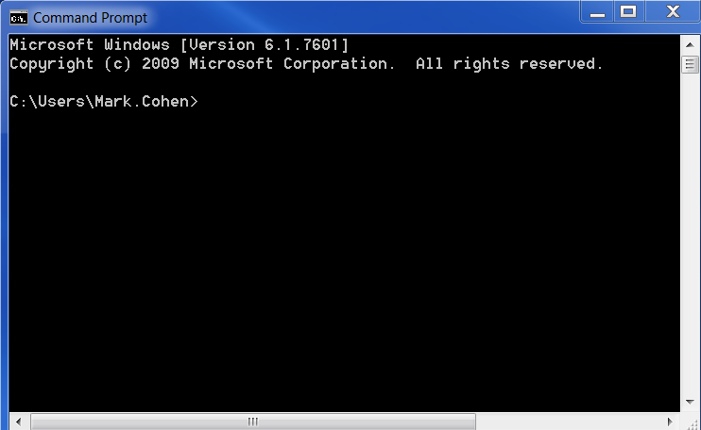
To run HYSPLIT from the Command Line, you must first open up a “terminal window” on your computer – slightly different in Windows, Linux, and Mac
Windows
Linux & Mac
Start → Search for “Command Prompt”

Slide 34
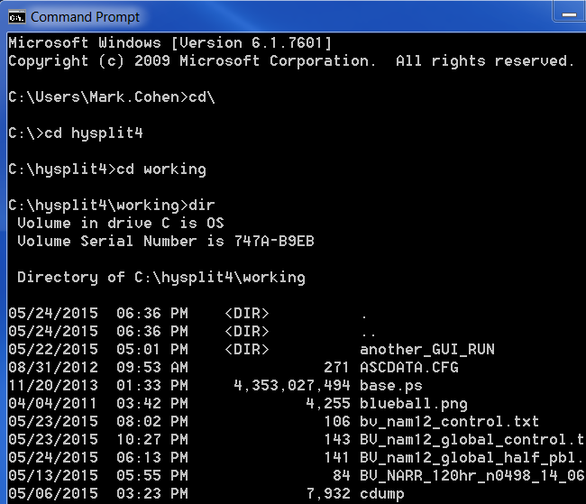
Basic Navigation within Terminal Windows
Windows
Linux and Mac
Often starts in users directory
c: → changes to c: drive
cd\ → changes directory to c:\]
cd hysplit → change dir to hysplit
cd working → change dir to working
dir → lists contents of directory (folder)
Starts in users Home directory
cd hysplit → change dir to hysplit
cd working → change dir to working
ls → lists contents of directory (folder)
cd\ [enter]
cd hysplit [enter]
cd working [enter]
dir [enter]

Slide 35
Basic Navigation within Terminal Windows
Windows
Linux & Mac
c: → changes to c: drive
cd\ → changes directory to c:\]
cd hysplit → change dir to hysplit
cd working → change dir to working
dir → lists contents of directory (folder)
dir/w → wide listing of directory
mkdir → make directory
del → delete a file
copy → copy a file
rename → rename a file
“up arrow” → previous command(s)
“down arrow” → following command(s)
cd ~ → changes to home directory
cd hysplit → change dir to hysplit
cd working → change dir to working
ls → lists contents of directory (folder)
ls -ltr → detailed dir, with new items last
mkdir → make directory
rm → remove (delete) a file
cp → copy file
mv → move file (e.g., to a different name)
“up arrow” → previous command(s)
“down arrow” → following command(s)

Slide 36
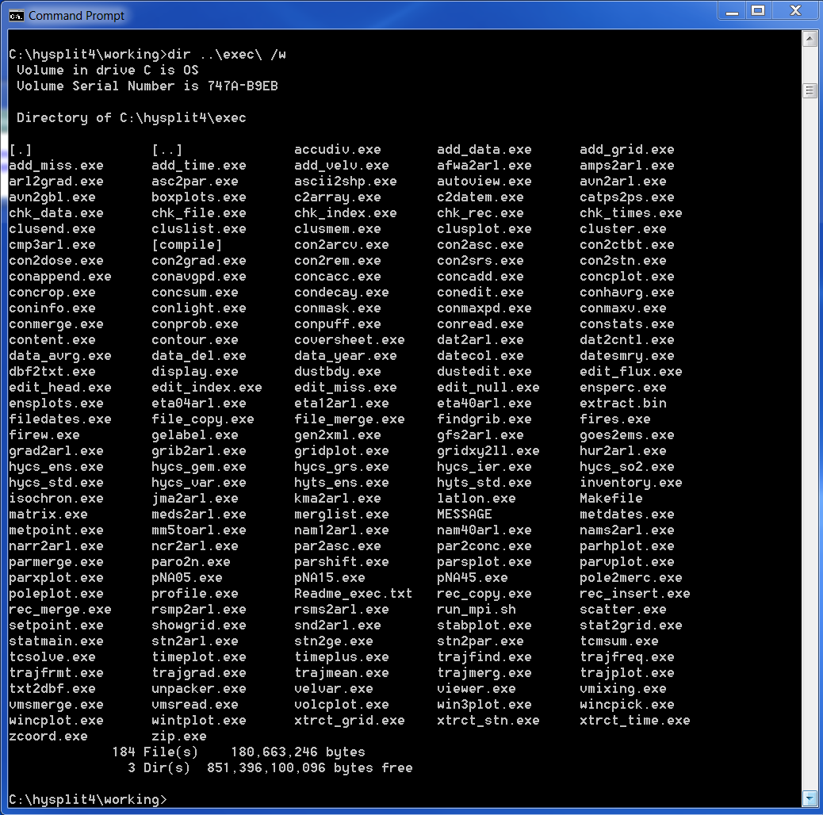
For Windows
dir ..\exec\ /w [enter]
/w = list in a wide format
exec\ = and then once you are there, look for the exec directory
..\ = go back one directory to hysplit

Slide 37
For Linux & Mac
ls ../exec/

